Slide 1
عیار سیگما
در مرحله سنجش در آزمایشگاه بالینی
حسن بیات
درس خوانده علوم آزمایشگاهی

Slide 2
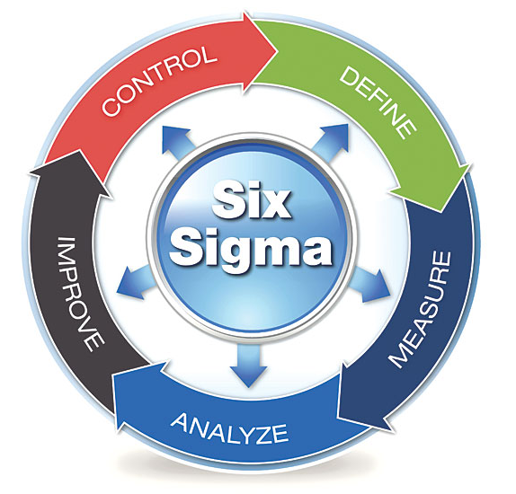
Background
Six Sigma management technology:
Developed by Motorola and General Electric in the 1980s
To systematically improve processes and eliminate defects
Sigma Metric is a core concept in Six Sigma Methodology

Slide 3
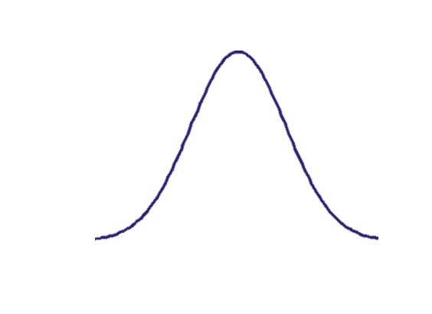
SM – Industrial view
Lower SL
TV
Upper SL
Target Value, TV
Centered performance
Specification, S (allowable deviation)
Specification Limit
TV - S
TV + S

Slide 4
SM – Industrial view
Lower SL
TV
Upper SL
Target Value, TV
Centered performance
Specification, S (allowable deviation)
Specification Limit
Defect
Perfect
Defect
TV - S
TV + S

Slide 5
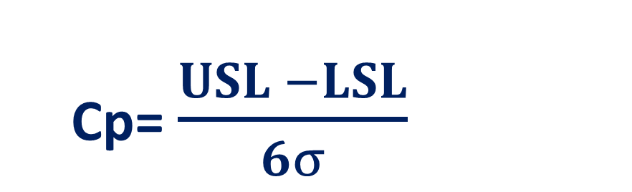
SM – Industrial view
Capability:
LSL
TV
USL
Cp= $\frac{USL −LSL}{6σ}$
(USL – LSL)/6SD

Slide 6
SM – Industrial view
Capability:
LSL
TV
USL
Cp= $\frac{USL −LSL}{6σ}$
(USL – LSL)/6SD
Off-center

Slide 7
SM – Industrial view
Capability:
LSL
TV
USL
Cp= $\frac{USL −LSL}{6σ}$
(USL – LSL)/6SD
Off-center

Slide 8

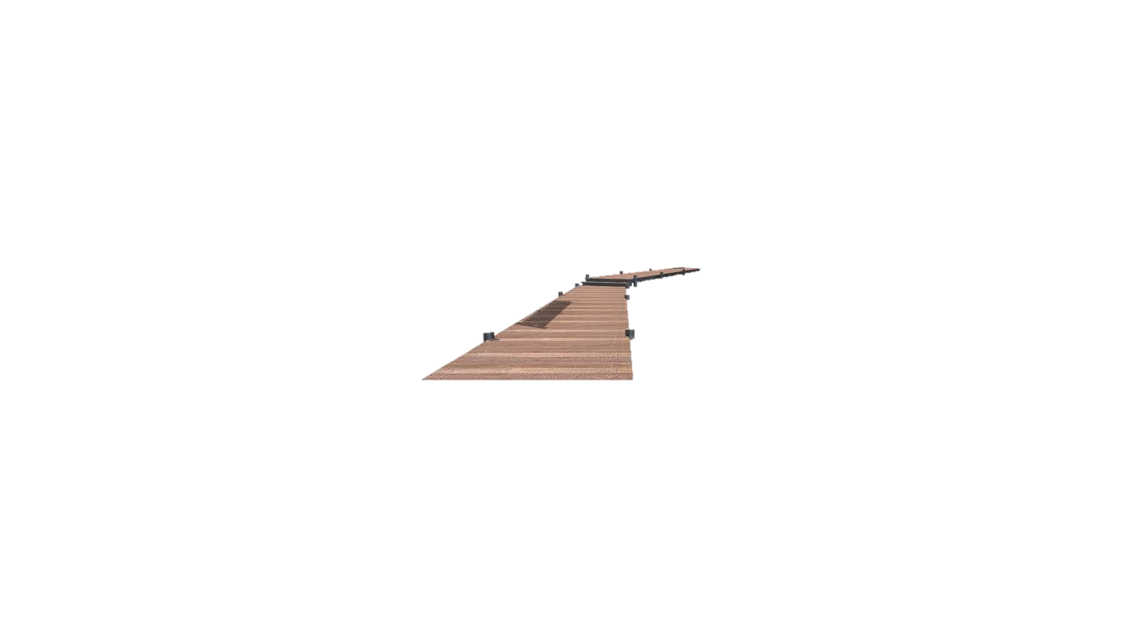
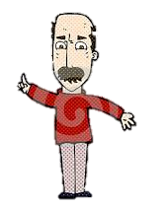


Just 3 meters!
7 meters away…; I’m really safe!
7 meter
3 meter
5 meter
2 m
5 meter

Slide 9
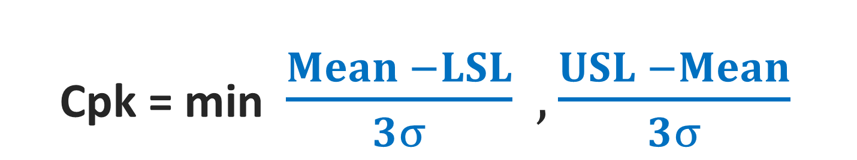
SM – Industrial view
Capability:
LSL
TV
USL
Cp= $\frac{USL −LSL}{6σ}$
D/3SD
D/3SD
D/3SD
Cpk = min $\frac{Mean −LSL}{3σ} , \frac{USL −Mean}{3σ}$

Slide 10
SM – Industrial view
Capability:
LSL
TV
USL
Cp= $\frac{USL −LSL}{6σ}$
D/3SD
D/3SD
Cpk = min $\frac{Mean −LSL}{3σ} , \frac{USL −Mean}{3σ}$

Slide 11
SM – Industrial view
Capability:
LSL
TV
USL
Cp= $\frac{USL −LSL}{6σ}$
D/3SD
D/3SD
Cpk = min $\frac{Mean −LSL}{3σ} , \frac{USL −Mean}{3σ}$

Slide 12
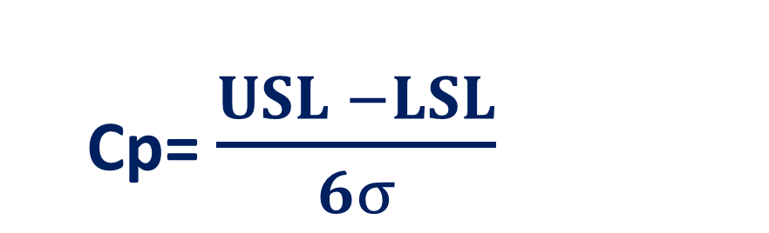
SM – Industrial view
Capability:
LSL
TV
USL
If 3 SDs feet between mean and SL:
Cp= $\frac{USL −LSL}{6σ}$
Cpk = 1
D/3SD
D/3SD
Defect = 0.03%
= 300 DPM
Cpk = min $\frac{Mean −LSL}{3σ} , \frac{USL −Mean}{3σ}$

Slide 13
SIGMA METRIC
Derived from Cpk
Combines “spread” and “centeredness”
Measure of correct outputs
LSL
TV
USL

Slide 14
SIGMA METRIC
Derived from Cpk
Combines “spread” and “centeredness”
Measure of correct outputs
LSL
TV
USL

Slide 15
SIGMA METRIC
Derived from Cpk
Combines “spread” and “centeredness”
Measure of correct outputs
Number of Sigmas (SDs) between “Mean” and nearest SL
LSL
TV
USL
How many SDs?

Slide 16

SIGMA METRIC
Derived from Cpk
Combines “spread” and “centeredness”
Measure of correct outputs
Number of Sigmas (SDs) between “Mean” and nearest SL
LSL
TV
USL
How many SDs?
SM = $\frac{Spcecification − |Shift|}{SD}$

Slide 17
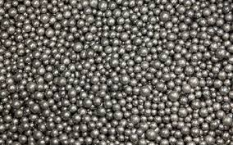
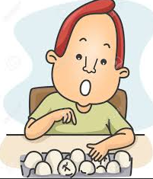
عیار سیگما و شمارش خطا
رویکرد شمارشی
رویکرد آماری (توزیع-بنیان)

Slide 18

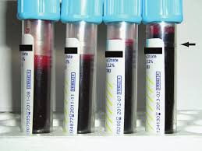
روش شمارش

Slide 19

روش آماری (توزیع-بنیان)

Slide 20
  روش آماری
  نمونه‌گیری از محصول
  برآورد عدم صحت و عدم دقت
  محاسبه سطح زیر منحنی بیرون از مرزهای مجاز

Slide 21
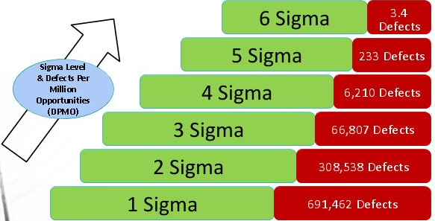
SM reflects defect rate
World Class
Excellent
Good
Marginal
Poor
Unacceptable

Slide 22

SM – Medical Laboratory
In medical laboratory:
Allowable Total Error (ATE) equals industrial Specification
Bias equals industrial Shift (Off-centeredness)
SM = $\frac{Spcecification − |Shift|}{SD}$

Slide 23


SM – Medical Laboratory
In medical laboratory:
Allowable Total Error (ATE) equals industrial Specification
Bias equals industrial Shift (Off-centeredness)
SM = $\frac{ATE − |Bias|}{SD}$
Introduced by James O. Westgard
SM = $\frac{Spcecification − |Shift|}{SD}$

Slide 24
SM – Medical Laboratory
ATE
Bias
SD

Slide 25
SM – Medical Laboratory
ATE
Bias
SD

Slide 26
SM – Medical Laboratory
ATE
Bias
SD
CLSI EP09
CLSI EP15
Estimated:
Certified Reference Materials - JCTLM, IFCC, NIST, WHO,…
EQA/PT materials
QC & Calibration Verification materials
Spiked samples
Conventional TVs
Patient samples tested in one or more central labs
Patient samples sent to a traceable lab traceable
Previously collected QC data

Slide 27
SM – Medical Laboratory
ATE
Bias
SD
CLSI EP05
CLSI EP15
Estimated from Verification/Validation studies
Recalculated from long-term IQC data

Slide 28
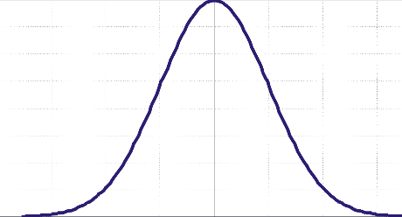
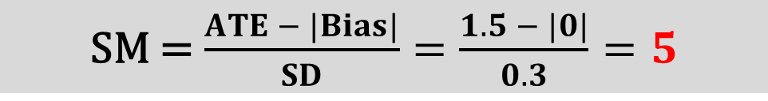
Example: WBC assay
ATE = 1.5 th/uL
Bias = 0 th/uL
SD = 0.3 th/uL
SM = $\frac{ATE − |Bias|}{SD}=\frac{1.5 − |0|}{0.3}=5$
TV
Mean
8.5
11.5
0.3 DPM
0.3 DPM
5 σ
5 σ

Slide 29
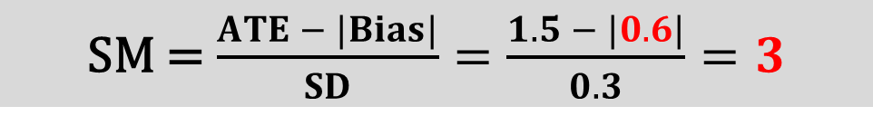
Example: WBC assay
ATE = 1.5 th/uL
Bias = 0.6 th/uL
SD = 0.3 th/uL
SM = $\frac{ATE − |Bias|}{SD}=\frac{1.5 − |0.6|}{0.3}=3$
8.5
11.5
0.000001 DPM
1350 DPM

Slide 30

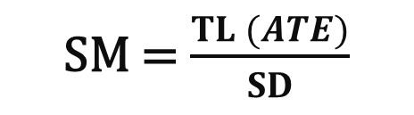
The number of SDs from the target to the ULs or LLs gives the SM value [2]
SM = $\frac{TL (ATE)}{SD}$
-ATE
TV
+ATE
Cp= $\frac{USL −LSL}{6σ}$
How many SD?
How many SD?

Slide 31
The number of SDs from the target to the ULs or LLs gives the SM value [2]
SM = $\frac{TL (ATE)}{SD}$
-ATE
TV
+ATE
Cp= $\frac{USL −LSL}{6σ}$
How many SD?
How many SD?

Slide 32
The number of SDs from the target to the ULs or LLs gives the SM value [2]
SM = $\frac{TL (ATE)}{SD}$
-ATE
TV
+ATE
Cp= $\frac{USL −LSL}{6σ}$
How many SD?
How many SD?

Slide 33
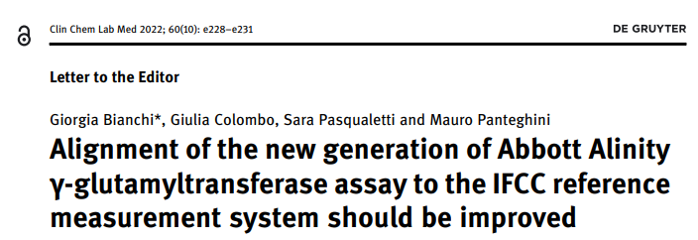

Slide 34
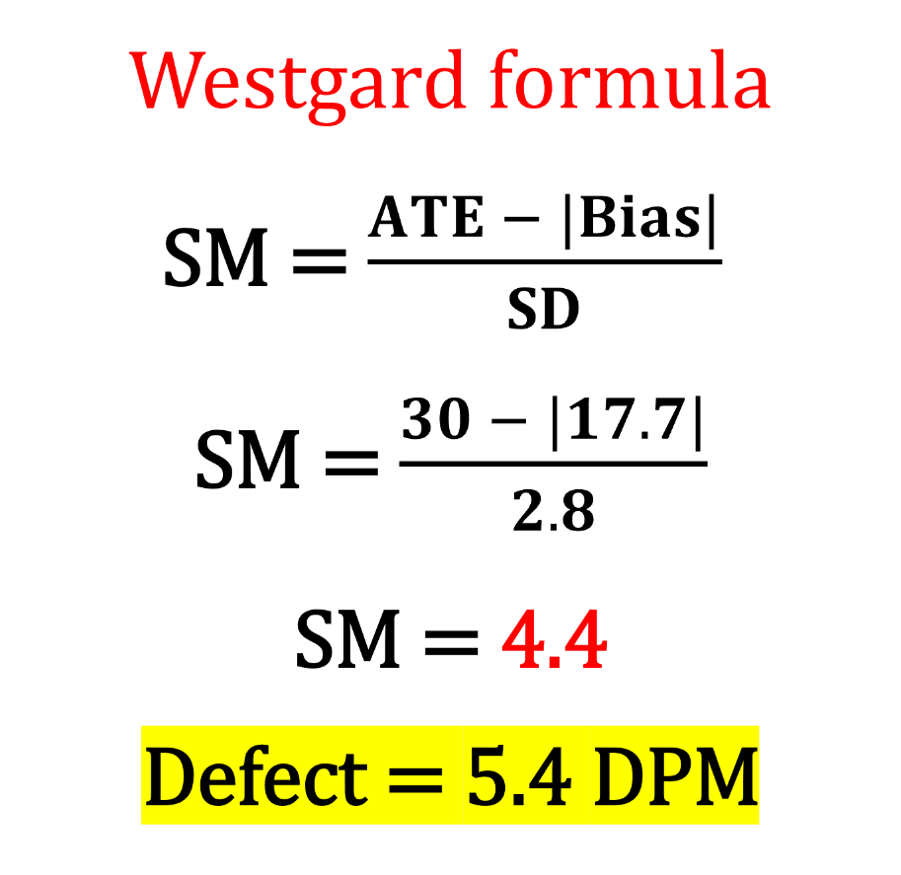
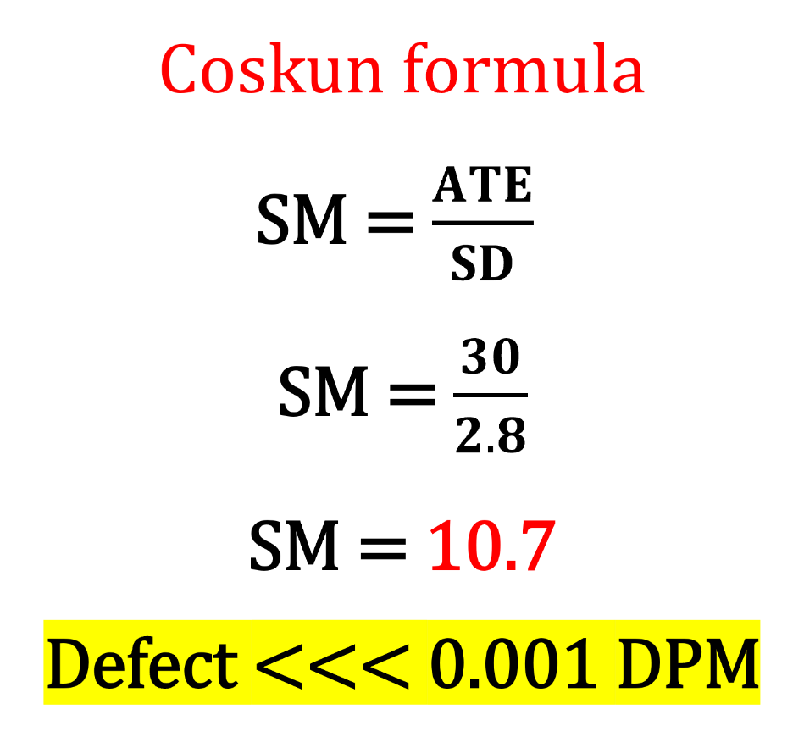
High level (211.3 IU/L)
Bias = 17.7 IU/L
SD = 2.8 IU/L
Xc = 200 IU/L
ATE = 30 IU/L

Slide 35
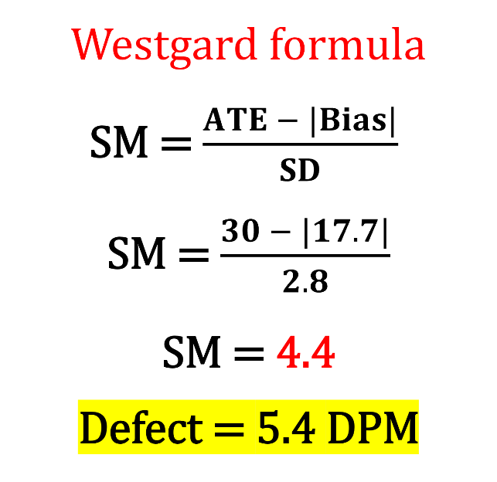

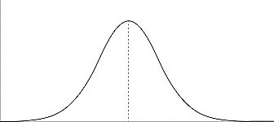
High level (211.3 IU/L)
Bias = 17.7 IU/L
SD = 2.8 IU/L
TV
200
-30
+200
Xc = 200 IU/L
ATE = 30 IU/L
BIAS

Slide 36
High level (211.3 IU/L)
Bias = 17.7 IU/L
SD = 2.8 IU/L
TV
200
-30
+200
Xc = 200 IU/L
ATE = 30 IU/L
5.4 DPM
BIAS

Slide 37

The number of SDs from the target to the ULs or LLs gives the SM value [2]
SM = $\frac{TL (ATE)}{SD}$
-ATE
TV
+ATE
Cp= $\frac{USL −LSL}{6σ}$
How many SD?
How many SD?

Slide 38

Warren Brussee:
Subtract the average you just calculated from the nearest specification limit. Divide the result by the sigma σ you just calculated to get the number of sigma that “fit.” This number indicates how well the process run when it is in control.
Brussee W. Statistics for Six Sigma made easy. New York: McGraw-Hill; 2004
-ATE
TV
+ATE
$$\overset{̿}{X}$$

Slide 39
Warren Brussee:
Subtract the average you just calculated from the nearest specification limit. Divide the result by the sigma σ you just calculated to get the number of sigma that “fit.” This number indicates how well the process run when it is in control.
Brussee W. Statistics for Six Sigma made easy. New York: McGraw-Hill; 2004
-ATE
TV
+ATE
$$\overset{̿}{X}$$
How many SDs?

Slide 40
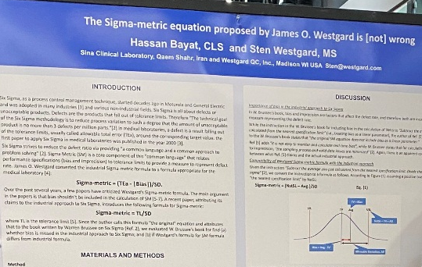
Poster #132
AACC 2022

Slide 41
SM – Applications in medical laboratory
Quality Indicator
Goal Setting
Method Evaluation
IQC Planning
EQAS
E.g., ISO 15189: % yield, % defects, DPMO, Six Sigma scale
E.g., IFCC WG-A1C: 2 sigma for routine testing, 4 sigma for clinical trials
Benchmarking new methods
Individualized QC
E.g., The Netherlands SKML

Slide 42
Six Sigma has brought no genuinely new and palatable food to the table of laboratory medicine
Incorrect adaptation of Six Sigma from industry to laboratory medicine and the utilisation of erroneous equations

Slide 43
Total Analytical Error model (TAE)
Six Sigma model
Lab med vs industry
Utilization of SM in medical laboratory
Sigma metric is powerful tool for patient safety

Slide 44
خصوصیات عیار سیگما

Slide 45
1) رابطه نرخ خطا با عیار سیگما
MEAN
TV
Sigma Metric
0.3 DPM
0.3 DPM
Sigma Metric = 5
SD
DR = 0.6 DPM

Slide 46
1) رابطه نرخ خطا با عیار سیگما
رابطه بین عیار سیگما و میزان خطا خطی نیست
TV
MEAN
SM: 5 → 2.5
DR: 0.6 → 6210
x 10500
5 Sigma
B = 2.5 SD
SM = 2.5
6210 DPM

Slide 47
Sigma | DPM
1 | 317000
2 | 45500
3 | 27000
4 | 63
5 | 0.6
6 | 0.002
7 | 0.0000013

Slide 48
TV
X̄
TV
X̄
1350
DPM
1
σ
3 σ
0.0002
DPM
1
σ
6 σ
32
DPM
0.0000013
DPM
SM: 4 → 3
SM: 7 → 6
DR: 32 → 1350
DR: 0.0000013→ 0.0002

Slide 49

Normal distribution is not uniform, therefore moving the curve, dramatically changes the AUC within TL.
Argument: In contrast to normal distribution, bias can be treated as a linear parameter only in uniform [rectangular] distribution.

Slide 50
2) عملیات حساب روی عیار سیگما
MEAN
TV
SM = 5

Slide 51
TV
MEAN
SM₂ = SM₁ - Bias
SM₂ = 5 – 2 = 3
BIAS
2 SD
SM = 3

Slide 52
TV
MEAN
1.5 SD
SM = 3.5
SM₂ = SM₁ - Shift
SM₂ = 3.5 – 1.5 = 2
2
1.5 SD

Slide 53
MEAN
TV
SM = 6
SD

Slide 54
- عدم صحت یا جابجایی میانگین، به واحد SD را می‌توان با عیار سیگما جمع و تفریق کرد
- می‌توان عیار سیگما را در فاکتور تغییر SD (یا CV) ضرب یا تقسیم کرد
TV
MEAN
SD₂ = 3 x SD₁
SM₂ = SM₁ ÷ 3
SM₂ = 6 ÷ 3 = 2
SD₂ = 3 x SD₁
SM = 2

Slide 55
Argument: Bias cannot be treated as a linear parameter.
1.35
SD
3.35 SD
4.70 SD
مثال
TEa = 8
SD = 1.7
Bias = -2.3 = 1.35 SD
SM = 3.35
DR = 404 DPM
کالیبر مجدد
Bias = 0
3.35 + 1.35
SM = 4.7
1.4 برابر افزایش عیار سیگما
DR = 2.6 DPM
155 مرتبه کاهش در نرخ خطا

Slide 56
3.62
2.38
مثال
TEa = 8
SD = 3.2
Bias = -0.4 = 0.12 SD
SM = 2.38
DR = 17313 DPM
بهبود دقت
SD = 2.1
F = 3.2/2.1 = 1.52
2.38 x 1.52
SM = 3.62
1.52 برابر افزایش عیار سیگما
DR = 296 DPM
58 مرتبه کاهش در نرخ خطا

Slide 57
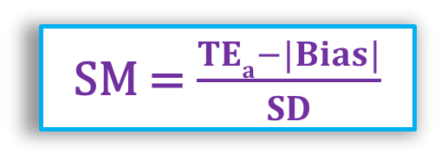
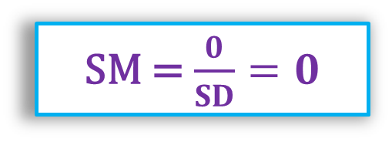
3) سیگمای صفر
وقتی سیگما صفر است، نرخ خطا نزدیک به 50% است، و بازده اندکی بیش از 50% است (یعنی تقریبا 50% محصول سالم داریم)
MEAN
TV
TEa
Sigma Metric = 0
SM = $\frac{TEa−|Bias|}{SD}$
Bias = TEa
SM = $\frac{0}{SD}=0$
Defect Rate
50%

Slide 58
3) سیگمای صفر
Argument: When Bias=TEa, Sigma becomes zero whereas yield is still about 50%; therefore this Sigma equation is wrong
MEAN
TV
Bias = TEa
Defect Rate
~50%
~50%

Slide 59
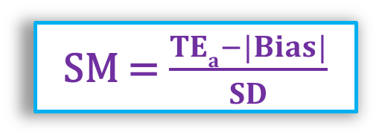
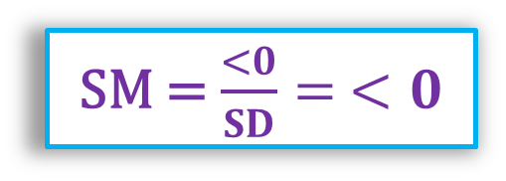
4) سیگمای منفی
بازده منفی معنی ندارد، اما سیگمای منفی معنی دارد!
سیگمای منفی یعنی نرخ خطا بیش از 50% است و بازده کمتر از 50%
TV
MEAN
SM = $\frac{TEa−|Bias|}{SD}$
TEa
SM = $\frac{<0}{SD}= <0$
Bias > TEa
NEGATIVE Sigma Metric
SM
SM = -1.3
Defect Rate
> 50%

Slide 60
4) سیگمای منفی
Argument: Negative Sigma is meaningless because number of perfects cannot be less than zero.
TV
MEAN
Bias > TEa
Defect Rate
<50%
> 50%

Slide 61
5) کدام فرمول: (TEa - B)/SD یا (TEa% - B%)/CV
Example 1:
TV=100 mg/dL
TEa = 8 mg/dL = 8%
Mean = 100 mg/dL
Bias = 0 mg/dL = 0%
SD = 2 mg/dL; CV = 2%
SM = (TEa - B)/SD
SM = (8 - 0)/2 = 4
SM = (TEa% - B%)/CV
SM = (8% - 0)/2% = 4
TEa% = (TEa/TV) x 100
B% = (B/TV) x 100
CV = (SD/Mean) x 100

Slide 62
5) کدام فرمول: (TEa - B)/SD یا (TEa% - B%)/CV
Example 2:
TV=100
TEa = 8 = 8%
Mean = 103
Bias = 3 = 3%
SD = 2; CV = (2 / 103) x 100 = 1.94%
SM = (TEa - B)/SD
SM = (8 - 3)/2 = 2.50
SM = (TEa% - B%)/CV
SM = (8% - 3%)/1.96 = 2.58
TEa% = (TE/TV) x 100
B% = (B/TV) x 100
CV = (SD/Mean) x 100

Slide 63
5) کدام فرمول: (TEa - B)/SD یا (TEa% - B%)/CV
Example 3:
TV=100
TEa = 8 = 8%
Mean = 97
Bias = -3 = -3%
SD = 2; CV = 2.06%
SM = (TEa - B)/SD
SM = (8 - 3)/2 = 2.50
SM = (TEa% - B%)/CV
SM = (8% - 3%)/2.06 = 2.43
TEa% = (TE/TV) x 100
B% = (B/TV) x 100
CV = (SD/Mean) x 100

Slide 64

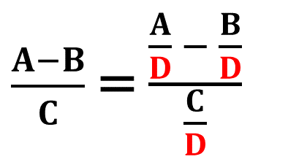
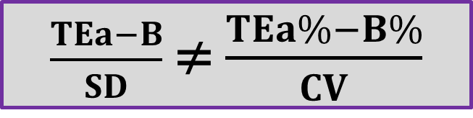
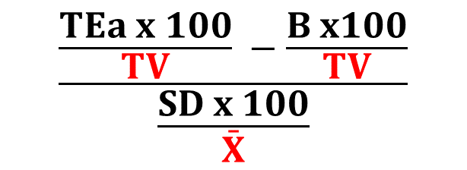
5) کدام فرمول: (TEa - B)/SD یا (TEa% - B%)/CV
اگر عدم صحت داشته باشیم، نتایج این دو فرمول کمی متفاوت است؛ در حضور عدم صحت، سیگمای حاصل از فرمول SD درست است
TV | TEa | X̄ | Bias | SD | CV | SM = (TEa-B)/SD | SM = (TEa%-B%)/CV
100 | 8 | 100 | 0 | 2 | 2 | 4 | 4
100 | 8 | 103 | +3 | 2 | 1.94 | 2.50 | 2.58
100 | 8 | 97 | -3 | 2 | 2.06 | 2.50 | 2.43
$\frac{A−B}{C}$ = $\frac{\frac{A}{D} − \frac{B}{D}}{\frac{C}{D}}$
TEa% = TEa x 100/TV
Bias% = Bias x 100/TV
CV= SD x 100/X̄
$$\frac{\frac{TEa x 100}{TV} −\frac{B x100}{TV}}{\frac{SD x 100}{\bar{X}}}$$
$$\frac{TEa−B}{SD}$$
≠
$\frac{TEa−B}{SD}$ ≠ $\frac{TEa\%−B\%}{CV}$

Slide 65

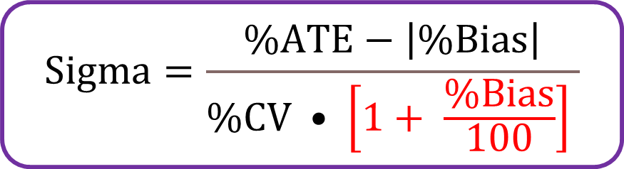

SM formulas: Unit-based vs Percent-based
SM = $\frac{ATE − |Bias|}{SD}$
SM = $\frac{\%ATE − |\%Bias|}{\%CV}$
Without bias, SM from both formulas is the same
If bias, percent-based SM deviates from unit-based SM
Positive bias → Overestimate
Negative bias → Underestimate
Correction for bias needed
$$Sigma=\frac{\%ATE−\left|\%Bias\right|}{\%CV • \left[1+ \frac{\%Bias}{100}\right] }$$

Slide 66
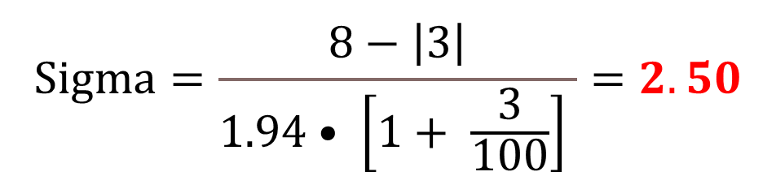
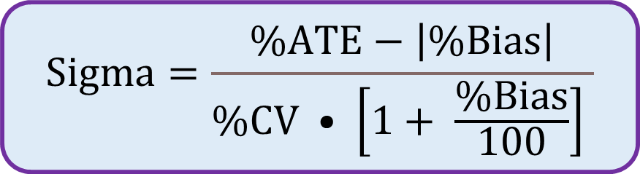
5) کدام فرمول: (TEa - B)/SD یا (TEa% - B%)/CV
SM = (TEa - B)/SD
SM = (8 - 3)/2 = 2.50
SM = (TEa% - B%)/CV
SM = (8% - 3%)/1.96 = 2.58
Example 2:
TV=100
TEa = 8 = 8%
Mean = 103
Bias = 3 = 3%
SD = 2; CV = 1.94%
$$Sigma=\frac{\%ATE−\left|\%Bias\right|}{\%CV • \left[1+ \frac{\%Bias}{100}\right] }$$
$$Sigma=\frac{8−\left|3\right|}{1.94• \left[1+ \frac{3}{100}\right] }=2.50$$

Slide 67
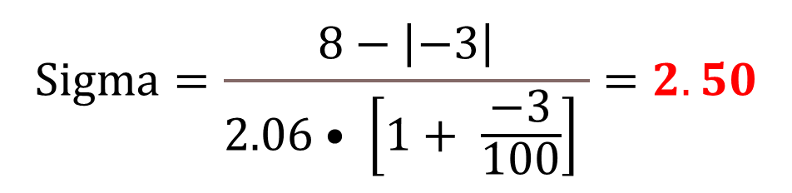
5) کدام فرمول: (TEa - B)/SD یا (TEa% - B%)/CV
Example 3:
TV=100
TEa = 8 = 8%
Mean = 97
Bias = -3 = -3%
SD = 2; CV = 2.06%
SM = (TEa - B)/SD
SM = (8 - 3)/2 = 2.50
SM = (TEa% - B%)/CV
SM = (8% - 3%)/2.06 = 2.43
$$Sigma=\frac{8−\left|−3\right|}{2.06• \left[1+ \frac{−3}{100}\right] }=2.50$$

Slide 68
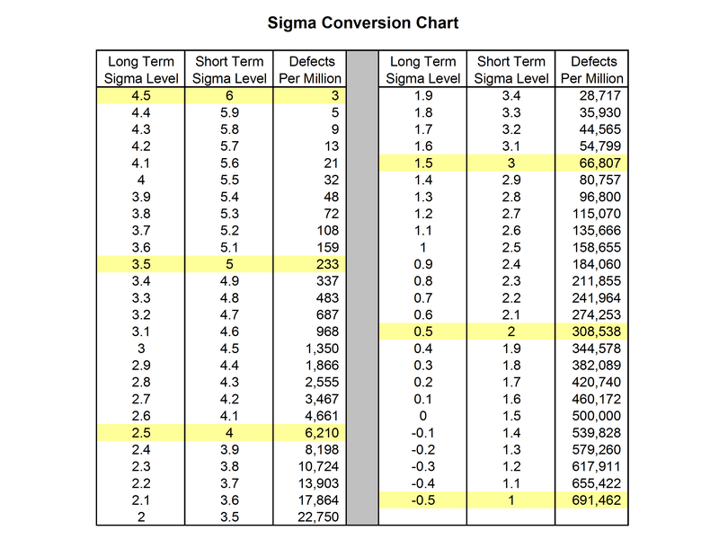

6) کوتاه مدت در مقابل بلند مدت
Example
TEa = 6
Bias = 2
SD = 1
SM = 4
P(Z>4) = 32 DPM
P(Z>2.5) = 6210
>>>32

Slide 69
6) کوتاه مدت در مقابل بلند مدت
پاسخ
سیگمای محاسبه شده گزارشی از گذشته است!
ما نیاز داریم که آینده را پیش‌بینی/تضمین کنیم
نظر به این که:
عیار سیگما در ارزیابی کوتاه مدت تعیین می‌شود
عوامل مختلف در کوتاه مدت کاملا بررسی نخواهد شد
برنامه‌های پایش کیفیت نمی‌توانند تغییرات جزئی را شناسایی کنند
برای بلند مدت، نرخ خطای بالاتری در نظر گرفته می‌شود

Slide 70
6) کوتاه مدت در مقابل بلند مدت
در روش شش سیگما برای پیش‌بینی نرخ خطا در بلند مدت، پس از محاسبه z از داده‌های کوتاه مدت، 1.5 واحد از آن کم می‌شود و سپس میزان خطا محاسبه می‌شود
مفروضات روش شش سیگما:
در بلند مدت، کم و بیش جابجایی کالیبراسیون در هر دو جهت اتفاق می‌افتد
این جابجایی‌ها کوچکتر از حساسیت پایش کیفیت هستند و شناسایی نمی‌شود
حتا در صورت شناسایی، اصلاح آن‌ها عملا ممکن نیست
این جابجایی‌ها خودبخود اصلاح می‌شود
حداکثر جابجایی، یعنی بدترین وضعیت، برابر 1.5 SD در نظر گرفته می‌شود
بر اساس قرارداد بنا شده در موتورولا، برای محاسبه نرخ خطای آینده (بلند مدت)، 1.5 SD از SM محاسبه شده از دادهای کوتاه مدت کم می‌شود

Slide 71
Example
TEa = 6
Bias = 2
SD = 1
SM = 4
P(Z>4) = 32 DPM
-TEa
Target
Mean
+TEa
STABLE
SM
6210 DPM
Bias
2SD
Shift
1.5 SD
STABLE
Defect Rate
Worst Scenario: Shift = 1.5 SD
32 DPM
SM = 4 - 1.5 = 2.5
DR = 6210 DPM

Slide 72
عیار سیگمای محاسبه شده با دو نرخ خطا مربوط است:
کوتاه مدت: عملکرد دیده شده
بلند مدت: عملکرد قابل تضمین
نرخ خطای بلند مدت در آزمایشگاه، بستگی دارد به توانایی برنامه پایش کیفیت
Sigma | DPM Short term | DPM Long term
1 | 317000 | 698000
2 | 45500 | 309000
3 | 27000 | 67000
4 | 63 | 6000
5 | 0.6 | 233
6 | 0.002 | 3.4
Argument: Bias shouldn’t be incorporated in Sigma equation because the presence of 1.5 SD bias is accepted in advance.

Slide 73

شاد باشید...

