Slide 1

طراحی برنامه پایش کیفیت آماری
QCF Calculator
حسن بیات
دانش آموخته علوم آزمایشگاهی
Winter in Mazandaran forest, IRAN

Slide 2
Background
Conventional QC Planning:
Set Performance Specification; TEa
Determine Performance Characteristics; Bias & CV
SQC Characteristics; P_{ed} & P_{fr}
QC frequency or Run size?
ISO 15189:
QC frequency … “based on…the risk of harm to the patient from an erroneous result”

Slide 3
Background
Conventional QC Planning:
Set Performance Specification; TEa
Determine Performance Characteristics; Bias & CV
SQC Characteristics; P_{ed} & P_{fr}
QC frequency or Run size?
Max E(Nuf) SQC Model
Developed by Dr. C. Parvin
Provides scientific basis for QC frequency
Incorporates QC frequency into QC planning
Endorsed by CLSI C24-Ed4 (2016)
Mitigating patient risk to tolerable limits
ISO 15189:
QC frequency … “based on…the risk of harm to the patient from an erroneous result”

Slide 4
Max E(Nuf) model is based on Total Analytical Error model
Correct results
Incorrect results
Incorrect results
SD
SD

Slide 5
Max E(Nuf) model is based on Total Analytical Error model
Correct results
Bias
Incorrect results
Incorrect results

Slide 6
Max E(Nuf) model is based on Total Analytical Error model
Related to Sigma Metric
SM = (TEa – B) / SD
Correct results
Bias
Incorrect results
Incorrect results

Slide 7




Schematic view of Max E(Nuf) model
QC
QC
QC
QC
QC
QC
Error Occurrence to Error Detection
+TEa
Target
SHIFT
Cor.
-TEa
How many increased errors are produced?
Of the them, how many are reported?

Slide 8
E(Nuf): Expected Number of Increased Unreliable Final Results
For a given size of error and QC: Increased errors reported from shift to detection
Unreliable: = Incorrect or Erroneous
Bracketed QC
Final
∆P_{E} = Stable P_{E} – Unstable P_{E}
E(Nuf)
Stable P_{E}
Unstable P_{E}
QC
QC
?
QC
I
I
U
QC
I
U
I
U
I
I
QC
U
QC
U
QC
U
QC
Reported or Finalized
Not reported or
Not Finalized
P_{E}: Probability of Error production

Slide 9
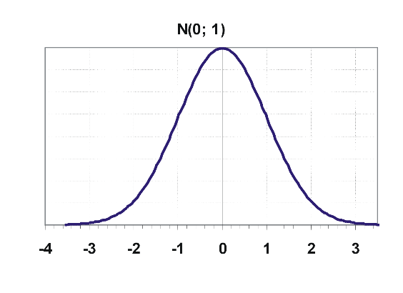
Factors contributing to E(Nuf)
∆P_{E} Increase in the probability of producing error
      Shift size; The larger is shift, the higher is ∆P_{E}

Slide 10
Factors contributing to E(Nuf)
∆P_{E} Increase in the probability of producing error
      Shift size; The larger is shift, the higher is ∆P_{E}
      Stable Bias

Slide 11
Factors contributing to E(Nuf)
∆P_{E} Increase in the probability of producing error
      Shift size; The larger is shift, the higher is ∆P_{E}
      Stable Bias
      Stable Imprecision
      The higher is Sigma, the lower ∆P_{E}
SM = (TEa – B) / SD

Slide 12
Factors contributing to E(Nuf)
1:2s, N2
0.90
∆P_{E}
ARL_{ed} = 1/P_{ed}
ARL_{ed}
1/0.90 = 1.1
1:4s, N1
0.08
ARL_{ed}
1/0.08 = 12.5
ARL_{ed}: Average Run Length
P_{ed}: Probability of Error Detection

Slide 13
Factors contributing to E(Nuf)
P_{acpt}
1 – 0.15
= 85%
∆P_{E}
ARL_{ed}
P_{ed} = 15%
P_{Accept} = 1 - P_{ed}
ARL_{ed}: Average Run Length
P_{ed}: Probability of Error Detection

Slide 14
Factors contributing to E(Nuf)
∆P_{E}
ARL_{ed}
Run Length; M Number of patient samples between QC events

Slide 15
Factors contributing to E(Nuf)
∆P_{E}
ARL_{ed}
Run Length; M
QC
QC
QC
QC
QC
`
QC
QC
QC

Slide 16
Factors contributing to E(Nuf)
∆P_{E}
ARL_{ed}
Run Length; M
Shift point
QC
QC

Slide 17
Factors contributing to E(Nuf)
∆P_{E}
ARL_{ed}
Run Length; M
Shift point
QC
QC
M/2

Slide 18
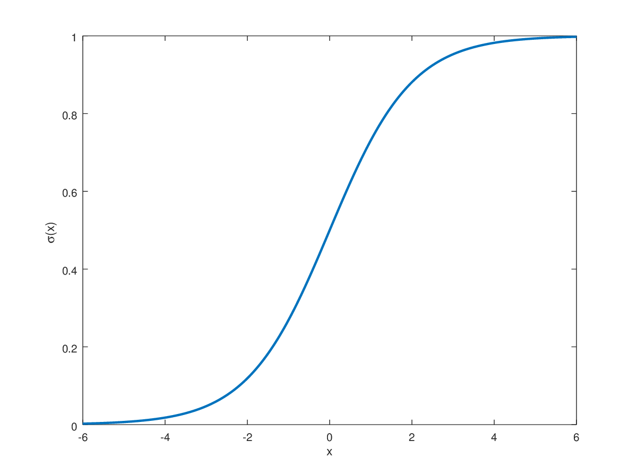
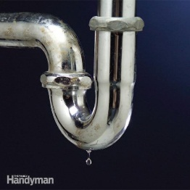



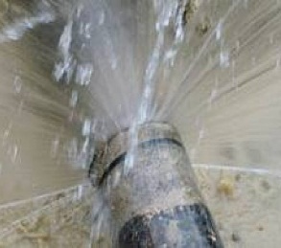
What about “Max”
WASTE
WASTING RATE
ERROR SIZE

Slide 19
Neglecting
Probability of missing the problem
ERROR SIZE

Slide 20
Neglecting
Max Waste
Probability
Wasting
ERROR SIZE

Slide 21
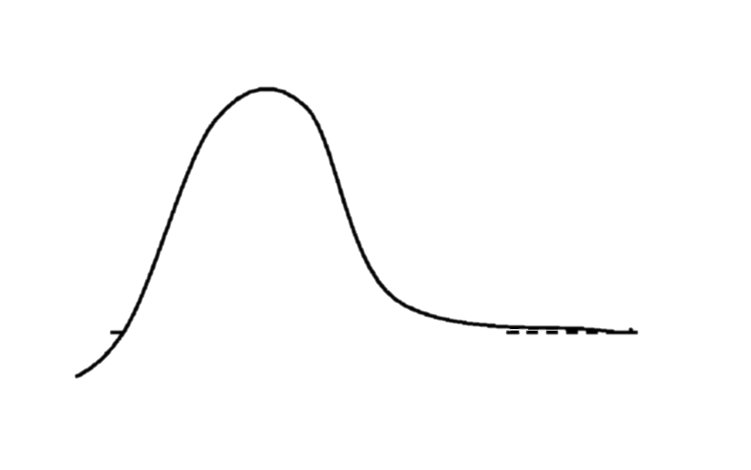
Max Waste
Wasted Water Volume
Worst Scenario
ERROR SIZE

Slide 22
Example: Sigma = 5; QC: 1:3s N1 M200

Slide 23
Example: Sigma = 5; QC: 1:3s N1 M200
Error production
ΔP_{E}

Slide 24
Example: Sigma = 5; QC: 1:3s N1 M200
P_{Acceptance}
1 - P_{ed}
Error production
ΔP_{E}

Slide 25
Example
Sigma = 5 QC: 1:3s, N1, M200
P_{E-Stable} = 0.00006%
SE (x SD) | ΔP_{E} | ARL_{ed} | E(Nuf)
0.5 | 0.0003% | 155 | 0.1
1 | 0.003% | 44 | 0.3
3 | 2% | 2 | 3.4
3.5 | 6.7% | 1.4 | 3.9
4 | 16% | 1.2 | 3.5
7 | 98% | 1.003 | 0.003
8 | 99.8% | 1.0000004 | 0.00003
∆P_{E}
for SM=5
Worst Scenario
Max E(Nuf)
P_{accept}
for 1:3s N1

Slide 26
Example:
Sigma = 5 QC Procedure: 1:3s N1 M200
SE (x SD) | ΔP_{E} | ARL_{ed} | MaxE (Nuf)
3.5 | 6.77% | 1.4 | 3.9
Patient Risk Factor; PRF
Max E(Nuf) = 3.9
∆P_{E}
for SM=5
Patient Risk Factor
P_{accept}
for 1:3s N1
3.5

Slide 27

Allowable PRF or allowable Max E(Nuf)
No consensus at present
Considerations:
Probability of hazard to patient
  Higher hazard → Lower PRF
Interpreted standalone or combined with other tests
  Standalone→ Lower PRF
Speed of acting upon an erroneous result
  Faster use → Lower PRF
The stability of the system
  Less stable → Lower PRF
Sigma Metric
  Higher Sigma → Higher PRF

Slide 28
Yago M, Alcover S.
Clin Chem62:7; 2016
Nomograms for M = 100

Slide 29
CCLM; 55(11), 23017
MR3 N3: 1_{3s}/2of3_{2s}/R_{4s}/3_{1s}
MR3 N6: 1_{3s}/2of3_{2s}/R_{4s}/3_{1s}/6x
MR2 N2: 1_{3s}/2_{2s}/R_{4s}
MR4 N4: 1_{3s}/2_{2s}/R_{4s}/4_{1s}
Max E(Nuf)/Run Size Ratio

Slide 30
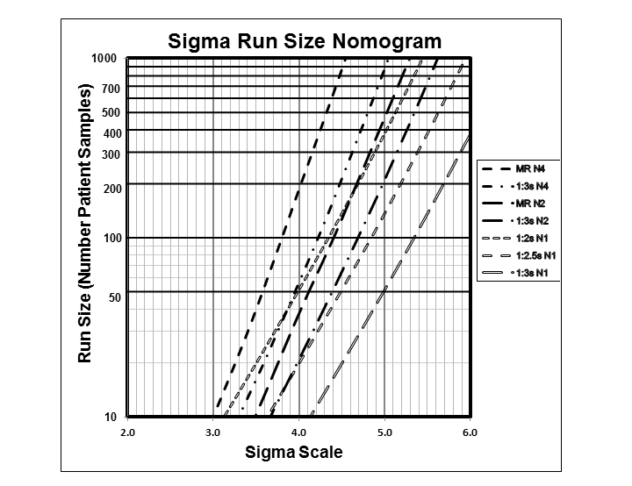
Planning Risk-Based Statistical Quality Control Strategies: Graphical Tools to Support the New Clinical and Laboratory Standards Institute C24-Ed4 Guidance
Bayat H, Westgard SA, Westgard JO
JALM; September 2017
Selecting a Risk-Based SQC Procedure for a HbA1c Total QC Plan
Westgard SA, Bayat H, Westgard JO
Journal of Diabetes Science and Technology 2017
Planning Risk-based SQC Schedules for Bracketed Operation of Continuous Production Analyzers
Westgard JO, Bayat H, Westgard SA
Clinical Chemistry Feb 2018, 64 (2) 289-296

Slide 31
Establishing Evidence-Based Statistical Quality Control Practice
Westgard JO, Westgard SA
Am J Cling Pathol 2018
Westgard Sigma Rules®
with Run Sizes
Sigma Run Size Matrix
Data
SQC
Candidate SQC (Pfr) | Maximum Run Size / Ped
 | 6-Sigma | 5.5-Sigma | 5.0-Sigma | 4.5-Sigma | 4.0-Sigma | 3.5-Sigma
MR N4 (0.03) | ≥1000 | ≥1000 | ≥1000 | 800 | 190 | 40
 | 1.00 | 1.00 | 1.00 | 0.98 | 0.91 | 0.73
1:3s N4 (0.01) | ≥1000 | ≥1000 | 900 | 220 | 60 | 15
 | 1.00 | 1.00 | 0.99 | 0.89 | 0.66 | 0.41
MR N2 (0.01) | ≥1000 | ≥1000 | 470 | 120 | 40 | 10
 | 1.00 | 0.99 | 0.94 | 0.82 | 0.59 | 0.35
1:2s N1 (0.05) | ≥1000 | ≥1000 | 370 | 140 | 50 | 20
 | 0.98 | 0.97 | 0.91 | 0.80 | 0.62 | 0.43
1:3s N2 (0.00) | ≥1000 | 700 | 220 | 70 | 25 | <10
 | 0.98 | 0.96 | 0.86 | 0.70 | 0.48 | 0.25
1:2.5s N1 (0.01) | 1000 | 400 | 150 | 50 | 20 | <10
 | 0.94 | 0.92 | 0.82 | 0.66 | 0.44 | 0.24
1:3s N1 (0.00) | 380 | 150 | 50 | 20 | 10 | <10
 | 0.85 | 0.82 | 0.67 | 0.46 | 0.27 | 0.11
Report Results
1_{3s}
No
2_{2s}
No
R_{4s}
No
4_{1s}
No
6_{X}
No
Yes
Yes
Yes
Yes
Yes
N=6
Run
Size
45
N=2
Run
Size
1000
N=2
Run
Size
450
N=4
Run
Size
200
Take Corrective Action
6σ
5σ
4σ
3σ

Slide 32

https://www.westgard.com/qc-frequency-calculator.htm

Slide 33
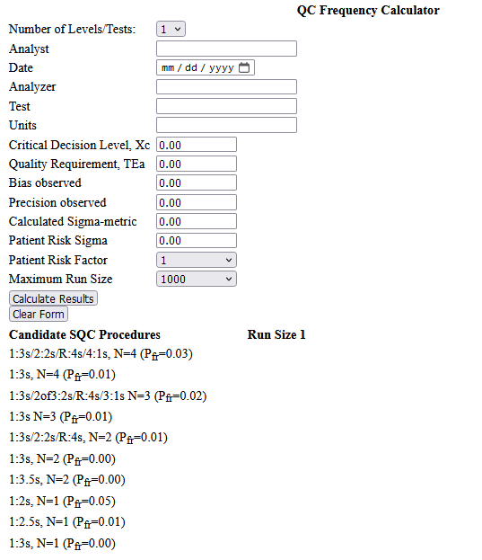
https://tools.westgard.com/frequency_calculator.shtml

Slide 34
https://tools.westgard.com/frequency_calculator.shtml

Slide 36
https://tools.westgard.com/frequency_calculator.shtml

Slide 37
عیار سیگمای بالای 6، در محاسبه برابر 6 در نظر گرفته میشود

Slide 38
عیار سیگمای بالای 6، در محاسبه برابر 6 در نظر گرفته میشود

Slide 39
عیار سیگمای بالای 6، در محاسبه برابر 6 در نظر گرفته میشود

Slide 40
عیار سیگمای بالای 6، در محاسبه برابر 6 در نظر گرفته میشود

Slide 41
عیار سیگمای بالای 6، در محاسبه برابر 6 در نظر گرفته میشود
D
E
C
R
E
A
S
E

Slide 42
عیار سیگمای بالای 6، در محاسبه برابر 6 در نظر گرفته میشود
تناوب انجام پ ک
Frequency
اندازه دود
Run size

Slide 43
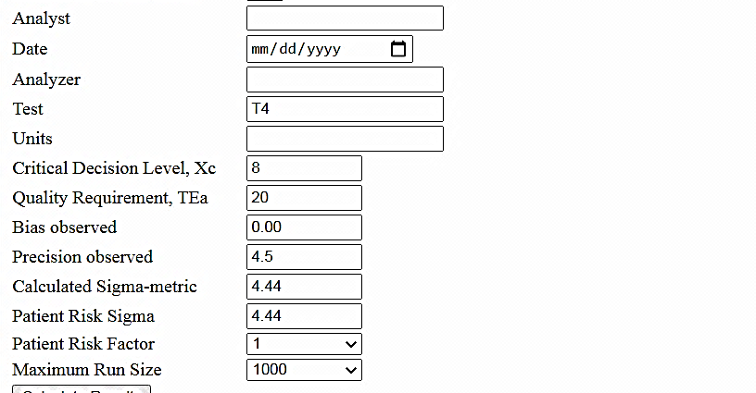
EXAMPLE

Slide 44
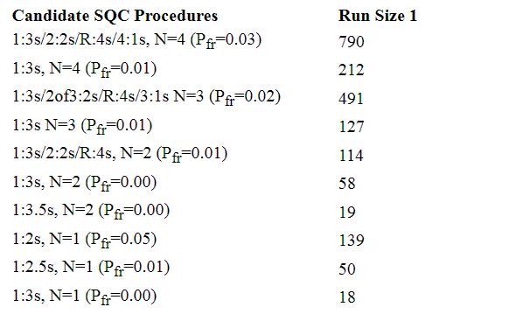
D
E
C
R
E
A
S
E

Slide 50
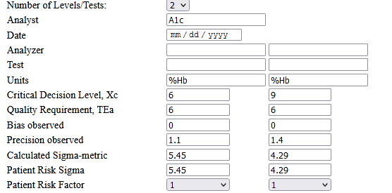
EXAMPLE
Hb A1C
Hb A1C
%Hb
%Hb

Slide 51
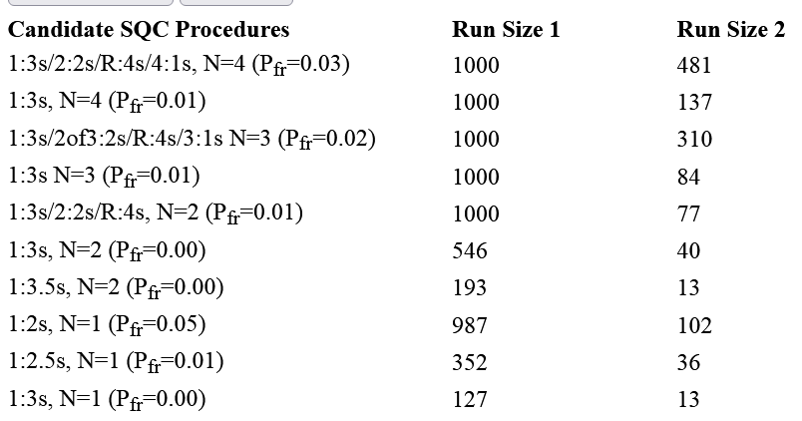
Sigma: 5.45
Patient Risk: 1
Sigma: 4.29
Patient Risk: 1

Slide 52
Example:
Bio. Test X
Bio. Test Y
%Hb
%Hb
4

Slide 53
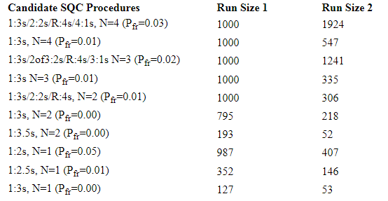
Patient Risk: 1
1:3.5s N=2
M=200
1:3s N=1
M=135
Sigma: 5.45
Patient Risk: 1
1:3s N=2
M=200
Sigma: 4.29
Patient Risk: 4
1:2.5s N=1
M=135

Slide 54
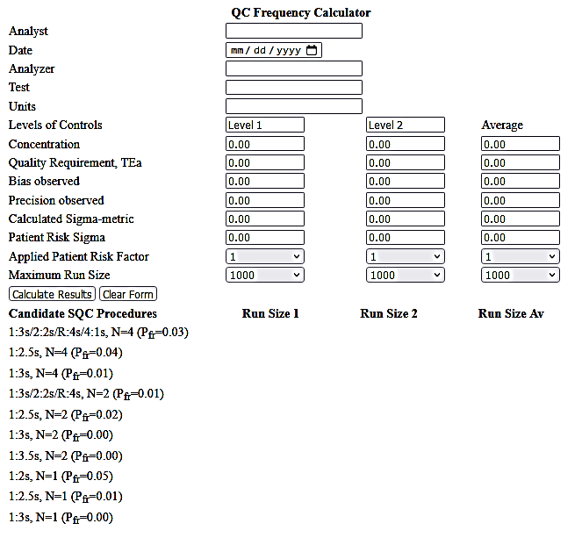
https://tools.westgard.com/frequency_calculator2.shtml

Slide 55
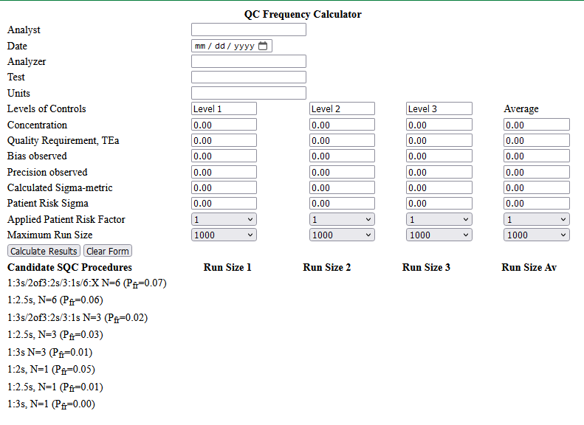
https://tools.westgard.com/frequency_calculator3.shtml.

Slide 56
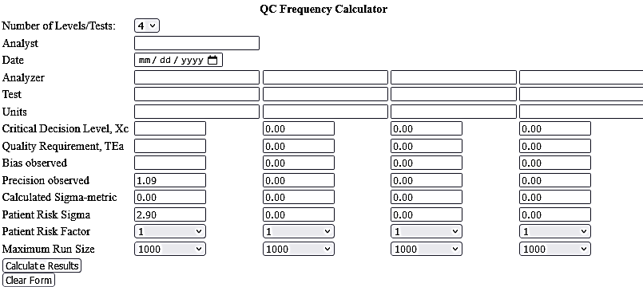

Slide 57
Impractical large run sizes for High Sigma performances
Restricted to 3s:
Run size goes more than 1000
Tacking large time to complete a run
Many repeats following corrective actions

Slide 58
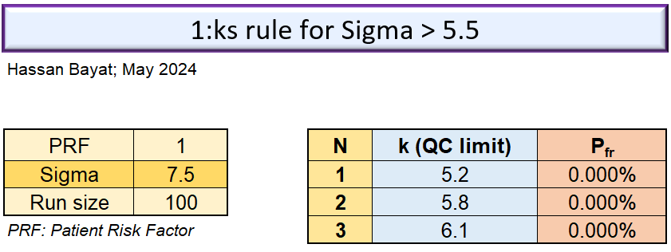

Slide 59

شاد باشید

