Slide 1


Slide 2
عدم قطعیت در آزمایشگاه بالینی
برآورد عدم قطعیت بر اساس راهنمای ISO/TS 20914:2019
حسن بیات
دانش آموخته علوم آزمایشگاهی

Slide 3
What’s the Problem?
“Although all medical laboratories seeking ISO 15189:2012 accreditation know that MU estimate is a specific requirement, few know what to do with the calculated MU.”
Braga F, Panteghini M. The utility of measurement uncertainty in medical laboratories. Clin Chem Lab Med 2020
“We wish to add that “few are truly aware of how to calculate MU in medical laboratories”.
Mario Plebani, Andrea Padoan and Laura Sciacovelli Measurement uncertainty: light in the shadows https://doi.org/10.1515/cclm-2020-0134

Slide 4
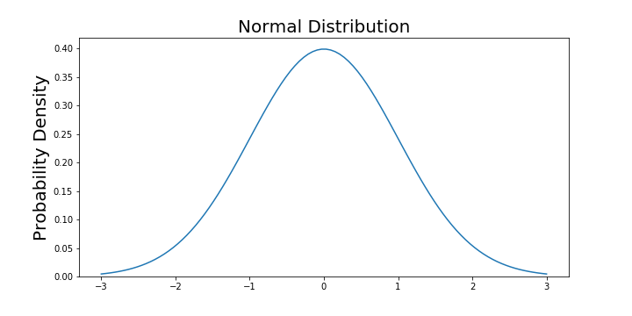
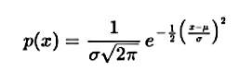
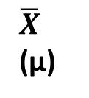
Gaussian Distribution
Normal (Gaussian) distribution
$\overline{X}$
(µ)
SD (σ)
-∞
+∞
Notes:
aaa

Slide 5
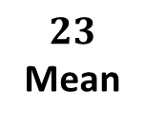
Example
Body Mass Index (BMI)
Mean = 23 Kg/m²
SD = 1.5 Kg/m²
Frequency of Over-weight (BMI>25)?
Frequency of Obese (BMI>30)?
Probability of BMI>25?
9.1%
Probability of BMI>30?
SD
1.5
0.002%
-∞
$$23$$
Mean
+∞
25
Overweight
30
Obese

Slide 6
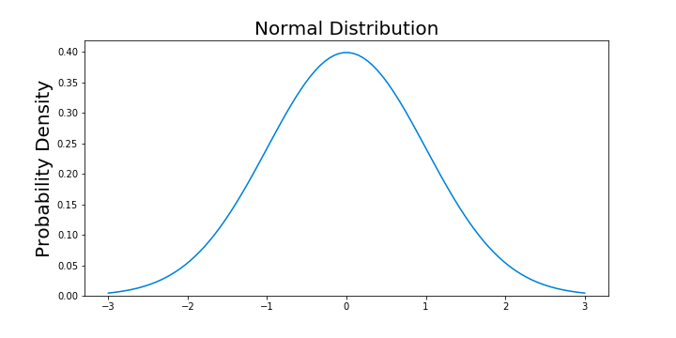
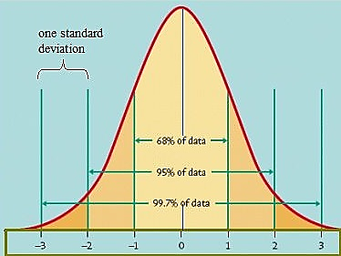
Note: Irrespective of the shape of the curve, area under curve is a function of the number of SDs

Slide 7
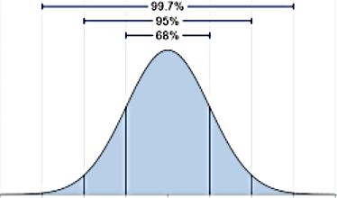
Example
Repeated assay of Glucose:
True Value = 100 mg/dL
SD = 3 mg/dL
The middle 68% of results width?
The middle 95% of results width?
Probability of falling between 97 and 103?
Probability of falling between 94 and 106?
91
94
97
100
103
106
109

Slide 8
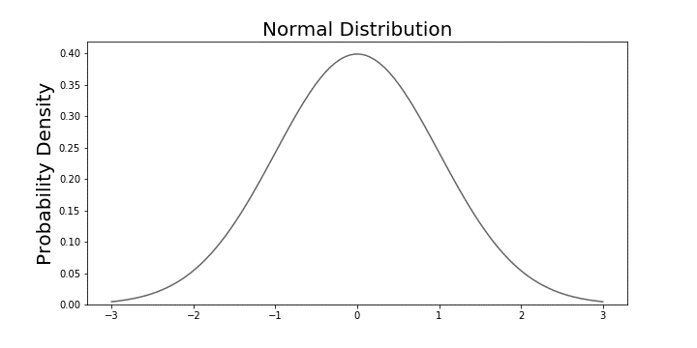

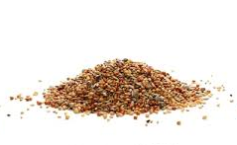
Q: With 95% probability, where is a certain bird?
A: In the range -2SD to +2SD from the seeds place.
-2SD
+2SD

Slide 9

Q: With 95% probability, where is the seeds place?

Slide 10
Q: With 95% probability, where is the seeds place?

Slide 11
Q: With 95% probability, where is the seeds place?

Slide 12
Q: With 95% probability, where is the seeds place?

Slide 13
Q: With 95% probability, where is the seeds place?

Slide 14
Q: With 95% probability, where is the seeds place?
A: In the range -2SD to +2SD from the bird.
-2SD
+2SD

Slide 15
Example
Repeated assay of Glucose:
True Value = 100 mg/dL
SD = 3 mg/dL
91
94
97
100
103
106
109

Slide 16
Q: With 95% probability, what is the True Value?
y
Result
TV
TV
-2SD
+2SD

Slide 17
True Value:
With 68% probability?
y ± 1SD
y ± 1SD
With 95% probability?
y ± 2SD
With 99.7% probability?
y ± 3SD
y
68% probability
y + 1SD
y - 1SD
y - 2SD
95% probability
y + 2SD
99.7% probability
y - 1SD
y + 1SD

Slide 18
Definition
Measurement uncertainty, MU:
Parameter characterizing the dispersion of the quantity values being attributed to a measurand, based on the information used.
VIM – 3rd Ed. GCGM 2012
It describes the interval within which the value of the measurand is assumed to lie with a stated level of confidence

Slide 19
Why MU?
To ensure that measurement results are useful and safe in medical practice:
Meaningful comparison with medical decision limits
Meaningful comparison with previous results
ISO 15189:2012,
5.5.1.4: “…shall determine measurement uncertainty for each measurement procedure in the examination phase used”
Screening
Diagnosis
Classification
Monitoring

Slide 20
Data sources
Type A: Evaluation of MU from the frequency distribution
Type B: Evaluation of MU based on experience or other information
Standard Deviation
&
Gaussian (Normal) distribution

Slide 21

Approaches to estimating uncertainty
Bottom-up:
- Determining different sources of uncertainty
- Establish a mathematical
- Estimating partial uncertainties
- Combining under the established model
Top-down:
Experimental evaluation of uncertainty in the final outcome
Bottom-up
Top-down

Slide 22

Example
Uncertainty
Driving time: About 3 hrs

Slide 23


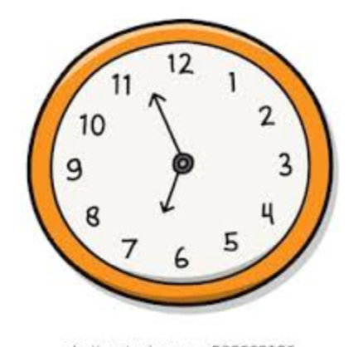




Example
Bias Correction?

Slide 24
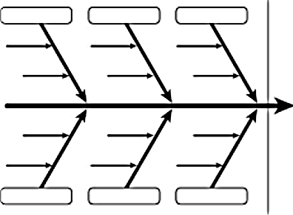
Fishbone Diagram
Clock Adjusting
Bus status
Driver
Traffic
Uncertainty of arrival time
Weather
Accident
Passengers

Slide 25


Hey! Listen to my experience.
I’ve taken this trip many times…
Bottom-up
Top-down

Slide 26
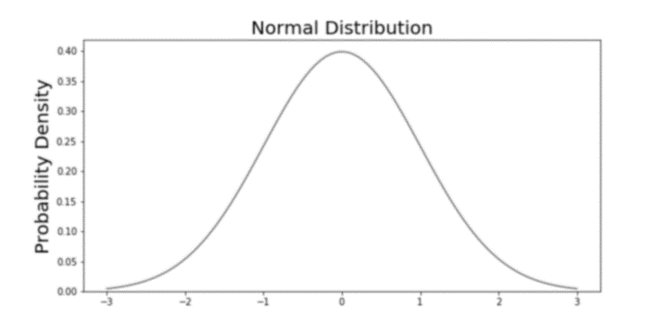
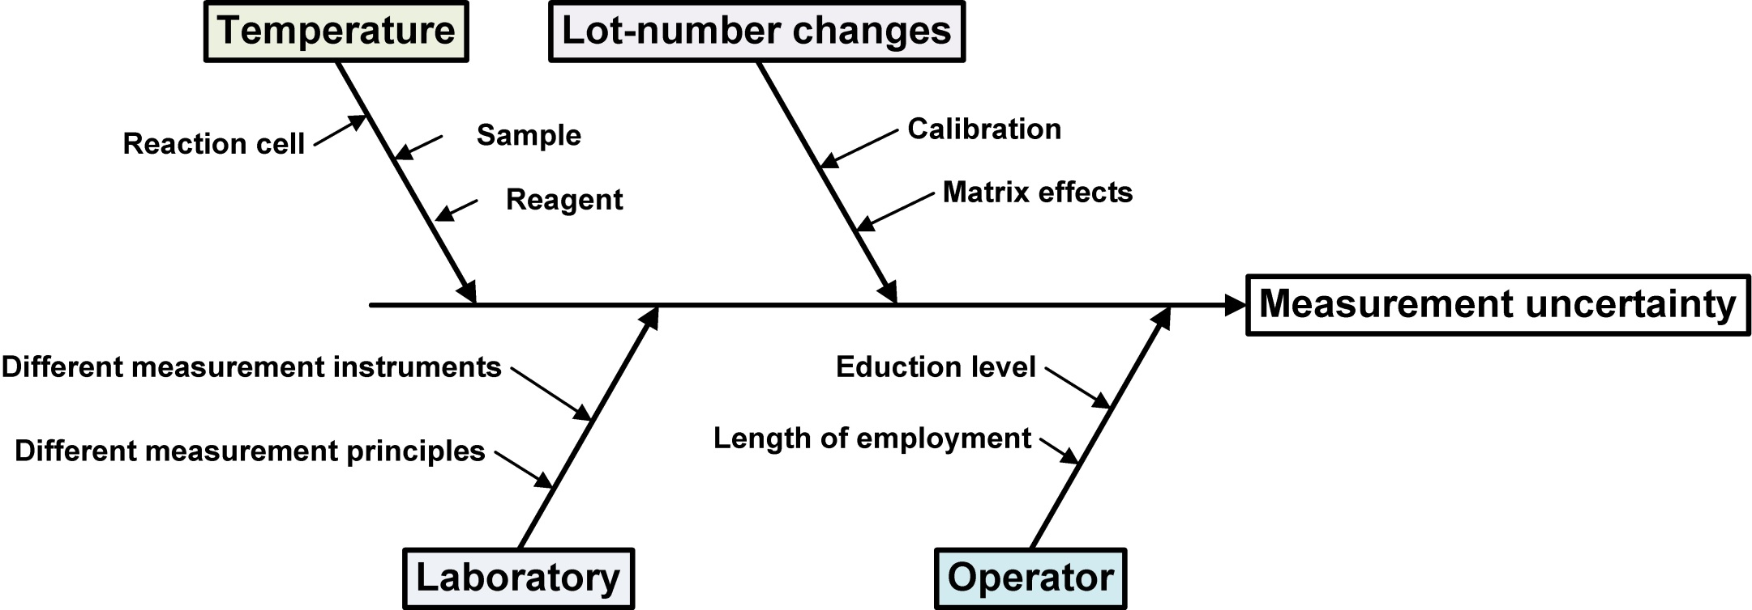
Sources of uncertainty in Medical Laboratory
Bias Correction
Control Material
Question: Bottom-up or Top-down?

Slide 27
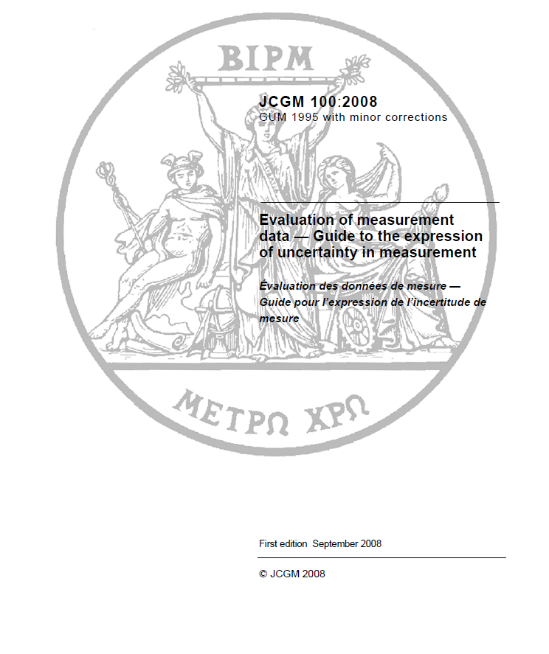
Evaluation of measurement data — Guide to the expression of uncertainty in measurement (GUM) JCGM 100:2008
1.2: “This document is primarily concerned with the expression of uncertainty in the measurement of a well-defined physical quantity that can be defined by an essentially unique value.”
1.4: “…(GUM) provides general rules for evaluating and expressing uncertainty in measurement rather than detailed, technology-specific instructions.”

Slide 28
Bottom-up:
Usually employed by reference laboratories to obtain ISO 17025 and 15195 certificate
The application in medical laboratories is too complicated and has encountered many practical problems and objections.
Top-down:
Simpler and represents a good alternative to the previous approach
Estimates MU by using IQC, commercial calibrator information, and bias correction
The utility of measurement uncertainty in medical laboratories. Braga et al. CCLM 2020; aop. https://doi.org/10.1515/cclm-2019-1336
The search for any potential source of analytical uncertainty according to the “bottom-up” approach is seen as a complicated and useless challenge
Measurement uncertainty: light in the shadows. Plebani et al. CCLM 2020; aop. https://doi.org/10.1515/cclm-2020-0134

Slide 29
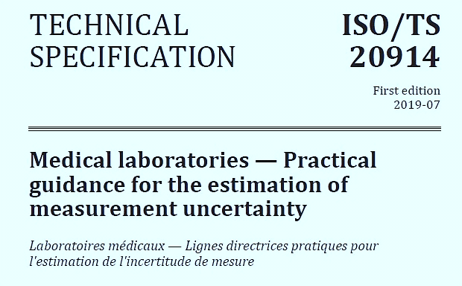

Slide 30
ISO/TS 20914:2019(E)
In medical laboratory:‍
The measurands are typically present in complex biological fluid and tissue matrices
Characterization of commercial devices and kits is limited to the gathering of empirical performance data using QC sample
Medical laboratory measurement procedures are well-suited to utilizing IQC and other available data to estimate MU without the need for measurement models and complex statistics
“…not intended … an exhaustive accounting of all possible uncertainties, but … major foreseeable sources…”
“…to provide practical estimates of MU that help ensure that patient results are fit for medical use.”

Slide 31
Common sources of MU in medical laboratory:
Sample inhomogeneity
Reconstitution procedures for lyophilized materials, e.g. calibrator and reagents
Uncertainty of calibrator values, re-calibrations
Instrumentation, e.g. electro-mechanical fluctuations, maintenance, parts replacement
Reagent and calibrator instability
Reagent and calibrator lot-to-lot variability
Fluctuations in laboratory environment
Operator bias introduced by reading analogue instrument indications
Variable manual dexterity for manual and semi-automated methods
Measurement bias vs. an accepted calibration hierarchy scheme
Measurement formulae, e.g. approximations, assumptions, inexact values for constants, rounding of digits
More than one of the same measuring system for the same measurand
More than one measurement procedure for the same measurand that may have different analytical performance characteristics

Slide 32
The most significant uncertainty contributions
1. Long-term imprecision data (SD or CV) obtained for IQC
Uncertainty of within-lab reproducibility, u_{Rw}
Inhomogeneity
Recalibrations
Reagent/Calibrator lot changes
Instrumentation (e.g. electro-mechanical, maintenance, part replacement
Environment
Operators
Formula (e.g. approximation, assumptions, rounding)
More than one system
More than one measurement procedures

Slide 33
Example:
Na IQC results
An SD from such long-term precision data is termed a standard uncertainty (u)
If a period sufficient to include all routine changes, the u is designated u_{Rw}, or the standard uncertainty under within-laboratory conditions

Slide 34
The most significant uncertainty contributions
1. Long-term imprecision data (SD or CV) obtained for IQC
2. Uncertainty of end-user calibrator values, u_{cal}
3. Occasionally a medically significant bias may be corrected, u_{bias}
Unfortunately, the information regarding uncertainty associated with commercial calibrators is currently very poor when consulting calibrator package inserts.
In the majority of cases, long-term imprecision is the largest contributor
u_{Rw} u_{cal} u_{bias}
u(y) = √(u²_{Rw} + u²_{cal} + u²_{bias})

Slide 35
1. Long-term imprecision, u_{Rw}
In the majority of cases, the largest contributor to the uncertainty
IQC materials close to important medical decision limits
IQC data produced when the measuring system is meeting analytical performance criteria
More than one level of IQC
Dissolving a lyophilized IQC material introduces a spurious contribution to the estimation of MU
Preferably by a third-party (i.e. different from that used to check the alignment of the measuring system)
Closely resembles authentic clinical samples (ideally a commutable material)
If IQC material does not undergo preparation step, a typical uncertainty for this step must be estimated

Slide 36
NOTE: Changes during IQC data collection
Calibrator lot change/Recalibratoin
Maintenance/Part replacement
Reagent lot change
IQC lot change
Single set;
Larger SD
Avg. separate sets;
Smaller SD
Avg. separate sets
Smaller SD

Slide 37
NOTE: Changes during IQC data collection
Are IQC results and patient sample results affected the same way?
Calibrator lot change/Recalibratoin
Maintenance/Part replacement
Reagent lot change
IQC lot change
YES. Usually affects IQC as patient samples. Treat IQC data as a single set
YES/NO. Both IQC and patient samples affected: treat IQC data as a single set; Only IQC affected: treat IQC data as separate sets
NO. Treat IQC data as separate sets

Slide 38
2. Uncertainty of end-user calibrator values, u_{cal}
combination of all uncertainties from the highest available reference (calibrator or measurement procedure) down to the assigned value of the calibrator
Manufacturer, is responsible for determining u_{cal}
If laboratory prepares the calibrator, the laboratory is responsible for determining u_{cal}
For some calibrators a comprehensive u_{cal} is technically unavailable; e.g. some international conventional biological reference materials

Slide 39
3. Uncertainty of bias, u_{bias}
IVD manufacturers are responsible for ensuring minimal, medically acceptable measurement bias
Therefore estimation of bias and u_{bias} by the laboratory is rarely required
If ongoing EQA indicates the introduction of a medically significant:
Responsibility of the IVD manufacturer, to take immediate corrective action
If the manufacturer is unable to correct bias, the laboratory may, if local regulations permit, can estimate bias by using reference materials
NOTE! EQA target value can itself be biased, depending on how the value is assigned to the material

Slide 40
BIAS = Lab Mean - Reference Value
Bias correction is always imperfect!
    Uncertainty of Reference; u_{ref}
    Uncertainty of Mean; SEM or SD_{mean}

Slide 41

Caveats about correcting bias
Only category I/II EQA are usable to evaluate bias
I: Commutable, Value assigned with RMP or CRM, Replicate samples
II: Commutable, Value assigned with RMP or CRM
Correction factor not permitted in some countries because:
- May alter the status of the system, removing any responsibility from the manufacturer
- Depriving the system and the results of the CE marketing certification
May labs continue to use the correction factor even when the bias has been corrected in the reagent production stage
“Therefore, we are not supporting the individual use of bias correction factors in daily practice”
III: Commutable, Replicate samples
IV: Commutable
V: Non-commutable, Replicate samples
VI: Non-commutable
The utility of measurement uncertainty in medical laboratories. Braga et al. CCLM 2020; aop. https://doi.org/10.1515/cclm-2019-1336

Slide 42
If local regulations permit, laboratory can manage bias by:
Applying a correction factor to the results
Re-assigning a calibrator value
Bias correction is always imperfect because estimates of the magnitude of bias have uncertainty (u_{bias})
Bias is not the case when:
- Monitor changes in an individual over time
- In-house determined reference intervals

Slide 43
MU is all about TRACEABILITY
Uncertainty of Reference Material; u_{ref}
Uncertainty of End-user Calibrator; u_{cal}
Uncertainty of Patient result; u(y)
u_{Rw}
Example of a calibration hierarchy for a measurand with full metrological traceability to the SI

Slide 44
MU is all about TRACEABILITY
Example of a calibration hierarchy for a measurand with full metrological traceability to the SI

Slide 45
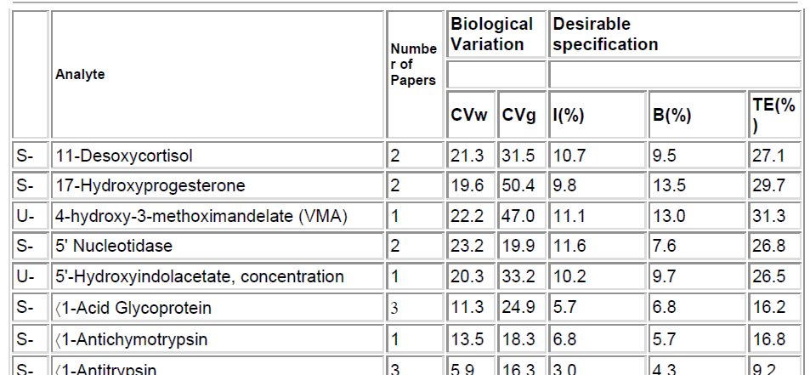
Maximum allowable measurement uncertainty
The magnitude of MU should be suitable for a result to be used in a medical decision and ideally as small as technically possible
If a measurement procedure exceeds the upper allowable uncertainty limit, it may be possible to reduce the uncertainty by identifying and modifying a technical step that makes a relatively large contribution to the total uncertainty
If the uncertainty cannot be sufficiently reduced, a decision must be made as to whether the measurement procedure is to be changed or if the quality goal should be reconsidered
CV_{I}
CV_{G}
Allowable CV; I(%)
Optimum: 0.25 x CV_{I}
Desirable: 0.5 x CV_{I}
Minimum: 0.75 x CV_{I}

Slide 46
Concepts & Definitions
Standard measurement uncertainty; u
Measurement uncertainty expressed as a standard deviation, SD
u_{r}: Repeatability uncertainty
u_{Rw}: Within-lab Reproducibility uncertainty
Coverage factor, k
Number larger than one by which a standard uncertainty value (u) is multiplied to obtain an expanded uncertainty, U
Expanded uncertainty; U U = k * u
Measurement uncertainty obtained from multiplying standard uncertainty by coverage factor
Coverage interval [(x – U) to (x + U)]
Interval containing the set of true quantity values of a measurand with a stated probability, based on the information available

Slide 47
Metrological Traceability
Property of a measurement result whereby the result can be related to a reference through a documented unbroken chain of calibrations, each contributing to the MU
Standard Error, SE
Quantitative measure of the variation or dispersion of sample means or sample averages
EXAMPLE: A reference material for serum creatinine was measured 20 times under repeatability conditions:
- Mean value = 22,0 N = 20 SD = 0,63
- SD_{mean}
= 0.63/√20 = 0.15 u = 0.15
U = 0.3, k = 2
- Coverage Interval = [21.7 – 22.3]; 95% Confidence

Slide 48
Basic calculations
Variance and Standard Deviation
Combining independently estimated uncertainties
NOTE! Variance can be added, subtracted, multiplied or divided, but SD cannot

Slide 49
Rounding
Performed only on the final calculated estimates
Number of decimal digits:
- Mean: Plus one additional decimal digit
- SD: Plus two additional decimal digits
- CV: One decimal digits
“The number of significant digits in the results shall not imply a smaller uncertainty than warranted by the uncertainty.”

Slide 50
Example:
Sodium measuring system reports Na values in whole numbers
136, 134, 133, 135, 136, 137, 135, 138, 136, 133
 = 135.3
SD = 1.64
CV = 1.2%

Slide 51
Re-estimation of measurement uncertainty
Apart from updating interim estimates, there is no need to re-estimate MU if IQC and EQA performance remain within specifications.
Re-estimation of MU should be undertaken if there has been a significant change in a measuring system or a new measurement procedure is introduced.

Slide 52

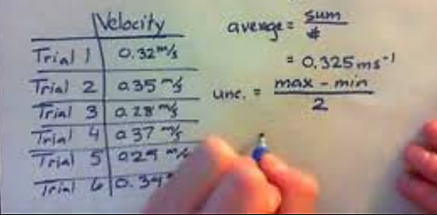

Slide 53
Flowchart Diagram for calculating MU

Slide 54
Example - Uncertainty of Sodium

Slide 56
Example - Uncertainty Intraoperative PTH monitoring
Calculation of u_{r}(y) under Repeatability conditions
Not applicable to the uncertainty for long-term precision conditions for other medical uses of PTH values. Useful as initial guidance.

Slide 57
MU across changes affecting only IQC results
Calibrator lot change/Recalibratoin
Maintenance
Reagent lot change
IQC lot change
Usually affects IQC as patient samples. Treat IQC data as a single set
- Both IQC and patient samples affected: treat IQC data as a single set
- Only IQC affected: treat IQC data as separate sets
Treat IQC data as separate sets

Slide 58
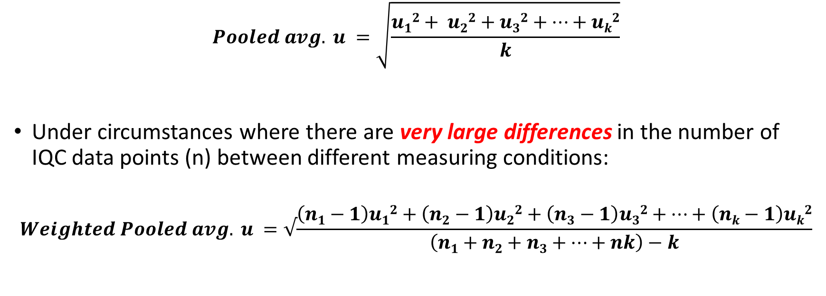
MU across changes affecting only IQC results
SD₁ = u₁
SD₂ = u₂
$$Pooled avg. u =\sqrt{\frac{u12+ u22+u32+…+uk2}{k}}$$
Under circumstances where there are very large differences in the number of IQC data points (n) between different measuring conditions:
$$Weighted Pooled avg. u =√\frac{\left(n1−1\right)u12+\left(n2−1\right)u22+\left(n3−1\right)u32+…+\left(nk−1\right)uk2}{\left(n1+n2+n3+…+nk\right)−k}$$

Slide 59
Example for Multiple IQC Lots

Slide 60
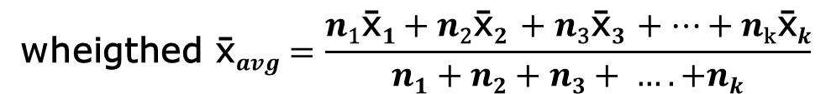
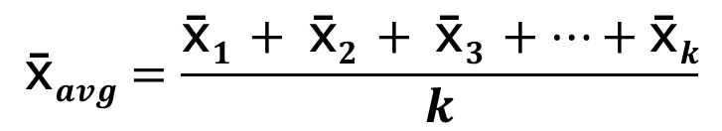
$$\text{}avg=\frac{\text{}1 + \text{}2 + \text{}3 +…+\text{}k}{k}$$
Under circumstances where there are very large differences in the number of IQC data points (n) between different measuring conditions:
$$\text{wheigthed} \text{}avg=\frac{n\text{1}\text{}1+n\text{2}\text{}2 +n\text{3}\text{}3 +…+n\text{k}\text{}k}{n1+n2+n3+ …. +nk}$$

Slide 61
Example – Uncertainty of PTH across 3 IQC lots

Slide 65
_{average} = (₁ + ₂ + ₃)/3 | 2.13667 | 17.87333 | 61.57

Slide 66
Laboratories using multiple measuring systems for the same measurand
Average u that can be applied to the results irrespective of the measuring system used.
u_{Rw} must be estimated separately for each measuring system, and then a pooled average can be calculated:
  Average within system Uncertainty, u_{Rw}(A,B,C)
Medically significant systematic bias between measuring systems should be eliminated, and the uncertainty of the mean residual bias should be calculate:
Between systems Uncertainty, u(A,B,C)
Total Uncertainty:

Slide 67
 _{A}, SD _{A}
 _{B}, SD _{B}
 _{C}, SD _{C}

Slide 68
 | Measuring System
 | A | B | C
n | 280 | 190 | 400
 | 5.15 | 4.93 | 5.28
SD | 0.160 | 0.190 | 0.200
u_{RW} | 0.160 | 0.190 | 0.200
 _{avg} = 5.12
u(A,B,C) = SD(_{A}, _{B}, _{C}) = 0.176918
u²(A,B,C) = 0.0313

Slide 69
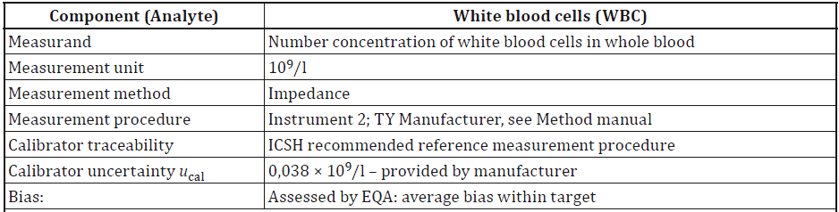
Example – Uncertainty of WBC counts

Slide 70
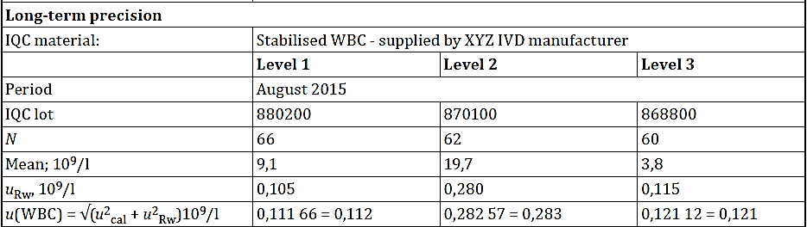

Slide 71
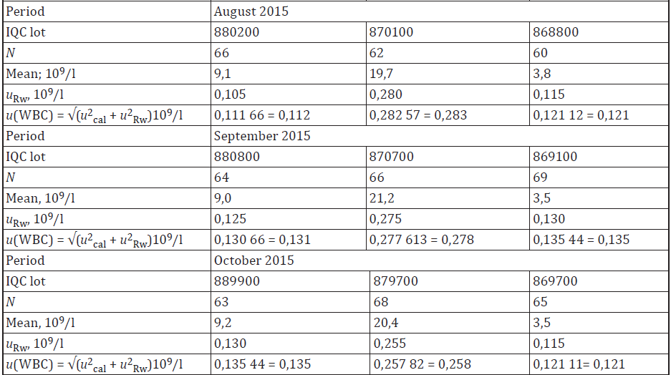

Slide 72
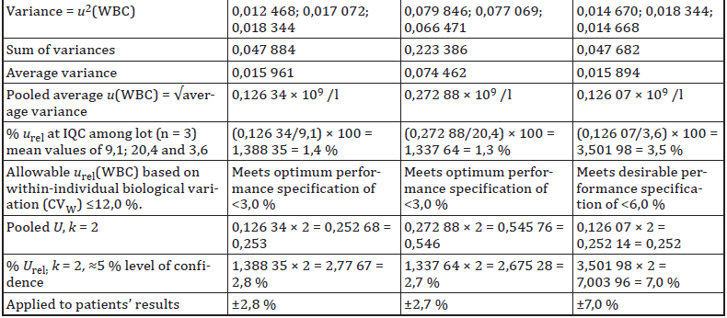
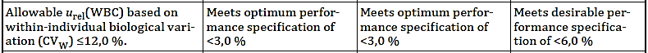

Slide 73
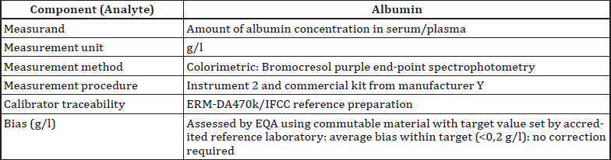
Standard uncertainty (u) vs. Relative uncertainty (u_{rel})
Example - Albumin in Serum/Plasma
A. Standard uncertainty method

Slide 74
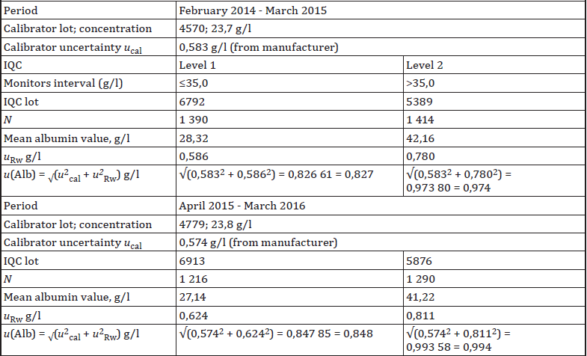

Slide 76
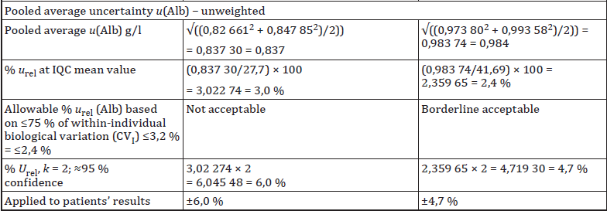
Minimum

Slide 77
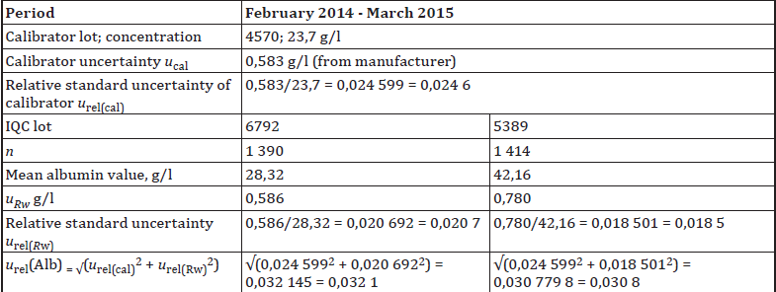
B. Relative uncertainty method

Slide 78
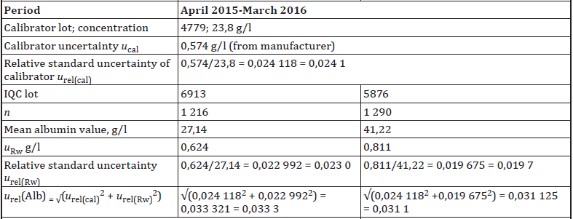

Slide 79
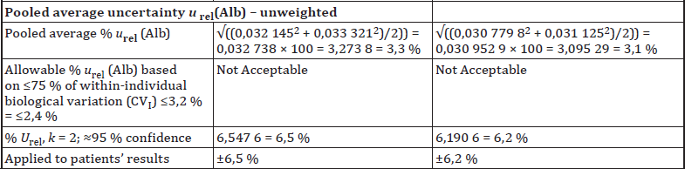
Minimum

Slide 80
Standard uncertainty method
Relative uncertainty method
Relative uncertainty method gives a better estimate of overall uncertainty
Standard uncertainty method underestimates overall uncertainty at levels higher than calibrator concentration

Slide 82
Multipoint Calibration
For practical purposes, the calibrator that is most applicable to each level of IQC is used for u_{cal}

Slide 84
Bias, Bias Correction, Uncertainty of bias
The role of IVD manufacturers is to define a calibration hierarchy to assign traceable values to their calibrators
If the IVD measuring system is CE-marked and correct alignment to higher-order references is expected:
Medical laboratories should rely on the IVD manufacturers who must ensure traceability
Therefore, regular estimation of bias by the end-user laboratory is not required
The utility of measurement uncertainty in medical laboratories. Braga et al. CCLM 2020; aop. https://doi.org/10.1515/cclm-2019-1336

Slide 85
Example
Glucose CRM
Assigned vale = 108 mg/dL
u_{ref} = 0.6 mg/dL
Lab
n = 10
 = 108.9
Bias = 108.9 - 108= 0.9 mg/dL
Significant Bias?
Not statistically significant; correction not necessary.
U_{ref}= 1.2 mg/dL
CI = 106.8 to 109.2 mg/dL
_{lab}
108.9
AV – U_{ref} AV + U_{ref}
106.8
108
109.2

Slide 86
Example
Glucoscante CRM
Assigned vale = 108 mg/dL
u_{ref} = 0.6 mg/dL
Lab
n = 10
 = 109.6
SD = 1.3
SD_{mean} (SE) = 1.3/√10 = 0.41
2SE = 0.82
CI_{mean} = 108.8 to 110.4 mg/dL
Bias = 109.6 - 108= 1.6 mg/dL
Significant Bias?
U_{ref}= 1.2 mg/dL
CI = 106.8 to 109.2 mg/dL
_{lab}
109.6
108.8
110.4
AV – U_{ref} AV + U_{ref}
Mean – 2SE mean + 2SE
106.8
108
109.2

Slide 87
Example
Glucoscante CRM
Assigned vale = 108 mg/dL
u_{ref} = 0.6 mg/dL
Lab
n = 10
 = 109.6
SD = 1.3
SD_{mean} (SE) = 1.3/√10 = 0.41
Bias = 109.6 - 108= 1.6 mg/dL
Significant Bias?
u_{bias} = √(u_{ref}² + SD_{mean}²)
If Bias > 2u_{bias} → Statistically Significant Bias
u_{bias} = √(0.6² + 0.41²) = 0.73 2u_{bias} = 1.46
1.6 > 1.46
Statistically Significant
Medically Significant Bias?

Slide 88
BIAS
Bias > 2u_{bias}
Statistically Significant Bias
NOTE!
The final assessment of significance of any correction for the bias should be based on its impact on medical interpretation of measurement results.

Slide 89
Example
Lab
n = 10
 = 3.72
SD = 0.11
SD_{mean} = 0.11/√10 = 0.034785
CRM (Albumin)
Assigned vale = 4.15 mg/dL
u_{ref} = 0.040
u_{bias} = √(0.04² + 0.034785² ) = 0.053009
2u_{bias} 0.11
Bias = 4.15 – 3.72 = 0.43 > 2u_{bias}

Slide 90
Component (Analyte) | Albumin
Measurand | Amount of albumin concentration in serum/plasma
Measurand unit | mg/dL
Bias (mg/dL) | Assessed by EQA using commutable material with target value set by accredited reference laboratory: 0.43; Significant bias; Correction required
Bias uncertainty, u_{Bias} | 0.053009
Calibrator uncertainty, u_{cal} | 0.058
IQC mean, mg/dL | 4.22
Laboratory uncertainty, u_{Rw} | 0.077918
u albumin | √(0.053009² + 0.058² + 0.077918²) = 0.110658 ≈ 0.11
U albumin | 0.221316 ≈ 0.22

Slide 91

شاد باشید

Slide 92
Combined uncertainty of calculated values
Examples:
Anion Gap
Cr Clearance
Calculated LDL
Non-HDL Cholesterol
ACR

Slide 93
1- Measured value is calculated by adding/subtracting, e.g. LDL:
Combine Standard uncertainties
2- Measured value is calculated by Multiplying/Dividing; e.g. Cr Clearance:
Combine Relative uncertainties

Slide 94
1- Adding/Subtracting
Example 1 – Uncertainty of Plasma Anion Gap

Slide 95
1- Adding/Subtracting
Example 2 – Uncertainty of Osmolality
Na = 130, u(Na) = 0,98
Urea = 6.5, u(urea) = 0,19
Glucose = 5.2, u(glu) = 0,090

Slide 96
2- Multiplying/Dividing
Example 1– Uncertainty of Spot Urine Calcium to Creatinine ratio
Ca = 6.40, u(Ca) = 0,040 (IQC mean: 2.71)
Cr = 2.30, u(Cr) = 0,150 (IQC mean: 6.17)
Ca/Cr = 2.78
%u_{rel}(Ca) = (0.04/2.71) x 100 = 1.4760 % = 1.5 %
%u_{rel}(Cr) = (0.15/6.17) x 100 = 2.4311 % = 2.4 %
%u_{rel}(Ca/Cr) = √(1.476² + 2.4311²) = 2.8394 % = 2.8 %
%U_{rel}(Ca/Cr) = 2 x 2.8394 % = 5.7 %
Ca/Cr = 2.78 ± 5.7% = [2.62 – 2.93]

Slide 97
2- Multiplying/Dividing
Example 2– uncertainty of Creatinine Clearance
u(P-Cr) = 1.438 (IQC mean = 70)
%u_{rel}(Cr) = (1.438/70) x 100 = 2.05 %
u(Ur-Cr) = 138.0 (IQC mean = 6060)
%u_{rel}(Ur-Cr) = (138/6060) x 100 = 2.28%
Notes:
To convert u to %u-rel, u is divided by IQC mean

Slide 98
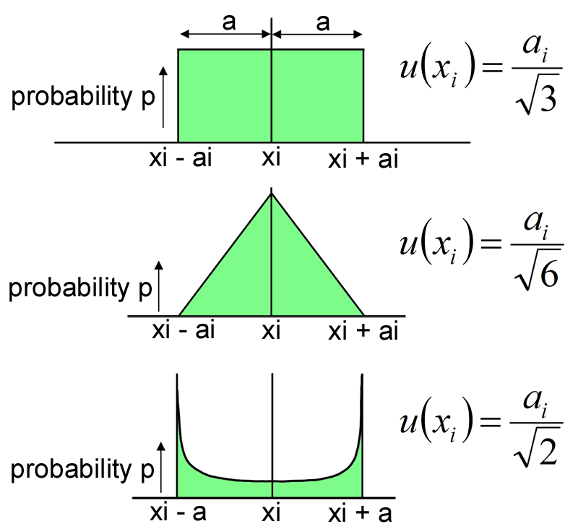
Rectangular & Triangular distributions

Slide 99
2- Multiplying/Dividing
Example 1– uncertainty of Creatinine Clearance
Volume Error = ± 100 mL
u(V) = 100/√3 = 57.7
%u_{rel}(V) = (57.7/2421) x 100 = 2.40 %
Time Error = ± 30 min
u(t) = 30/√3 = 17.32
%u_{rel}(t) = (17.32/1441) x 100 = 1.20%

Slide 100
2- Multiplying/Dividing
Example 1: Creatinine Clearance
Clearance = 33.4
%u_{rel}(Clearance) = 2.05 % = 4.0744 % = 4.1%
%u_{rel}(Cr) = 2.05 %
%U_{rel}(Clearance) = 8.1488 = 8.1%
%u_{rel}(Ur-Cr) = 2.28%
33.4 x (8.1488/100) = 2.7217 = 2.72
%u_{rel}(V) = 2.40 %
Patient result = 33.4 ± 2.72 = [30.7 – 36.1]
%u_{rel}(t) = 1.20%

Slide 101
2- Multiplying/Dividing
Example 2– Uncertainty of INR
INR = (PT/MNCT)^{ISI}
SD of IQC
SD_{mean} of Normal Specimens

Slide 103
ISI
u_{rel} MNCT
U_{rel (Rw)}(PT)

Slide 104
Uncertainty of Calculated results: Direct estimation using IQC data
Better reflect the uncertainty
Include, for example, small uncertainties introduced by automatic rounding of values by a laboratory IT system

Slide 105
Example 1: Anion Gap = (Na + K) – (Cl + HCO₃)
SD (AG)
 (AG)

Slide 106
Example Patient:
[Na+] = 143 mmol/l
[K+] = 4,0 mmol/l
[Cl-] = 104 mmol/l
[HCO3-] = 22 mmol/l
AG = (143 + 4) – (104 + 22) = 21 mmol/l
Patient AG is between 18 and 24; 95% confidence
%U (AG) = (3/25.85) x 100 = 11.6%

Slide 107
Example 2: MU of eGFR
For method standardized against NIST reference method/material

Slide 108
Calculate eGFR for phantom 40 years old female and male using IQC results
Female
QC1
Male
QC1
Female
QC2
Male
QC2

Slide 109
0.93 mg/dL
6.03 mg/dL
0.02 mg/dL
0.10 mg/dL

Slide 110
0.93 mg/dL
6.03 mg/dL
0.02 mg/dL
0.10 mg/dL
Example- Female; eGFR = 80
U = (80 x 5.2)/100 = 4.16
Patient eGFR is between 76 and 84; 95% confidence

Slide 111
0.93 mg/dL
6.03 mg/dL
0.02 mg/dL
0.10 mg/dL
Example- Male; eGFR = 11
U = (11 x 3.7)/100 = 0.41
Patient eGFR is between 10.6 and 11.4; 95% confidence

Slide 112
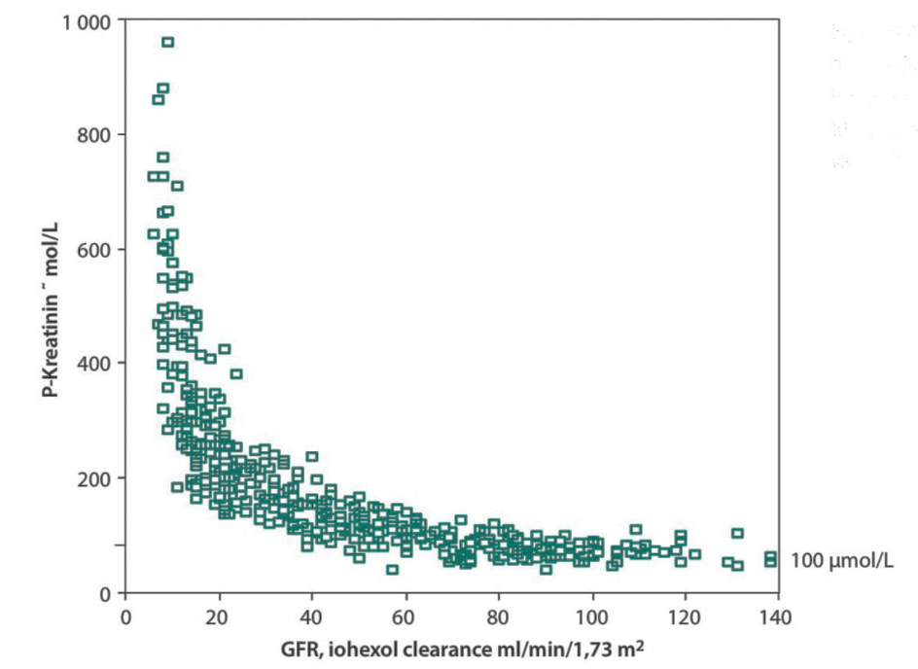
NOTE!
The best-fit function to derive CKD-EPI eGFR reveals very significant scatter
eGFR values could be up to approximately ±30 % of the measured GFR value
Therefore, uncertainty from laboratory performance is only a small portion of Total Diagnostic Uncertainty!

Slide 113
NOTE!
The best-fit function to derive CKD-EPI eGFR reveals very significant scatter
eGFR values could be up to approximately ±30 % of the measured GFR value
Therefore, uncertainty from laboratory performance is only a small portion of Total Diagnostic Uncertainty!
“Doctors continually have to make decisions on the basis of imperfect data and limited knowledge, which leads to diagnostic uncertainty, coupled with the uncertainty that arises from unpredictable patient responses to treatment and from health care outcomes that are far from binary.”
Han PK, Djulbegovic B. Tolerating uncertainty about conceptual models of uncertainty in health care. J Eval Clin Pract 2019;25:183–5
William Osler:
“Medicine is a science of uncertainty and an art of probability”

Slide 114
SUMMARY:
u_{Rw} u_{cal} u_{bias}
u = √(u_{Rw}² + u_{cal}² + u_{bias}²)
u = √(u_{Rw}² + u_{cal}²)
u = u_{Rw}
u < CV_{I} → Acceptable
U = 2u
Result ± U

Slide 115
According to ISO 15189 [63], MU should be made available by the laboratory on request. Careful interpretation is needed, as MU is already taken into account also in other test characteristics such as sensitivity, specificity, predictive value, etc. Physicians might correct decision levels knowing the MU of a test, taking MU into account again. Analytical variation as well as other sources of uncertainty, including biological and preanalytical variation, are already reflected in reference interval limits and are (or should be) also taken into account in decision limits in clinical guidelines, as “grey zones”, and borderline areas. Lower MU results in higher predictive values and lower clinical uncertainty. This might even lead to a different clinical application of the test, with HbA1c assays as a typical example. The improved reliability of the results made expert organizations revise the guidelines and recommend HbA1c for diagnosis. Such an improved clinical uncertainty is also seen with high-sensitive troponin assays.
Careful interpretation is needed
…are already reflected in RIs and decision limits as “grey zones” and borderline areas.

Slide 116

شاد باشید

Slide 117
MU calculation according to different purposes
*For tests used for both monitoring and diagnosis the specific clinical question should be considered
Measurement uncertainty: light in the shadows. Plebani et al. CCLM 2020; aop. https://doi.org/10.1515/cclm-2020-0134

Slide 118
Example - Uncertainty of BCR-ABL1 gene transcript measurement

Slide 120
Example - Uncertainty of HIV viral load

Slide 121
Note! Non-asymmetric confidence interval

Slide 122
Uncertainty of Qualitative results based on numerical results
Delineate ‘uncertainty zones’ around the negative/positive cut-offs, e.g. negative, probably negative, probably positive, positive
At signal values other than those near the decision limits is unnecessary

Slide 123
Example - Uncertainty of HBs Ag

Slide 124
Bias, Bias Correction, Uncertainty of bias
Example of a calibration hierarchy for a measurand with full metrological traceability to the SI

Slide 125
Bias, Bias Correction, Uncertainty of bias
Example of a calibration hierarchy for a measurand with full metrological traceability to the SI

