Slide 1

به نام خدا
دکتر ژابیز مدرسی
MD, PhD

Slide 2
تفسیر داده های آزمایشگاهی
برای
متخصصین تغذیه
LABORATORY TESTS INTERPRETATION
FOR
NUTRITIONISTS

Slide 3
EXERCISE 1
Order appropriate lab tests for the following pt.
58 yr/ Male
Wt = 86Kg
Ht = 175cm
Waist circumference = 104 cm
DM since 5 years ago

Slide 4

How to order lab tests?
Lab please:
CBC, diff
TG, Total Chol, LDL, HDL
ALT, AST, ALP, GGT
UA, UC
S/E x 3
BUN, Cr
Na, K, Ca, Phosphorous
TSH
PT, PTT
Bilirubin (total, direct)
ESR, CRP
25(OH)D

Slide 5
Exercise 2 (LFT)
What do you think?
The patient is:
A 41 yr/ female
CC: Obesity
Wt = 68Kg
Ht = 156 cm
Lab tests:
AST = 75 IU (NL<31 U/L)
ALT = 87 IU (NL <31U/L)
ALP = 360 (NL<306 U/L)
Bil total = 0.8
Bil Direct = 0.2
CBC NL
FBS = 98 mg/dl
TG = 350
Chol total = 250
HDL = 35
LDL = 145

Slide 6
Liver Function Tests (LFT)
ALT, AST, GGT
LDH, ALP
Bilirubin
  Total
  Direct
Coagulation
  PT
  PTT
  INR

Slide 7
AST or SGOT
Found in many sources, including liver, heart, muscle, intestine, pancreas
Released when cells are hurt or destroyed
Not very specific for liver disease
Will increase in MI, skeletal muscle damage
Normal range: 5-40 U/L
Notes:
وضعیت سلولهای ﭘارانشیمال کبد

Slide 8
ALT or SGPT
Found primarily in hepatocytes
Released when cells are hurt or destroyed
Normal levels depend on the reference
Range which actually differs lab to lab
Considered normal between 5-40 U/L

Slide 9
AST/ALT
بیشتر از 2: ﻫﭘاتیت الکلی – کارسینوم ﻫﭙاتوسلولار
بین 1 و 2 : سیروز
زیر 1 اما با مقادیر بسیار بالای این دو آنزیم: ﻫﭘاتیت ویرال
زیر 1: نرمال

Slide 10
GTT
Is present in the cell membranes of many tissues: liver, kidneys, bile duct, pancreas, gallbladder, spleen, heart, brain, and seminal vesicles
Normal range is 0 to 51 international units per liter (IU/L)
Elevated serum GGT activity can be found in diseases of the liver, biliary system, and pancreas
Slightly elevated serum GGT has also been found to correlate with cardiovascular diseases
Notes:
More recently, slightly elevated serum GGT has also been found to correlate with cardiovascular diseases and is under active investigation as a cardiovascular risk marker. GGT in fact accumulates in atherosclerotic plaques,^{[12]} suggesting a potential role in pathogenesis of cardiovascular diseases,^{[13]} and circulates in blood in the form of distinct protein aggregates,^{[14]} some of which appear to be related to specific pathologies such as metabolic syndrome, alcohol addiction and chronic liver disease. High body mass index is associated with type 2 diabetes only in persons with high serum G

Slide 11
GTT (continued)
The main value of GGT over ALP is:
  Verifying if ALP elevations are due to biliary disease; ALP (but not GGT) can also be increased in certain bone diseases
Numerous drugs can raise GGT levels, including barbiturates, phenytoin, carbamazepine, cimetidine, furosemide, heparin, isotretinoin, methotrexate, oral contraceptives and valproic acid

Slide 12
GTT (continued)
Hepatic causes of increased GGT:
  Hepatitis (acute and chronic)
  Cirrhosis
  Liver metastasis and carcinoma
  Cholestasis
  Alcoholic liver disease
  Primary biliary cirrhosis and sclerosing cholangitis

Slide 13
GTT (continued)
Extrahepatic causes for increased GGT:
  Pancreatitis
  Carcinoma of prostate
  Carcinoma of breast and lung
  Systemic lupus erythematosus
  Alcoholism
  Congestive heart failure and chronic coronary artery disease: The level of elevation correlates with the risk of death secondary to cardiovascular disease
Smoking may cause elevated GGT levels

Slide 14
ALP
ALP is still the first test for biliary disease
liver (especially biliary tract), bones, intestines, & placenta
Liver AP rises with obstruction or infiltrative diseases (i.e., stones or tumors)
Normal range: 20-70 U/L
Also present in bone & placenta
Increases in adolescence
paget disease of bone isoenzymes
pregnancy

Slide 15
Bilirubin
Bilirubin: two primary sources
Indirect (unconjugated): old red cells,removed by the spleen, sent to the liver
Liver “adds” glucuronic acid, making it water soluble for excretion; now called direct (or conjugated)
Normal range: less than 0.8 mg/dL

Slide 16
DDX for high Bil
Jaundice is classified into three categories, depending on which part of the physiological mechanism the pathology affects
Category | Definition
Pre-hepatic/ hemolytic | The pathology is occurring prior to the liver
Hepatic/ hepatocellular | The pathology is located within the liver
Post-Hepatic/ cholestatic | The pathology is located after the conjugation of bilirubin in the liver

Slide 17
Function test | Pre-hepatic Jaundice | Hepatic Jaundice | Post-hepatic Jaundice
Total bilirubin | Normal / Increased | Increased
Conjugated bilirubin | Normal | Increased | Increased
Unconjugated bilirubin | Normal / Increased | Increased | Normal
Urobilinogen | Normal / Increased | Decreased | Decreased / Negative
Urine Color | Normal | Dark (urobilinogen + conjugated bilirubin) | Dark (conjugated bilirubin)

Slide 18
Function test | Pre-hepatic Jaundice | Hepatic Jaundice | Post-hepatic Jaundice
Stool Color | Normal | Normal/Pale | Pale
Alkaline phosphatase levels | Normal | Increased
Alanine transferase and Aspartate transferase levels |  | Increased
Conjugated Bilirubin in Urine | Not Present | Present
Splenomegaly | Present | Present | Absent

Slide 19

Now let ‘s consider different scenarios…

Slide 20
Elevations in ALT & AST only:
  suggests cellular injury
Elevations in AlP & Bilirubin:
  suggests cholestasis or obstruction
Mixed pattern: ALT, AST, AlP & Bili:
  probably the most common scenario

Slide 21
Very high (over 1000 U/L) ALT and AST usually only come from a couple of sources:
  Acute viral hepatitis (A,B,C, HSV)
  Acetominophen toxicity / overdose
  Shock Liver (cardiac or surgical event)
Most other items don’t cause huge levels
Notes:
The clinical syndrome of "shock liver," also known as ischemic hepatitis, is characterized by sudden elevation (to more than 20 times the upper limit of normal) of SGOT and SGPT in response to cellular anoxia, followed by resolution to near normal levels within seven to ten days

Slide 22
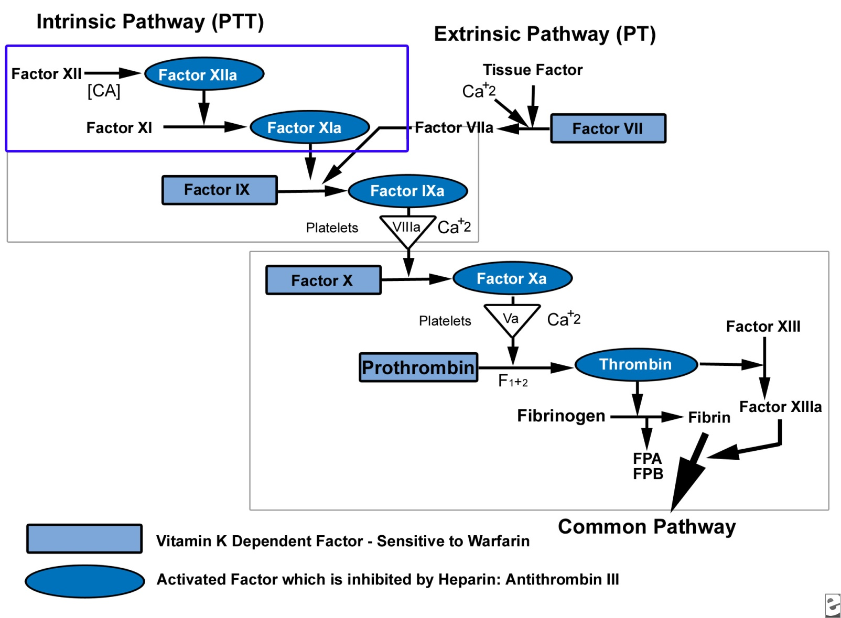
COAGULATION TESTS

Slide 23
PT
بررسی مسیر خارجی انعقاد
افزایش در : کمبود ویتامینK – مصرف OCP – بیماریهای کبدی – مصرف آنتی کواگولانت (وارفارین) - DIC

Slide 24
PTT
بررسی مسیر داخلی انعقاد
aPTT: More than 70 seconds (signifies spontaneous bleeding)
PTT: More than 100 seconds (signifies spontaneous bleeding)

Slide 25
A prolonged aPTT result may indicate the following:
Congenital deficiencies of intrinsic system clotting factors such as factors VIII, IX, XI, and XII, including hemophilia A and hemophilia B
Von Willebrand disease, which is the most common inherited
bleeding disorder, affecting platelet function owing to decreased von Willebrand factor activity
Hypofibrinogenemia
Notes:
(the liver makes most of the clotting factors, including those that are vitamin K-dependent ones); diseases of the liver may result in an inadequate quantity of clotting factors, prolonging the aPTT
A shortened aPTT result may indicate the following:[
Extensive cancer (eg, ovarian cancer, pancreatic cancer, colon cancer)
Immediately after acute hemorrhage
An acute-phase response leading to high factor VIII levels

Slide 26
A prolonged aPTT result may indicate the following (continued):
Liver cirrhosis
Vitamin K deficiency: inadequate quantity of intrinsic system and common pathways clotting factors, as a result the aPTT is prolonged
Heparin therapy, which inhibits the intrinsic pathway at several points
Coumarin therapy, which inhibits the function of factors I, IX and X
Notes:
(the liver makes most of the clotting factors, including those that are vitamin K-dependent ones); diseases of the liver may result in an inadequate quantity of clotting factors, prolonging the aPTT
A shortened aPTT result may indicate the following:[
Extensive cancer (eg, ovarian cancer, pancreatic cancer, colon cancer)
Immediately after acute hemorrhage
An acute-phase response leading to high factor VIII levels

Slide 27
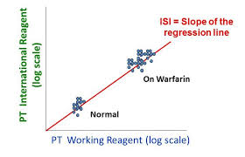
INR:
(International normalized ratio blood test)
برای اصلاح تفاوت های مر بوط به اندازه گیری PT در آزمایشگاه های مختلف که ناشی از تفاوت درمواد شیمیایی مصرفی برای انجام تست است
INR = (patient PT/mean normal PT) ^{ISI}
ISI : international sensitivity index for each batch of thromboplastin reagent by manufactures

Slide 28
Exercise 3 (CBC)
What do you think?
The patient is:
A 19 yr/ female
CC: poor appetite and low body Wt
No comorbidities
Lab tests:
FBS = 79
TG = 120
Total Chol = 194
Hg = 9.5
Hct = 30
MCV = 69
MCH = 25
RDW = 16

Slide 29
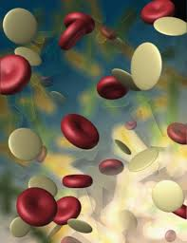
Complete Blood Count
(CBC)

Slide 30
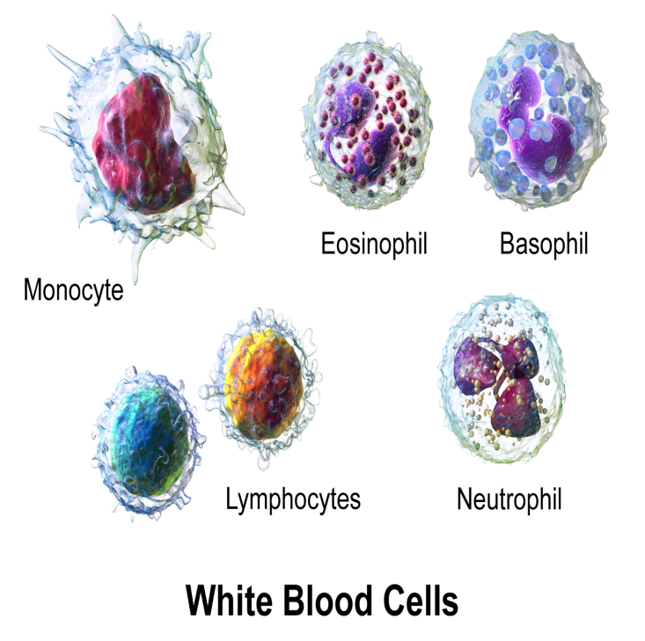
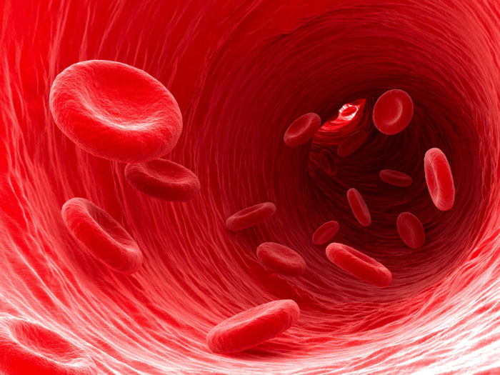
CBC
Diff
RBC (red blood cell)
Hemoglobin (Hgb)
Hematocrit (Hct)
Mean cell volume (MCV)
Mean cell hemoglobin (MCH)
Mean cell hemoglobin concentration (MCHC)
White blood cell count (WBC)
Plt
RDW
Neutrophils 55-70%
Lymphocytes 20-40%
Monocyte 2-8%
Eosinophil 1-4%
Basophil 0.5-1%

Slide 31
RBC Indexes
MCV = average red blood cell size
The MCV is measured directly by a machine
MCV: 80 - 100 femtoliter
MCH = Hemoglobin amount per red blood cell
MCH = Hgb/RBC count
27-31 picograms (pg)/cell in adult
MCHC = The amount of hemoglobin relative to the size of the cell (hemoglobin concentration) per red blood cell
MCHC = Hgb/Hct
MCHC: 32-36 g/dL in adult

Slide 32
Assessment of Anemias
Iron deficiency anemia
Hct
% RBC in total blood volume
Usually it is 3 times the Hgb
Affected by : - High WBC
- Hydration status
- High altitude
Hgb
A more direct measure of iron deficiency (quantifies total Hgb in RBC not a % of blood volume)

Slide 33
Serum Iron
Amount of circulating iron that is bound to transferrin
Poor index of iron status :
Large day to day changes
Durnal variations (highest between 6-10 AM)
Total iron binding capacity (TIBC)
Transferrin binds ferric iron
TIBC usually increases in iron deficiency

Slide 34
Ferritin
Storage protein for iron
A small amount of it leaks into the circulation (1 ng/ml of ferritin is approximately 8 mg of stored iron)
An indicator of body iron storage pool
It is an acute phase reactant (elevates in 1 to 2 days after onset of acute illness , peaks at 3 to 5 days)
Infection, metastatic cancer, acute inflammation, lymphoma ,…

Slide 35
RDW (red blood cell distribution width)
11.5 – 14.5%
نشانگری برای تعیین تنوع سایز RBC
افزایش آن بیانگر تنوع بیشتر در سایزRBC ها است
افزایش RDW + کاهش MCV : آنمی فقر آهن - تالاسمی
افزایش RDW + افزایش MCV : آنمی ناشی از کمبود فولات و ویتامین B12
RDW نرمال + کاهش MCV : تالاسمی
در تالاسمی مینورRDW نرمال است.

Slide 36
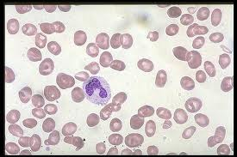
Anemia of vitamin B12 / folate deficiency
Folate
RBC Folate is calculated by measuring the difference between whole blood folate and serum folate
Vitamin B12
Is measured in the serum
Schilling test for vitamin B12
Notes:
This test may be performed in four different stages to find the cause of low vitamin B12 levels.
Stage I: You will get two doses of vitamin B12 (cobalamin). You will take a small, first dose (a radioactive form of B12) by mouth. You will a second, larger dose by a shot 1 hour later. You will need to collect your urine over the next 24 hours, and deliver it to a lab or your doctor's office. The urine will be checked to see if you are absorbing vitamin B12 normally. For information on collecting the urine sample, see: 24-hour urine collection
If Stage I is abnormal, Stage II may be done 3 - 7 days later.
Stage II: You are given radioactive B12 along with intrinsic factor. Intrinsic factor is a protein produced by cells in the stomach lining. The body needs it so the intestines can absorb vitamin B12 efficiently.
Stage II of the test can tell whether low vitamin B12 levels are caused by problems in the stomach that prevent it from producing intrinsic factor.
If a Stage II test is abnormal, a Stage III test is performed.
Stage III: This test is done after you have taken antibiotics for 2 weeks. It can tell whether abnormal bacterial growth has caused the low vitamin B12 levels.
Stage IV: This test determines whether low vitamin B12 levels are caused by problems with the pancreas. With this test, you will take pancreatic enzymes for three days, followed by a radioactive dose of vitamin B12.
Folate values can be measured using either a serum/plasma folate or a red cell folate assay. National guidelines indicate that a negative folate balance seen in hospital patients can result in a low serum folate value without folate deficiency

Slide 37

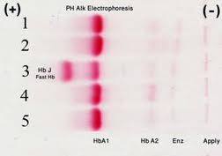
Complementary tests
Stool Exam (OB - parasite )
Hb electrophoresis
Notes:
Serum iron / TIBC = 32 / 460 = 6%
Nl >15%
Hb A2 > 3% in minor tal

Slide 38
Exercise 4 (Lipid profile, BS)
What do you think?
The patient is:
A 51 yr/ male
Ht of DM since 7 years ago
Referred by endocrinologist for wt reduction
Lab tests:
FBS = 250
HbA1c = 9.2
TG = 210
Total Chol = 220
HDL = 28
LDL = 150
UA
  Albumin trace
  Glucose 2+
  Ketone body Neg

Slide 39
Blood Glucose
FBS
BS
Glucose Tolerance Test
HBA1C

Slide 40
FBS & BS
 For FBS an 8 hour fasting is mandatory
Criteria for the Diagnosis of DM
Plasma Glucose | Impaired Fasting Glucose (mg/dl) | Impaired Glucose Tolerance (mg/dl) | DM (mg/dl)
Fasting | >/= 100 and <126 | - | >126
2-Hour Post-load | - | >/=140 and <200 | >200
random | - | - | >/=200 with symptoms

Slide 41
Diabetes can be provisionally diagnosed with:
any one of the three criteria listed below. In the absence of unequivocal hyperglycemia with acute metabolic decompensation the diagnosis should be confirmed, on a subsequent day, by any one of the same three criteria.
A fasting plasma glucose of >126 mg/dl (after no caloric intake for at least 8 hours) or,
A casual plasma glucose >200 mg/dl (taken at any time of day without regard to time of last meal) with classic diabetes symptoms: increased urination, increased thirst and unexplained weight loss or,
An oral glucose tolerance test (OGTT) (75 gram dose) of >200 mg/dl for the two hour sample. Oral glucose tolerance testing is not necessary if patient has a fasting plasma glucose level of >126 mg/dl.
The fasting plasma glucose is the preferred test because of its ease of administration, convenience, acceptability to patients, and lower cost in comparison to the OGTT.

Slide 42
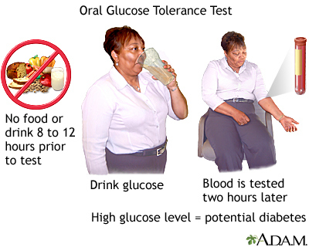

Slide 43
Glucose Tolerance Test
Oral Glucose Tolerance Test (OGTT)
  Is the standard for diagnosis of DM
  Defined by WHO:75 gr glucose load
Gestational DM
Plasma Glucose (mg/dl) | 50 gr screening test (mg/dl) | 75 gr diagnostic test (mg/dl) | 100 gr diagnostic test (mg/dl)
Fasting | - | >/= 95 | >/= 95
1 hr | >/= 140 | >/= 180 | >/= 180
2 hr | - | >/= 155 | >/= 155
3 hr | - | - | >/= 140
Notes:
GDM:2-5% of all pregnancies (up to 15%)
Accounts for 90% of diabetes during pregnancy
Screening 24-28weeks over 25 yr or
BMI>25 or BMI 18-25 with central obesity
Habitually sedentary lifestyle
First degree relative with DM(sibling, parent)
High risk ethnic population
Delivered a baby >4kg, unexplained perinatal death Hx of GDM
HTN(>140/90)
HDL<35 and/or TG>250
Impaired glucose tolerance test(plasma glucose >/=140 but<200 during 2 hour after 75 gr oral glucose tolerance test or impaired fasting glucose (plasma glucose 100-125)
Have other clinical conditions with insulin resistance(PCOS, acanthosis nigricans)
HX of vascular disease esp. cardiovascular, cerebrovascular
OGTT is the standard but FPS is simpler, cheaper, equally accurate, faster to perform, more reproducable and convinient so FPG is used for routin diagnosis
HIGH RISK pregnancy should be tested at the first
antipartum visit and if negative, again at 24-28 weeks.
AVERAGE RISK pregnancy should be
tested at 24-28 weeks.
LOW RISK pregnancy does not require glucose testing. (Low risk
criteria include age<25 years, normal pre-pregnancy weight, low
ethnic prevalence
of GDM, no history of poor obstetric outcome and no history of
abnormal glucose tolerance or first-degree relatives with diabet
es)

Slide 44
HbA1C
The A1C test measures the average blood glucose for the past 3 months.
The patient doesn’t have to fast or drink anything.
It shows how well diabetes is being controlled.
Diabetes is diagnosed at a HbA1C of greater than or equal to 6.5%
  Normal: Less than 5.7%
  Pre-diabetes: 5.7% to 6.4%
  Diabetes: 6.5% or higher
Notes:
No special preparation is needed.
Situations where HbA1c is not appropriate for diagnosis of diabetes:
ALL children and young people
Patients of any age suspected of having Type 1 diabetes
Patients with symptoms of diabetes for less than 2 months
Patients at high diabetes risk who are acutely ill (e.g. those requiring hospital admission)
Patients taking medication that may cause rapid glucose rise e.g. steroids, antipsychotics
Patients with acute pancreatic damage, including pancreatic surgery
In pregnancy
Presence of genetic, haematologic and illness-related factors that influence HbA1c and its measurement - see Annex 1 from WHO report

Slide 45
What is prediabetes?
Prediabetes is a condition when blood glucose is higher than normal but not high enough to be diabetes
This condition puts the patient at risk for developing type 2 diabetes
Results indicating prediabetes are:
  An A1C of 5.7% – 6.4%
  Fasting blood glucose of 100 – 125 mg/dl
  An OGTT 2 hour blood glucose of 140mg/dl – 199 mg/dl

Slide 46
Criteria for testing for diabetes in asymptomatic adult individuals
Testing for diabetes should be considered in all individuals at age 45 years and above, particularly in those with a BMI >25 kg/m2* and, if normal, should be repeated at 3-year intervals.
Testing should be considered at a younger age or be carried out more frequently in individuals who are overweight (BMI >25 kg/m2) and have additional risk factors, as follows:
  are habitually physically inactive
  have a first-degree relative with diabetes
  have delivered a baby weighing >4 Kg or have been diagnosed with GDM
  are hypertensive (>140/90 mmHg)
  have an HDL cholesterol level <35 mg/dl and/or a triglyceride level >250 mg/dl
  have PCOS
  on previous testing, had IGT or IFG
  have a history of vascular disease

Slide 47
Lipid indexes of cardiovascular risk
8 – 12 fasting is required (no food or drink, except water)
LDL
Friedewald formula :
LDL = TC - -HDL – TG/5
(TG levels should be <400 mg/dl)
Acceptable <110 mg/dl
Borderline 110-129 mg/dl
High >/= 130 mg/dl
Total cholesterol
Acceptable <170 mg/dl
Borderline 170-199 mg/dl
High >/= 200 mg/dl
HDL
Desirable > 40 mg/dl

Slide 48
LDL in more details:
  Less than 70 mg/dL for those with heart or blood vessel disease and for other patients at very high risk of heart disease (those with metabolic syndrome)
  Less than 100 mg/dL for high risk patients (e.g., some patients who have multiple heart disease risk factors)
  Less than 130 mg/dL for individuals who are at low risk for coronary artery disease
Notes:
1 mg/dl decrease in LDL results in 1-2% decrease in relative risk for CHD

Slide 49
Triglycerides (TG)
Goal is Less than 150 mg/dl
Elevated in:
  obese or diabetic patients
  eating simple sugars
  drinking alcohol

Slide 50
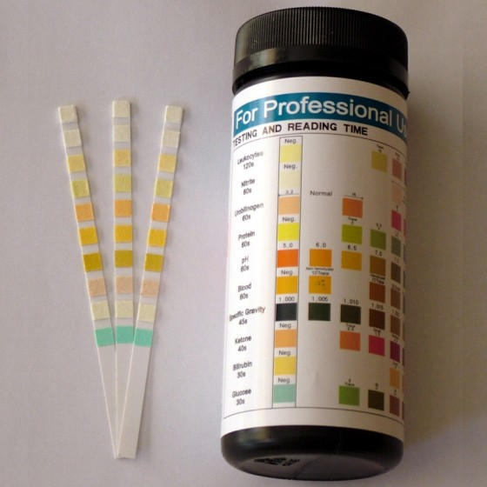
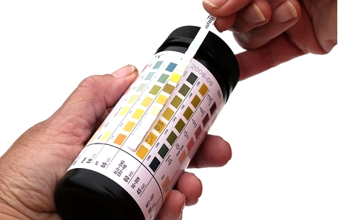
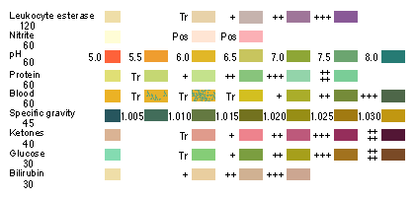
Urinalysis (UA)
Specific Gravity
PH
Protein
Glucose
Ketones
Blood
Bilirubin
Urobilinogen
Nitrite
Leukocyte esterase

Slide 51
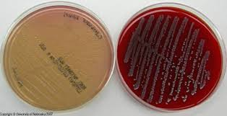
Urine Culture - Antibiogram

Slide 52
ESR
Erythrocyte sedimentation rate (ESR) measures how fast red cells fall through a column of blood
It is an indirect index of acute phase protein concentrations
It is a sensitive but nonspecific index of plasma protein changes which result from inflammation or tissue damage
The ESR is affected by:
  hematocrit variations
  red cell abnormalities (eg sickle cells)
  delay in analysis (more than four hours)
  Age
  Sex
  menstrual cycle
  Pregnancy
  drugs (eg steroids).

Slide 53
ESR (continued)
A normal ESR does not exclude organic disease
A mildly elevated ESR of 20-30 mm/hour probably doesn't mean very much in itself
Very high ESR: infection, collagen vascular disease or metastatic malignancy
When an increased rate is encountered with no obvious clinical explanation, the physician should repeat the test after an appropriate interval rather than pursue an exhaustive search for occult disease.
ESR is more useful than CRP for diagnosis and monitoring of polymyalgia rheumatica or temporal arteritis and possibly, rheumatoid arthritis
Notes:
Low ESR: polycythaemia, hypofibrinogenaemia, congestive cardiac failure, spherocytosis, sickle cells.
ESR is useful in monitoring these conditions and may predict relapse in patients with Hodgkin's disease

Slide 54
CRP
C-reactive protein is produced by the liver.
CRP level rises when there is inflammation in the body.
Normal CRP values vary from lab to lab. Generally, there is no CRP detectable in the blood
A positive test means you have inflammation in the body. This may be due to a variety of different conditions:
  Cancer
  Connective tissue disease
  Heart attack
  Infection
  Inflammatory bowel disease (IBD)
  Lupus
  Pneumococcal pneumonia
  Rheumatoid arthritis
  Rheumatic fever
  Tuberculosis
Notes:
highly sensitive test called hs-CRP to help determine your risk of heart disease. According to the American Heart Association:
You are at low risk of developing cardiovascular disease if your hs-CRP level is lower than 1.0mg/L
You are at average risk of developing cardiovascular disease if your levels are between 1.0 and 3.0 mg/L
You are at high risk for cardiovascular disease if your hs-CRP level is higher than 3.0 mg/L

Slide 55
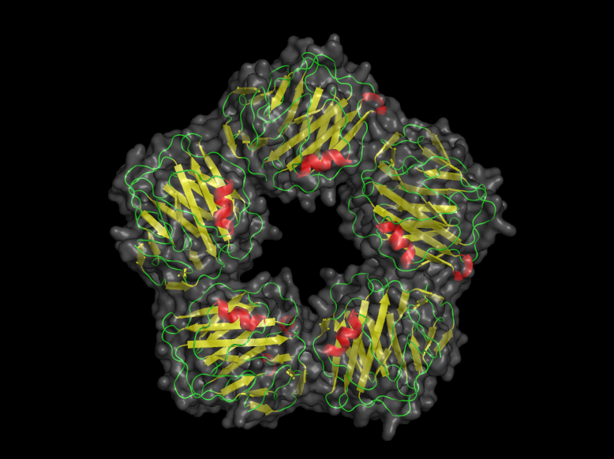
Remember …
Positive CRP results also occur during the last half of pregnancy or with the use of birth control pills (oral contraceptives).
hs-CRP (Risk CVD)
  < 1.0mg/L = low risk
  1-3 = average risk
  > 3 = high risk

Slide 56
Uric Acid
Is produced from the natural breakdown of body's cells and from the foods we eat.
High levels of uric acid in the blood can cause gout , kidney stones
A uric acid blood test is done to:
  Help diagnose gout
  Check to see if kidney stones may be caused by high uric acid levels in the body
  Check to see if medicine that decreases uric acid levels is working
  Check uric acid levels in people who are undergoing chemotherapy or radiation therapy. These treatments destroy cancer cells that then may leak uric acid into the blood
Notes:
Most of the uric acid is filtered out by the kidneys and passes out of the body in urine. A small amount passes out of the body in stool. But if too much uric acid is being produced or if the kidneys are not able to remove it from the blood normally, the level of uric acid in the blood increases.
If gout remains untreated, these uric acid crystals can build up in the joints and nearby tissues, forming hard lumpy deposits called tophi.

Slide 57
High uric acid values may be caused by:
Conditions, such as:
  Kidney disease or kidney damage
  Increased breakdown of body cells
    some types of cancer (including leukemia, lymphoma, and multiple myeloma)
    cancer treatments
    Hemolytic anemia, sickle cell anemia, or heart failure.
    Disorders, such as alcohol dependence, preeclampsia, liver disease (cirrhosis), obesity, psoriasis, hypothyroidism, and low blood levels of parathyroid hormone
  Starvation, malnutrition, lead poisoning.
  A rare inherited gene disorder called Lesch-Nyhan syndrome
Medicines, such as some diuretics, vitamin C, lower doses of aspirin (75 to 100 mg daily), niacin, warfarin, cyclosporine, levodopa
Eating foods that are very high in purines, such as organ meats (liver, brains), red meats (beef, lamb), some seafood (sardines, herring), game meat, dried beans, dried peas, mushrooms
Notes:
Low values
Low uric acid values may be caused by:
Severe liver disease, Wilson's disease, or some types of cancer.
The syndrome of inappropriate antidiuretic hormone (SIADH), a condition that causes large amounts of fluid to build up in the body.
Not eating enough protein.
Sulfinpyrazone, large amounts of aspirin (1,500 mg or more daily), probenecid(such as Probalan), and allopurinol (such as Zyloprim).
Having a high uric acid level does not mean that you have gout. If your uric acid level is high and you do not have any other symptoms, you will not need to take any medicine to decrease your uric acid level.
A high level of uric acid in the blood does not always mean that a person with a painful joint has gout. Testing the fluid taken from an affected joint for the presence of uric acid crystals is the only sure method to diagnose gout. For more information, see the medical test Joint Fluid Analysis.
Uric acid may also be measured in urine. If your blood uric acid level is high, a 24-hour urine collection may help determine whether your body is producing too much uric acid or your kidneys are not getting rid of enough of it. For more information, see the medical test Uric Acid in Urine.
Uric acid blood levels vary from day to day. The level is usually higher in the morning and lower in the evening.
Blood uric acid levels that increase during pregnancy, even if the levels remain within the normal range, may help diagnose preeclampsia.

Slide 58
Stool Exam
Occult Blood
Ova
Parasite
Undigested food in feces

Slide 59
Exercise 5 (TFT)
What do you think?
The patient is:
29 yr/ female
Returned for wt reduction F/U
Wt = 87 Kg
Ht = 163 cm
speaks slowly and has a puffy face
pale, cool, dry, and thick skin
Lab tests
TSH = 23 µIU/mL (NL= 0.5 - 4.70)
T4 = 3.8 µg/dL(NL= 4.5 - 12.5)
TG = 210
AST = 60
ALT = 64
ALP = 280
FBS = 89
Total Chol = 225
LDL = 112
HDL = 40

Slide 60
Thyroid Function Tests (TFT)
T3
T4
T3UP
TSH
Anti- TPO

Slide 61
Total T4 & Free T4
Total T4
Most of the thyroxine (T4) in the blood is attached to thyroxine-binding globulin. Less than 1% of the T4 is unattached. A total T4 blood test measures both bound and free thyroxine
Free T4
Free thyroxine affects tissue function in the body, but bound thyroxine does not
Free thyroxine (T4) can be measured
  directly (FT4)
  calculated as the free thyroxine index (FTI)
The FTI tells how much free T4 is present compared to bound T4. The FTI can help tell if abnormal amounts of T4 are present because of abnormal amounts of thyroxine-binding globulin

Slide 62
Triiodothyronine (T3)
Most of the T3 in the blood is attached to thyroxine-binding globulin. Less than 1% of the T3 is unattached.
A T3 blood test measures both bound and free triiodothyronine.
T3 has a greater effect on the way the body uses energy than T4, even though T3 is normally present in smaller amounts than T4.

Slide 63
TSH
Screening for thyroid dysfunction
Serum TSH normal — no further testing performed
Serum TSH high — free T4 added to determine the degree of hypothyroidism
Serum TSH low — free T4 and T3 added to determine the degree of hyperthyroidism
We measure serum free T4 if the patient has convincing symptoms of hyper- or hypothyroidism despite a normal TSH result
Notes:
Second and third generation serum TSH assays are both more sensitive and specific than serum free T4 measurements for outpatients if a single screening test is utilized [14,15]. However, some experts recommend that both serum TSH and free T4 be measured in all patients for screening purposes, since errors may be made when only TSH is measured in patients with secondary or central hypothyroidism or TSH-mediated hyperthyroidism.
This approach adds considerable cost to screening, and is likely to pick up few cases of unsuspected pituitary disease. As a result, many laboratories are using strategies such as the following to limit unnecessary laboratory testing:
Serum TSH normal — no further testing performed
Serum TSH high — free T4 added to determine the degree of hypothyroidism
Serum TSH low — free T4 and T3 added to determine the degree of hyperthyroidism

Slide 64
T3UP
Hyperthyroidism — high serum total T4, high T3-resin uptake, high free T4 index
TBG excess — high serum total T4, low T3-resin uptake, normal free T4 index
Hypothyroidism — low serum total T4, low T3-resin uptake, low free T4 index
TBG deficiency — low serum total T4, high T3-resin uptake, normal free T4 index
Notes:
The T3-resin uptake is the traditional test utilized to calculate the free hormone index. This test is performed by incubating the patient's serum with radiolabeled T3 tracer and subsequently adding an insoluble resin that traps the remaining unbound radiolabeled T3. A typical resin is dextran-coated charcoal. The value reported is the percent tracer bound to the resin, which varies inversely with the number of available free binding sites for T3. The number of free binding sites is determined by both binding protein levels and endogenous hormone production.
The normal range varies considerably among laboratories. While many laboratories still report the actual measured value for the T3 resin, it is preferable to calculate a THBR or THBI (thyroid hormone binding ratio or index), which is simply a normalized T3-resin uptake value [12]:
THBI = patient's T3 resin ÷ normal pool T3 resin
The mean THBI is therefore by definition 1.00, with a normal range of approximately 0.83 to 1.16.
The free T4 index approximates the free T4 by dialysis and is calculated by "correcting" the total T4 by the binding ratio or index:
Free T4 index = total T4 x THBI
If the index is calculated by using the T3-resin measurement directly, the result is a unitless number with a normal range distinct for the laboratory. If, on the other hand, the index is calculated using the THBI, the index should have approximately the same normal range as the total T4 values for the laboratory.
The T3-resin uptake was designed to distinguish TBG excess and deficiency from hyperthyroidism and hypothyroidism.
Hyperthyroidism — high serum total T4, high T3-resin uptake or THBI, high free T4 index
TBG excess — high serum total T4, low T3-resin uptake or THBI, normal free T4 index
Hypothyroidism — low serum total T4, low T3-resin uptake or THBI, low free T4 index
TBG deficiency — low serum total T4, high T3-resin uptake or THBI, normal free T4 index
However, the index may not fully correct at the extremes of binding protein abnormalities.
A serum free T3 index can also be calculated using the THBI.
Measurement of free T4 by equilibrium dialysis is available only in a few reference laboratories. The classic technique measures the distribution of radiolabeled T4 tracer across a dialysis membrane to estimate the unbound fraction. The method is too tedious and expensive for routine use.

Slide 65
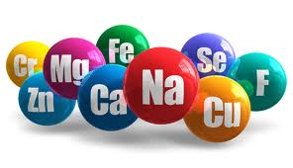
Micronutrients
Sodium
Potassium
Calcium
Phosphorous
Magnesium
Ceruloplasmin
Copper
Zinc
25(OH)D - 1,25(OH)D
Retinol
Folate
B12

Slide 66
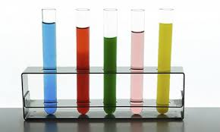
Others
Hormones
  Insulin
  ACTH
  Cortisol
Serum protein electrophoresis

Slide 67

Thank you for your attention ….

