Slide 1
PARENTERAL NUTRITION
Dr Abdolreza Norouzy
Assistant Professor in Clinical Nutrition
Mashad Medical School

Slide 2
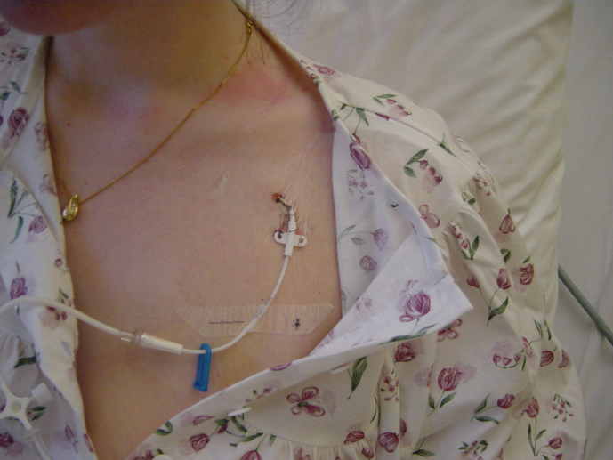
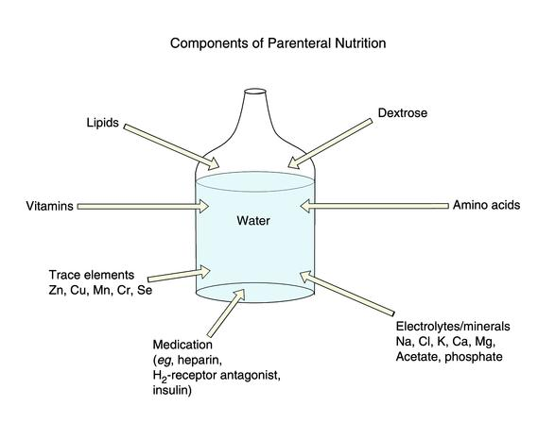
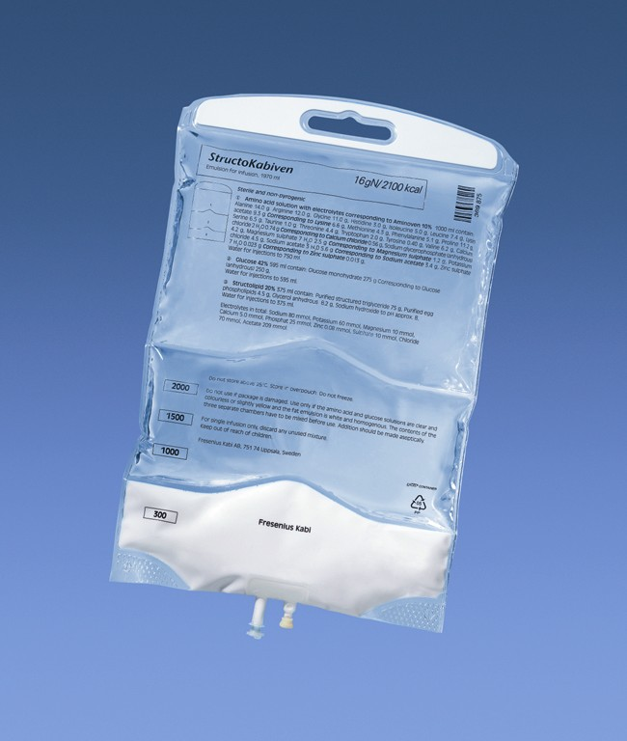
Total parenteral Nutrition
Notes:
2

Slide 3
Total Parenteral Nutrition
Normal Diet TPN
  Protein……………..…...Amino Acids
  Carbohydrates………….Dextrose
  Fat……………………….Lipid Emulsion
  Vitamins…………………Multivitamin Infusion
  Minerals…………...…….Electrolytes and Trace Elements

Slide 4
Parenteral Nutrition
GENERAL INDICATIONS
TPN FORMULATION
STABILITY
COMPATIBILITY

Slide 5
Total Parenteral Nutrition
Supplementary Parenteral Nutrition

Slide 6
Risk
Food is absorbed partially from GI tract, the absorption is controlled in the bowel to supply the patients needs eg trace elements
All IV nutrients should be metabolized
Overfeeding is easy
Different metabolism of nutrients in organ failure or injured patients

Slide 7
Total Parenteral Nutrition
A.S.P.E.N Guidelines *
Severe stress or malnutrition NPO > 4-5 days
Moderate stress or malnutrition NPO > 7-10 days
Non-stressed / normal nourished NPO > 10 days
No indication for TPN < 4 days
*Based on opinion of authors.
Also see:
A.S.P.E.N. Board of Directors: Guidelines for the use of parenteral and enteral nutrition in adult and pediatric patients. JPEN 26: No.1, Suppliment
January-February 2001

Slide 8
Requirements’ calculation

Slide 9
Fluid requirement
Energy requirement
Protein requirement
CHO/Protein
Micronutrients

Slide 10
Total Parenteral Nutrition: fluid requirement
Water Requirements
  Maintenance: 30-35 ml/kg/d
  Generally 2-3 L per day

Slide 11
How much volume to give?
Cater for maintenance & on going losses
Normal maintenance requirements
  By body weight
    25-55 year 35 cc/kg
    56-65 year 30 cc/kg
Add on going losses based on I/O chart
Consider insensible fluid losses also
    add 13% for every ºC rise in temperature

Slide 12
Energy
The aim
should be to provide 25–30 kcal/kg BW/day.

Slide 13
Requirement of energy
 | stress
Weight | Low | Moderate | Severe
Decrease | 15 kcal/kg | 20 kcal/kg | 25 kcal/kg
Maintenance | 20 kcal/kg | 25 kcal/kg | 30 kcal/kg
Increase | 25 kcal/kg | 30 kcal/kg | 35 kcal/kg

Slide 14
Caloric requirements: the other way!
Based on Total Energy Expenditure
  Can be estimated using predictive equations
    TEE = BEE × Stress Factor × Activity Factor

Slide 15
Caloric requirements (cont1)
Stress Factor
Malnutrition 1.3
peritonitis 1.15
soft tissue trauma 1.15
fracture 1.2
fever (per ºC rise) 1.13
Moderate infection 1.2
Severe infection 1.4
<20% BSA Burns 1.5
20-40% BSA Burns 1.8
>40% BSA Burns 2

Slide 16
Protein
Usual stress | 0.8-1 g/kg
Mild stress | 1.25 g/kg
Moderate stress | 1.5 g/kg
Sever stress | 1.75-2 g/kg

Slide 17
How much protein to give?
Based on non pro calorie / nitrogen ratio
Based on degree of stress & body weight (BW)
Based on Nitrogen Balance (NB)

Slide 18
Total Parenteral Nutrition: Amino Acids
Ideal Amino Acid Solution
  50:50 Ratio of Essential:Nonessential AA
  Wide Variety of Nonessential AA
  Minimum of Glycine
  Substantial amounts of Branch Chained AA

Slide 19
Total Parenteral Nutrition: Carbohydrate
  Give 40-60% of non-protein calories as dextrose

Slide 20
How much CHO?
  CHO usually form 40-60 % of calories
  Commercial CHO consist anhydrous dextrose
  monohydrate in sterile water
  These are available in concentration
  ranging 5% to 70% & contain 3.4 kcal/g of
  dextrose
  Not more than 5 mg / kg / min Dextrose
    (less than 7 g / kg / day)

Slide 21
How much Fat?
  Fats usually form 25 to 30% of calories
  Not more than 40 to 50%
  Increase usually in severe stress
  Aim for serum TG levels < 350 mg/dl s

Slide 22
How much Fat? (cont)
  Three concentration 10%, 20% & 30% are
  available
  Lipid emulsion 10% have 1.1 kcal/ml, 20%
  have 2 kcal/ml & 30% have 3 kcal/ml
  Not more than 50 cc/hr Lipid
    (less than 1 g / kg / day)

Slide 23
Total Parenteral Nutrition
Electrolytes
Elect. | Daily Requirement | Standard Concentration
Na | 60-150 meq | 35-50 meq/L
K | 40-240 meq | 30-40 meq/L
Ca | 3-30 meq | 5 meq/L
Mg | 10-45 meq | 5-10 meq/L
Phos. | 30-50 mM | 12-15 mM/L

Slide 24
Electrolyte Requirements
Cater for maintenance + replacement needs
  Na 1 to 2 meq/kg/d
  K⁺ 1 to 2 meq/kg/d
  Mg⁺⁺ 0.35 to 0.45 meq/kg/d
  Ca⁺⁺ 0.2 to 0.3 meq/kg/d
  PO₄²⁻ 20 to 30 mmol/d

Slide 25
Standard electrolytes solution
Na 35 meq/L
K 28.8 meq/L
Ca 5 meq/L
Phos 4.5 mmol/L
Cl 35 meq/L
Acetate 29.5 meq/L

Slide 26
Trace Elements Requirements
    Zn 2.5-5 mg/day
    Cr 10-15 mg/day
    Cu 0.3 to 0.5 mg/day
    Mn 0.15 to 0.8 mg/day

Slide 27
Total Parenteral Nutrition
Trace Elements
  Zinc Poor wound healing
  Copper Anemia
  Chromium Glucose Intolerance
  Selenium Keshan’s Disease

Slide 28
Total Parenteral Nutrition
Trace Elements
Why not iron?
  Stores of 3-4 gm.
  Average daily loss of 1 mg.
  Other trace elements:
    Molybdenum*
    Iodine*
    Cobalt
    Vanadium
    Nickel
    Flouride
    *contained in MTE-7

Slide 29
Total Parenteral Nutrition
Vitamins
Recommendations per NAG
  Multivitamin Infusion 10 ml
  Contain all essential vitamins
  MVI-Adult(Mayne) or Infuvite (Baxter)
  Fat soluble: A, D, E, K
  Water soluble: Thiamine, Riboflavin, Niacin, Pantothenic Acid, Pyridoxine, C, Folic Acid, B12, Biotin
  In 2004 Vitamin K added per FDA recommendations

Slide 30
Osmolarity of solution
Calculated by adding the osmolarity of
the solutions to be infused
Estimation:
      Grams of dextrose × 5 ( per L)
      Grams of AA × 10 ( per L)
      electrolytes, vitamins, minerals add
      300- 400 mOsm/L
      IV fat is isotonic

Slide 31
Example
solution of 500 ml 50% dextrose and
500 ml 8.5% AA plus electrolytes, min
and vitamins has osmolarity of:
(50 × 5 × 5) + (8.5 × 5 × 10) + (300 to 400)
= 1975 to 2075 mOsm/L

Slide 32
Which rate to start?
What rate:
  50% of calculated energy for 24 hour
  75% for day 2
  100% day 3 after LFT and BS control

Slide 33
Transitional Feeding
A process of moving from one type of feeding to another with multiple feeding methods used simultaneously
Examples:
parenteral feeding to enteral feeding
parenteral feeding to oral feeding
enteral feeding to oral feeding

Slide 34
Transitional Feeding: parenteral to enteral
Introduce enteral feeding – 30 cc/hr while giving parenteral
If tolerated, gradually ↓ parenteral while increasing enteral
Once pt tolerate 75% of needs enterally, d/c parenteral
Process is called a stepwise decrease
Use step-wise decrease method; wait until pt accepting 75% oral and then decrease parenteral or enteral method

Slide 35
Total Parenteral Nutrition
PERIPHERAL CATHETER
CENTRAL CATHETER
  TPN Osmolarity
  generally 1000-2000 mOsm/L
    Subclavian
    Internal Jugular
    PICC
    Hickman
    Groshong

Slide 36
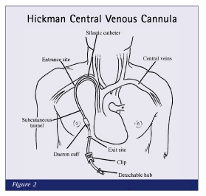
TC

Slide 37


Slide 38
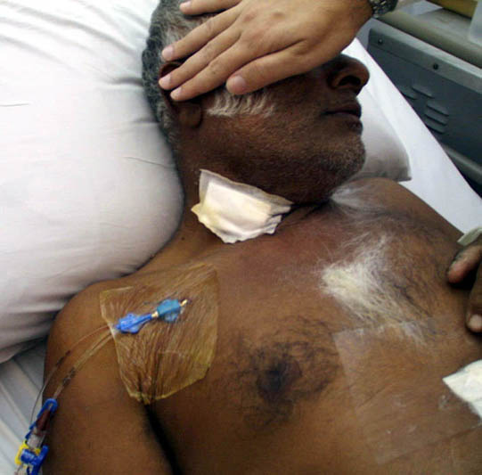

Slide 39
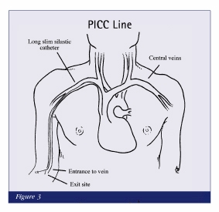
PICC

Slide 40


Slide 41
SUMMARY
Mean for a 75 kg patient
Energy: 30 kcal/kg
Glucose: 5 g/kg
Triglyceride: 1 g/kg
Essential FA: 0.02-0.04 g/kg
Protein: 0.8-1.8 g/kg

Slide 42
Na: 1 mmol/kg
K: 1 mmol/kg
Ca: 0.05 mmol/kg
Mg: 0.15 mmol/kg
Phosphate: 0.2 mmol/kg
Water: 30 ml/kg

Slide 43
Vitamin A (retinol): 1000 µg
Vitamin D (cholecalciferol): 5-10 µg
B complex, vitamin E, Vitamin C
Iron, zinc, copper, iodide, chromium
Soluvit, addamel, neurobion, vitalipid, adiphos

Slide 44
PN admixtures
Bottles with single components
Bottles with combined components
Two-in-one admixtures
All-in-One admixtures

Slide 45
All-in-One (AIO) admixtures
Complex pharmaceutical formula
Oil/water emulsion
Incompatibilities issues
Stability issues
Impact on safely, quality and effectiveness of PN
More prominent if drugs are added to the admixture
New plastic materials for lipid containing (EVA)

Slide 46
Multi-bottle system
Partial PN admixtures
All-in-one admixtures

Slide 47
Multi-bottle system
Glucose
Amino acids
Triglycerides
Electrolytes
Trace elements
Vitamins

Slide 48
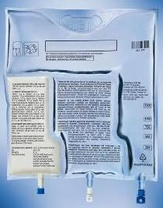

Slide 49
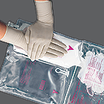

Slide 50
Advantages of AIO
Reduced
infection complications
Metabolic complications
Intolerance
Mechanical complications
Errors in handling of bottles
Quality of life
Costs (long term and short term)

Slide 51
Exceptions of AIO
Neonates
Home parenteral nutrition
Special nutrient requirement

Slide 52
2:1 or 2 in one PN admixtures
Amino acids, glucose and electrolytes in one bag
Bottle of lipids is infused in parallel

Slide 53
ترکیبات موجود تغذیه پرنترال

Slide 54
In Iran
Separate system is available
Intralipid and lipoven in 5% and 10%
Aminoven and aminoplasma in 5% and 10%

Slide 55
Lipid Emulsions: Formulations
LCT LCT/MCT SL OO FO
Intralipid® Lipofundin® Structolipid® ClinOleic® Omegaven®
Lipid source Soybean Coco/soy Coco/soy Olive/soy Fish
w/w% 100% 50/50% 36/64% 80/20% 100%
Fat (g/l) 200 200 200 200 100
Phospholipid
(g/l) 12 12 12 12 12
Glycerol (g/l) 22 25 22.5 22.5 25
pH 8.0 6.5-8.5 8.0 7.0-8.0 7.5-8.7
Osmol (mosm/l) 350 380 350 270 273
Energy (kcal/l) 2000 1908 1960 2000 1120
n-6/n-3 7:1 7:1 7:1 9:1 0.08:1
α-toc (μmol/l) 87 502 16 75 505
Notes:
55

Slide 56
Trace elements and fat soluble vitamins is not available widely
Addamel as a very good source of trace elements
Vitamin B-complex ampules
Vitamin C ampules

Slide 57
PN workload
Dietitian/nutritionist:
  Indication (nutritional)
  Requirement calculations
  Monitoring
Physician:
  Indication/contraindication
  Monitoring procedures

Slide 58
Nurses:
  Administration
  Procedures
  Equipments
Pharmacists:
  Purchasing and stock control
  Compounding
  Compatibility with other medications

Slide 59
Incompatibility issues
Oil/water emulsions
Lipid peroxidation
Oxidative loss of vitamin C, vitamin B2 and vitamin A
Electrolyte precipitations (physical stability)
  Ca and phosphate

Slide 60
Immunonutrition
Reduce immune impairment
  Specially in post operative patients
In ICU reduces mortality and morbidity
Arginine
Omega-3 FA
Glutamine

Slide 61
COMPLICATIONS

Slide 62
Mechanical
Metabolic
Infections

Slide 63
Total Parenteral Nutrition
Compatibility
Calcium-Phosphate compatibility
  Factors which affect stability
    Additive concentration
    Choice of calcium salt
    Order of mixing
    Amino acid product (brand)
    Amino acid concentration
    Dextrose Concentration
    Temperature (not what you think)
    Storage time
    Addition of l-cysteine (neonatal)

Slide 64
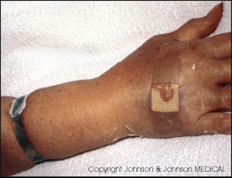
IV-Related Phlebitis

Slide 65
Metabolic complications of PN
Refeeding syndrome
Hyperglycemia
Acid-base disorders
Hypertriglyceridemia
Hepatobiliary complications (fatty liver, cholestasis)
Metabolic bone disease
Vascular access sepsis

Slide 66
Refeeding Syndrome
Patients at risk are malnourished, particularly marasmic patients
Can occur with enteral or parenteral nutrition
Results from intracellular electrolyte shift

Slide 67
Refeeding Syndrome Symptoms
Reduced serum levels of magnesium, potassium, and phosphorus
Vitamin deficiency (vitamin B1)
Interstitial fluid retention
Cardiac decompensation and arrest

Slide 68
Refeeding Syndrome Prevention/Treatment
Monitor and supplement electrolytes, vitamins and minerals prior to and during infusion of PN until levels remain stable
Initiate feedings with 15-20 kcal/kg or 1000 kcals/day and 1.2-1.5 g protein/kg/day
Limit fluid to 800 ml + insensible losses (adjust per patient fluid tolerance and status)
Fuhrman MP. Defensive strategies for avoiding and managing parenteral nutrition complications. P. 102. In Sharpening your skills as a nutrition support dietitian. DNS, 2003.

Slide 69
Monitoring for Complications
Malnourished patients at risk for refeeding syndrome should have serum phosphorus, magnesium, potassium levels monitored closely at initiation of SNS. (B)
ASPEN BOD. Guidelines for the use of enteral and parenteral nutrition in adult and pediatric patients. JPEN 26;41SA, 2002

Slide 70
Monitoring: blood glucose
In patients with diabetes or risk factors for glucose intolerance, SNS should be initiated with a low dextrose infusion rate and blood and urine glucose monitored closely. (C)
Blood glucose should be monitored frequently upon initiation of SNS, upon any change in insulin dose, and until measurements are stable. (B)
ASPEN BOD. Guidelines for the use of enteral and parenteral nutrition in adult and pediatric patients. JPEN 26;41SA, 2002

Slide 71
Monitoring: electrolytes
Serum electrolytes (sodium, potassium, chloride, and bicarbonate) should be monitored frequently upon initiation of SNS until measurements are stable. (B)
ASPEN BOD. Guidelines for the use of enteral and parenteral nutrition in adult and pediatric patients. JPEN 26;41SA, 2002

Slide 72
Monitoring: lipid profile
Patients receiving intravenous fat emulsions should have serum triglyceride levels monitored until stable and when changes are made in the amount of fat administered. (C)

Slide 73
Complications: Liver function tests
Liver function tests should be monitored periodically in patients receiving PN. (A)

Slide 74
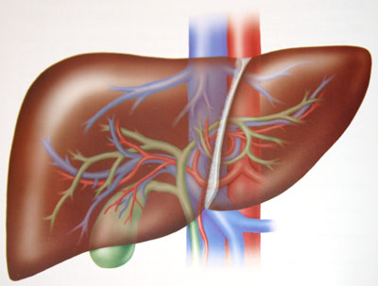
Influence of parenteral lipids
on liver function

Slide 75

PN-induced liver dysfunction
Intrahepatic cholestasis:
low-grade inflammation in many HPN pts
AF and γGT ≈ TNFα, IL-6, ESR
calories and CH in TPN
Steatosis: micro- & macrovesicular
Steatohepatitis ≈ NASH; > risk for end-stage LD
Severity: Mild: 30-40% (1.5-2 x normal)
End-stage: 5-15%
Buchman, Hepatology 2006
Notes:
75

Slide 76
PN-induced liver function #: risk factors
PN duration
Small bowel length
SBBO (small bowel bacterial overgrowth): chronic portal endotoxin
Disrupted bile acid pool: Δ bile (cholesterol ↑)
↓ bile flow
Excessive carbohydrate (“foie gras”) / total calories
Antioxidant ↓: vit C, E; Selenium
Lipid overload / lipid peroxidation
Buchman, Hepatology 2006
Notes:
76

Slide 77
TPN-induced liver dysfunction: treatment
Metronidazole (?)
Enteral nutrition
Ursodeoxycholic acid (?)
Choline (?)
ERCP / cholecystectomy:
100% sludge after 6 wks of TPN
End-stage: liver (and small bowel) Tx
Withhold TPN
Alter lipid formulation: OO to LCT/MCT to SL (to FO??)
Notes:
77

Slide 78
Complications: Glycaemic Control
Until recently, BG<200 mg/dl was tolerated in critically ill patients.
Now greater attention is given to glycemic control due to evidence that glucose is associated with morbidity/mortality and risk of infection
New recommendation is to keep BG<150 mg/dl or as close to normal as possible
Van den Berghe et al. NEJM, 2001

Slide 79
But now
Conventional control of blood sugar (BS >140mg) is recommended (NICE-SUGAR study, NEJM, 2009)

Slide 80
Acute Inpatient PN Monitoring
Parameter | Daily | Frequency 3x/week | Weekly
Glucose | Initially | √
Electrolytes | Initially | √
Phos, Mg, BUN, Cr, Ca |  | Initially | √
TG |  |  | √
Fluid/Is & Os | √
Temperature | √
T. Bili, LFTs |  | Initially | √

Slide 81
Inpatient Monitoring PN
Parameter | Daily | Frequency Weekly | PRN
Body Weight | Initially | √
Nitrogen Balance |  | Initially | √
HGB, HCT |  | √
Catheter Site | √
Lymphocyte Count | √ |  | √
Clinical Status

Slide 82
Monitoring: Malnutrition
Serum Hepatic Proteins
Parameter t ½
Albumin 19 days
Transferrin 9 days
Prealbumin 2 – 3 days
Retinol Binding Protein ~12 hours

Slide 83
Fluid Excess
Critically ill pts and those with cardiac, renal, hepatic failure may require fluid restriction
May need to restrict total calories to reduce total volume
Use most concentrated source of PN components (50% dextrose = 2 kcal/ml; 20% lipid = 2 kcal/ml)
PPN may be contraindicated due to fluid volume of 2-4 liters

Slide 84
متشکرم.

