Slide 1
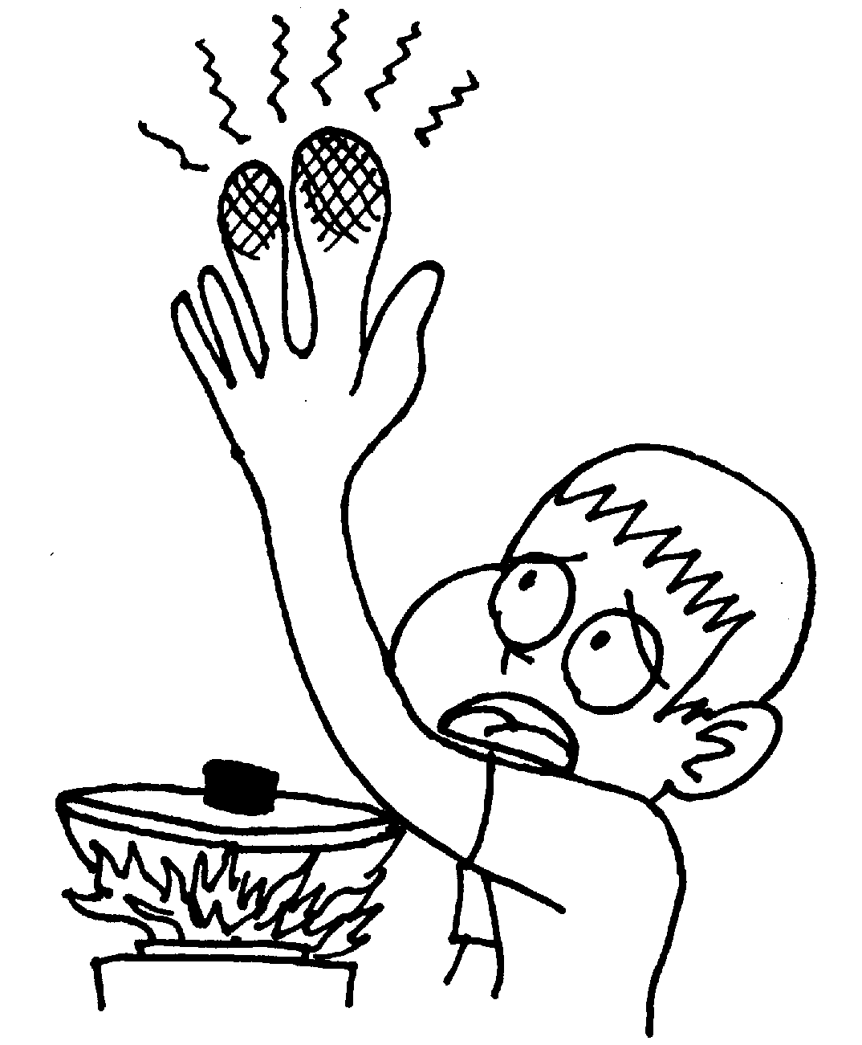
حمایتهای تغذیه ای در بیماران سوختگی
دکتر عبدالرضا نوروزی
متخصص تغذیه و فلوشیپ بیماریهای متابولیک
دانشیار دانشکده پزشکی مشهد

Slide 2
Identify the types and degree of burns
Understand the bodies metabolic, hormonal, and immune response to burn
Identify proper energy requirements for burn victims
Understand the significant of CHO, protein and fat in burn patients
Recognize the vitamins and minerals important in burn healing

Slide 3
Four types of burn
Thermal
Radiation
Chemical
Electrical

Slide 4
Burn injury
Severity depends on:
  Depth of burn
  Extend of surface area involved

Slide 5
Skin Layers
Epidermis
  Tough protective barrier
Dermis
  Contains blood vessels, nerve endings
  Prevents water loss due to evaporation
  Prevents loss of body heat

Slide 6
Functions of Skin
Protection Heat regulation
Sensory perception
Excretion
Vitamin D production
Expression
  important with body image
  fear of disfigurement

Slide 7
Rule of Nines
Estimation of total burn area
Percentage of total body area
Head & Neck: 9%
Arm: 9%
Trunk: 18% each side
Genitalia & perineum: 1%
Leg: 18% each

Slide 8
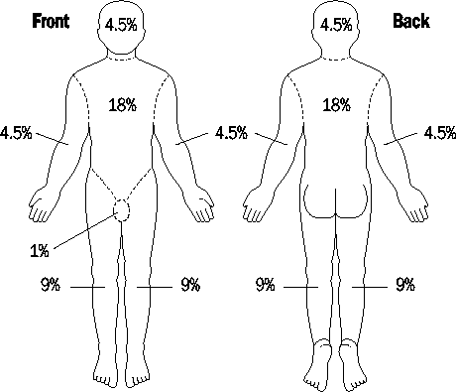

Slide 9
Degree of burns
First degree burns
  Superficial, dry, red and painful
Second degree burns
  Blisters, very painful
Third degree burns
  Extends completely through dermis, less painful
Fourth degree burns
  Extends beneath fat into bone or muscle, electrcal

Slide 10
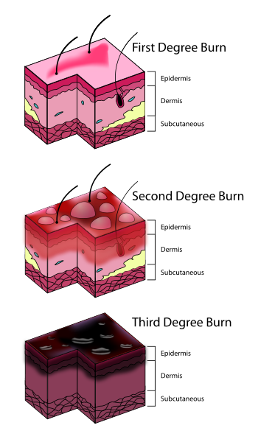

Slide 11
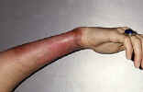
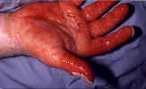
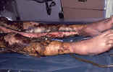
BURN INJURY (32)

Slide 12
Alternative Classification
Partial Thickness
  Superficial
  Deep
Full thickness

Slide 13
Determining Severity of Injury
Size (surface area)
Depth
Age
Prior status of health of victim
Location of burn
Severity of associated injury

Slide 14
3. Severity of burn injury
·mild: Ⅱ⁰ <10%TBS
·moderate: Ⅱ⁰ 10-30%; or
Ⅲ⁰<10%TBS
·severe: total area 30-50%; or
Ⅲ⁰ 10-20%; or with shock, airway burn, combined injury
·major: total area >50%; Ⅲ⁰ >20%; or with severe complications
BURN INJURY (27)

Slide 15
depth: superficial: Ⅰ⁰and superficial Ⅱ⁰ deep: deep Ⅱ⁰ and Ⅲ⁰ area: small area: <15% middle area: 15-30% large area: >30%
BURN INJURY (28)

Slide 16
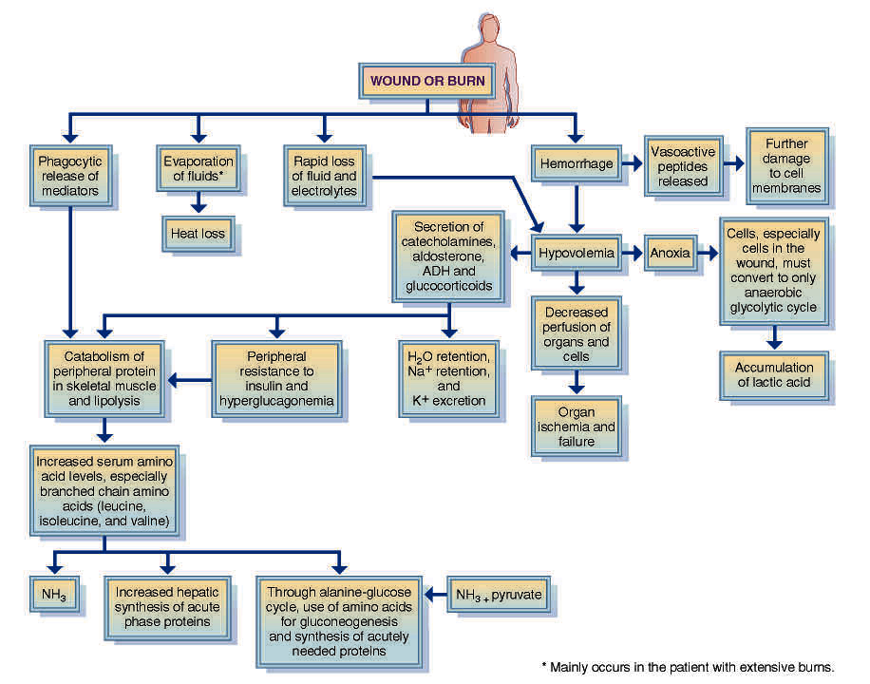
Immediate Physiologic and Metabolic Changes after Injury or Burn
ADH, Antiduretic hormone; NH₃, ammonia.

Slide 17
Metabolic Response
Hypermetabolism
  Up to 100% basal metabolic rate is required
  Severe weight loss
    Up to 10%: increased mortality
    >30%: almost 100% mortality
Decrease in basal metabolic rate in recovery

Slide 18
Hormonal Response
Increased circulating cathecolamines, cortisol and glucagon
Normal/slightly elevated insulin
Increased proteolysis and lipolysis
Release of large amounts of amino acids, glycerol and free fatty acids

Slide 19
Evaporative water loss from burn wounds may reach 300 cc/m2/h (normal = 15)
Heat loss may reach 580 Kcal/hour

Slide 20
Fighting the Metabolic
Response
Aggressive nutritional support
Rapid wound closure
Control pain and stress
Prevent sepsis

Slide 21
Hypovolemic State: First 48°
Rapid fluid shifts
Capillary permeability with burns increases with vasodilation
Fluid loss deep in wounds
Metabolic acidosis
Protein loss
Hemoconcentration
  Hct increases
Low blood volume, oliguria
Hyponatremia
K – damaged cells release K

Slide 22
Goals of MNT
Prevent weight loss
Preserve lean body mass
Promote healing

Slide 23
Your responsibility
• ASSESS PATIENT WITHIN 48 HOURS (TRY 24 HRS)
• FOLLOW UP WITH THE PATIENT EVERY 3 DAYS
• WEEKLY MULTIDISCIPLINARY BURN ROUNDS

Slide 24
Initial assessment
HEIGHT
• ADMIT WT
• USUAL WT
• % TBSA
• FOOD ALLERGIES / INTOLERANCES
• DIFFICULTY CHEWING / SWALLOWING
• SUPPLEMENTS PRIOR TO ADMISSION
• PREVIOUS GASTROINTESTINAL ISSUES
• PREVIOUS SUBSTANCE ABUSE?

Slide 25
Diuretic Phase: 48-72° After Injury
Capillary membrane integrity returns
Edema fluid shifts back into vessels – blood volume increases
Hemodilution - low Hct, decreased potassium as it moves back into the cell or is excreted in urine with the diuresis
Fluid overload can occur due to increased intravascular volume
Metabolic acidosis - HCO3 loss in urine, increase in fat metabolism
Increase in renal blood flow - result in diuresis (unless renal damage)

Slide 26
Nutrition Assessment: Calories
Use pre-burn or usual weight, if known (fluid resuscitation may alter admit weight; ICU body wts not accurate indicator of body cell mass).
Adjusted body weight is appropriate with obesity (>120% IBW)
Use actual body weight even if below 100% ideal

Slide 27
Energy Requirements
Different formulas
Curreri formula: simple
Long formula: considers BEE, activity and injury activity
Ireton-Jones formula: ventilator consideration
Wolfe formula: children
Galveston formula: children

Slide 28
Ireton-Jones 1997 Equations
Ventilator-Dependent Patients:
EEE = 1784 – 11(A) + 5(W) + 244(G) + 239(T) = 804(B)
Spontaneously-Breathing Patients:
EEE = 629 – 11(A) + 25(W) – 609(O)

Slide 29
Ireton-Jones Equations
Where:
A = age in years
W = weight (kg)
O = presence of obesity >30% above IBW (0 = absent, 1 = present)
G = gender (female = 0, male = 1)
T = diagnosis of trauma (absent = 0, present = 1)
B = diagnosis of burn (absent = 0, present = 1)
EEE = estimated energy expenditure

Slide 30
Ireton-Jones 1997 Equations
Three studies comparing RMR and the updated Ireton-Jones 1997 equations report similar mean values
However, only 36% of subjects were predicted within 100% of RMR.
Further research in the critically ill population is needed regarding the Ireton-Jones 1997 equations (Grade III)

Slide 31
Adult Energy Requirements
General rule:
  For burns <40%: 30-40kcal/day
  For burns >40%: 40-55kcal/day
Curreri formula:
  25 x ideal body weight + 40 x total burn surface as %

Slide 32
Carbohydrate Requirements
Glucose reduces extent of hypermetabolic response and protein breakdown
Limited to 50% of energy intake
Adults: 5 g/kg per day
EN and PN
Ventilator problem

Slide 33
High rate of glucose delivery
Hyperglycaemia needing insulin
Stimulating hepatic lipogenesis
Increased CO2 production
Prevents & slows weaning form ventilator

Slide 34
Fat Requirements
Increased lipolysis
Fat should not exceeds 30% of energy

Slide 35
Protein Requirements
Intact proteins rather than amino acids
Wound loss, excretion loss and catabolism
Total nitrogen loss estimation: Total urine nitrogen + 4
2-4g/kg ideal body weight

Slide 36
Nutrition Assessment: Protein
Primary goal is healing, closure, LBM sparing: do not reduce protein to preserve renal function.
Significant protein loss via wound exudate despite nutrition support
  Estimated 110g/d during first 10 days post-burn
Estimated protein needs (depending on TBSA):
  20-25% overall calories
  Superficial: 1.5-2.0 g/kg/d
  Partial thickness: 2.0-2.5g/kg/d
  Full thickness 2.5-3.0g/kg/d
  In some cases up to 4g/kg/d/d

Slide 37
Feeding Modalities
If <20% TBSA, can trial high kcal/prot diet with protein supps, calorie count. 10-20% TBSA may still need enteral nutrition if protein suboptimal.
If ≥20% TBSA or <90% IBW, EN indicated. Usually started within first 24h of admission.
TPN only indicated when EN fails, or in cases of abdominal compartment syndrome

Slide 38
Feeding tubes placed within 4 hours of admission, EN started as soon as placement confirmed
Osmolite 1.2/1.5 as standard formula

Slide 39
Additional Supplementation
Daily MVI
500mg Ascorbic Acid BID
220mg Zinc (if not receiving IV trace elements) – length of tx unknown (10-14 days?)
10,000 IU Vitamin A
Oxandrolone (anabolic steroid to decrease loss of LBM, promote wound healing, counteract lysis during hypermetabolic state)
IV Trace elements (copper, zinc, selenium) for >20% TBSA. Requires central access.
  14d course for 20-60% burn
  21d course for >60% burn

Slide 40
Adjusting Needs
Needs max around 7-10 days post-burn
May consider adjusting needs weekly until burns covered
Predictive equations may not be reliable after 30 days post-burn
Adjust needs for % open area:
  Decreases needs: grafting, re-epithelialization
  Increases needs: wound infection, graft loss, donor sites

Slide 41
Long-term Follow-up
Cycling Tube Feeding: Allow for improved appetite as po increases
  50-100% TF volume often delivered over 12-16h if pt can tolerate volume until po >60% est needs.
Calorie count
High calorie/high protein diet
Oral supplementation

Slide 42
GI problems
• Diarrhea – If on antibiotics
• Ileus – decreased GI motility due to pain
medications
• Gastroparesis – decreased GI motility most
common with poorly controlled diabetes

Slide 43
Monitoring Gastric Residuals
Performed by inserting a syringe into the feeding tube and withdrawing gastric contents and measuring volume
Often a part of nursing protocols/physician orders for tubefed patients

Slide 44
Enteral Nutrition Monitoring: Gastric Residuals
The value and method of monitoring of gastric residuals is controversial
Associated with increase in clogging of feeding tubes
Collapses modern soft NG tubes
Residual volume not well correlated with physical examination and radiographic findings
There are no studies associating high residual volume with increased risk of aspiration

Slide 45
Absorption/Secretion of Fluid in the GI Tract
Addtions (mL)
Diet | 2000
Saliva | 1500
Stomach | 2500
Pancreas/Bile | 2000
Intestine | 1000
Subtractions (mL)
Colointestinal | 8900
Net stool loss | 100
Harig JM. Pathophysiology of small bowel diarrhea. Cited in Rees Parrish C. Enteral Feeding: The Art and the Science. Nutr Clin Pract 2003; 18;75-85.

Slide 46
Fluid requirement: Parkland Formula
First 24°:
  4 mL Lactated Ringer’s X weight in kg X %total body surface area burned
50% of fluid in first 8°
50% over next 16°
Keep urinary output 0.5 – 1 mL/kg/°h

Slide 47
Signs of Adequate Fluid Resuscitation
Pulse < 120 beats per minute
Urine output for adults 30 - 50 cc/hour
Systolic blood pressure > 100 mm Hg
Blood pH within normal range 7.35 -7.45

Slide 48
Acute Resuscitation: Crystalloids
Isotonic
  most common are lactated Ringers or NaCl (0.9%)
  these do not generate a difference in osmotic pressure between the intravascular and interstitial spaces
  subsequently LARGE amounts of fluid are required

Slide 49
Acute Resuscitation: Colloids
Replacement begins during the second 24° following the burn to replace intravascular volume
Once capillary permeability significantly decreases

Slide 50
Post-Resuscitation Period: The Second 24 Hours
IV fluid should consist of glucose in water and plasma to maintain adequate circulating volume
Calorie and protein needs may be twice normal
Oral feeding if possible
Parenteral (IV) feeding may be necessary

Slide 51
Indications for Enteral Nutrition
Malnourished patient expected to be unable to eat adequately for > 5-7 days
Adequately nourished patient expected to be unable to eat > 7-9 days
Adaptive phase of short bowel syndrome
Following severe trauma or burns

Slide 52
Contraindications to Enteral Nutrition Support
Malnourished patient expected to eat within 5-7 days
Severe acute pancreatitis
High output enteric fistula distal to feeding tube
Inability to gain access
Intractable vomiting or diarrhea
Aggressive therapy not warranted
Expected need less than 5-7 days if malnourished or 7-9 days if normally nourished

Slide 53
Choosing Appropriate Formulas
Categories of enteral formulas:
  Polymeric
    Whole protein nitrogen source, for use in patients with normal or near normal GI function
  Monomeric or elemental
    Predigested nutrients; most have a low fat content or high % of MCT oil (medium-chain triglycerides); for use in patients with severely impaired GI function
  Disease specific
    Formulas designed for feeding patients with specific disease states
    Formulas are available for respiratory disease, diabetes, renal failure, hepatic failure, and immune compromise
    *well-designed clinical trials may or may not be available

Slide 54
Arginine
Increased immune function
Very abundant in protein
Precursor for nitric oxide
Enhances collagen deposition
Up to 20 gram per day is recommended

Slide 55
Glutamine
Most abundant amino acid in body
Preserves integrity of intestinal mucosa/permeability
Stimulates blood flow to gut
Improves immune function
Decreases bacterial translocation
Up to 30 gram per day is recommended

Slide 56
Citrulin

Slide 57
Ornithine
Precursor for glutamine
Supplementation of 10-20 g/day
  Improves nitrogen balance
  Reduce protein catabolism
  Improve wound healing
  Improve glucose tolerance

Slide 58
Omega 3 PUFA
Immunomodulatory and anti-inflammatory
3-5 g/day

Slide 59
Vitamin Requirements
Multivitamin supplementation
Vitamin A: 10,000 IU/day in adults
Vitamin C: 500mg twice daily
Copper, zinc and selenium supplements
Watch calcium, phosphorus and magnesium balance

Slide 60
Enteral vs. Parenteral Feeding
Meeting recommendations
Cost problem
Complications
Difficult access
Preserving gut function

Slide 61
Complications
Re-feeding syndrome
Dumping sydnrome
Hyperglycaemia
Hyperlipidaemia
Liver steatosis
Line related
Hyperalimination

Slide 62
Make proper energy recommendations
Be sure patients receiving adequate amounts of carbohydrate, protein and fat
Be sure patients receiving proper vitamin and mineral supplementation
Select proper feeding route
Individualization

Slide 63
Goals of Nutrition Support
Avoid malnutrition
  Avoid weight loss and preserve lean body mass
  Sustain functioning systems by providing adequate nutrients
Promote wound healing and graft retention
Preserve immune function and gut integrity
Avoid overfeeding -- hyperglycemia, increased CO2 production, organ system dysfunction

