Slide 1
Nutritional support in NICU/PICU
A Norouzy
Assistant Professor in Clinical Nutrition
Mashad Medical School

Slide 2
NICU

Slide 3
Energy and protein goals: TPN
Term:
  Energy: 80-100 kcal/kg/day
  Protein: 2.5-3.5 g/kg/day
Pre-term:
  Energy: 90-100 kcal/kg/day
  Protein: 2.5-3.5 g/kg/day

Slide 4
Energy and protein goals: enteral
Term:
  Energy: 108 kcal/kg/day
  Protein: 2.2 g/kg/day
Pre-term:
  Energy: 120 kcal/kg/day
  Protein: +3 g/kg/day

Slide 5
IV Lipids
Preterm infants can develop EFA deficiency within 72 hours of birth
Dose: 0.5-1 g/kg/day to achieve 3 g/kg/day
maximum 60% of total energy

Slide 6
Amino Acids
Start 1.5-3 g/kg/d
Advance: 0.5-1 g/kg/d
Goal: 2.5-4 g/kg/d
Monitor: renal function, albumin

Slide 7
Dextrose
<1000 g: glucose infusion rate: 4-6 mg/kg/min
1000-1500 g: GIR: <8 mg/kg/min
GIR goal: <12 mg/kg/min
GIR>14: converts CHO to fat in liver

Slide 8
Vanilla TPN order
Start with amino acids ASAP
Dextrose: 8-18 g/kg/d
AA: 1.5-3 g/kg/d
Fat: 0.5-1 g/kg/d
Calcium: 150-200 mg/kg/day
Phosphorous: 0.3-0.5 mmol/kg/d
MVI & trace elements

Slide 9
Tapering TPN/PPN
Start from lipids
Keep AA until last

Slide 10
Enteral nutrition
BMF or formula
Trophic feed or full feed

Slide 11
Barriers and Challenges of Nutrition Support
Metabolic vs nutrition support
Wasting specific lesions (pre-operative nutritional status)
Hemodynamic instability
Severe hypotensive gut
Fluid restriction
Enteral vs parenteral
Philosophy nutrition support will do more harm than good in immediate post-operative period
Urgency to remove central line

Slide 12
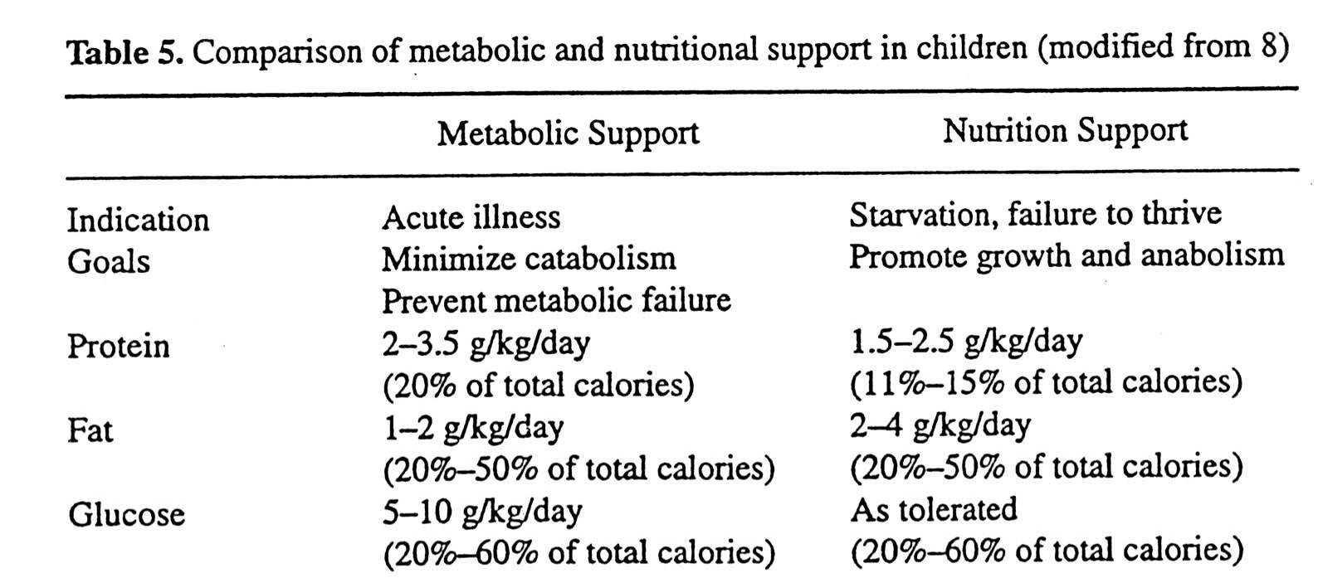
Too Little vs Too Much
Diamond 1995

Slide 13
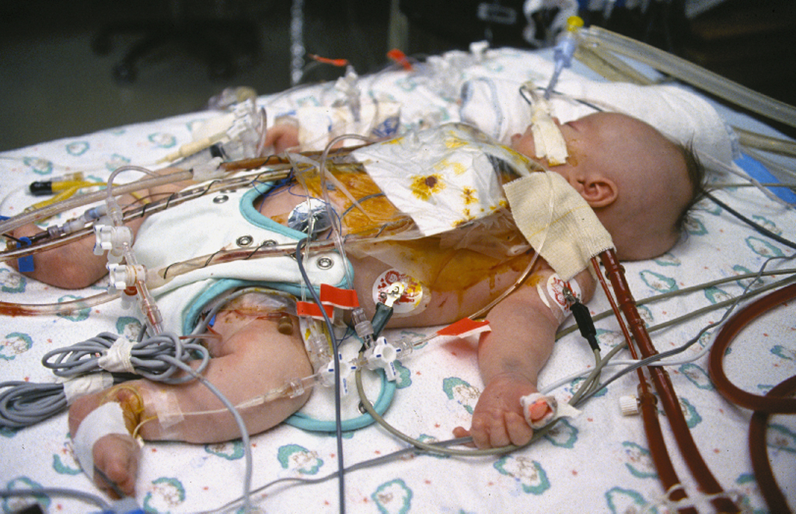
Too Little vs Too Much
Sedation
Paralysis
Intubation/ventilation
+ inotropes
+ wasting

Slide 14
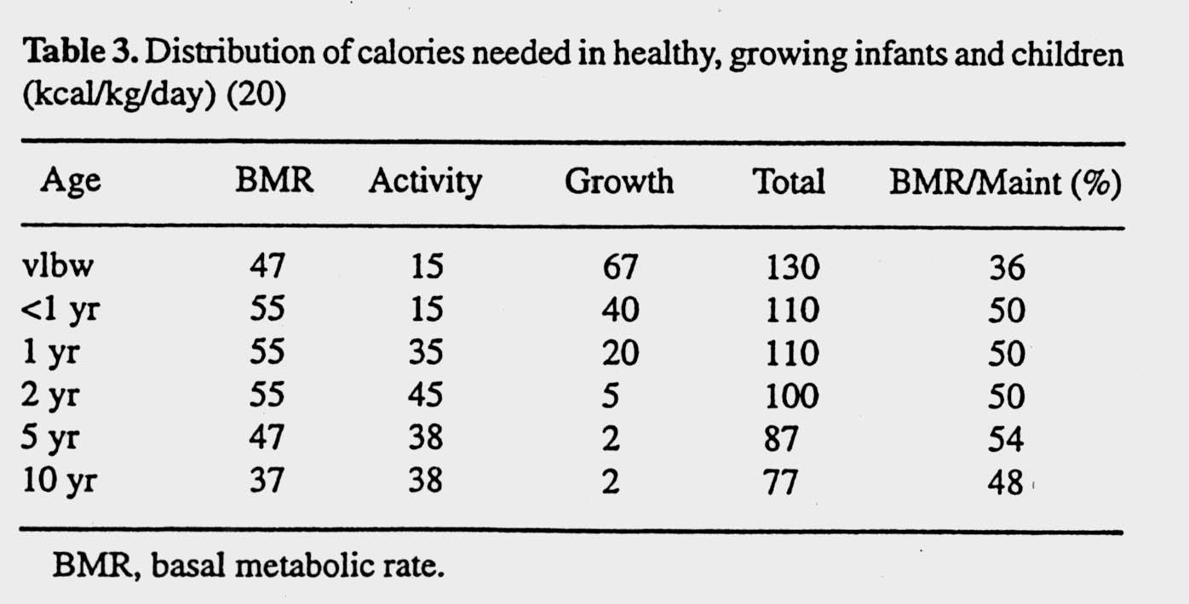
Determining Caloric Requirements

Slide 15
Route of Administration:
Enteral vs Parenteral
Indications for TPN:
SBS
Ileus
Severe dysmotility
NEC
Unable to provide adequate support with enteral nutrition
The gut can be used in critical illness

Slide 16
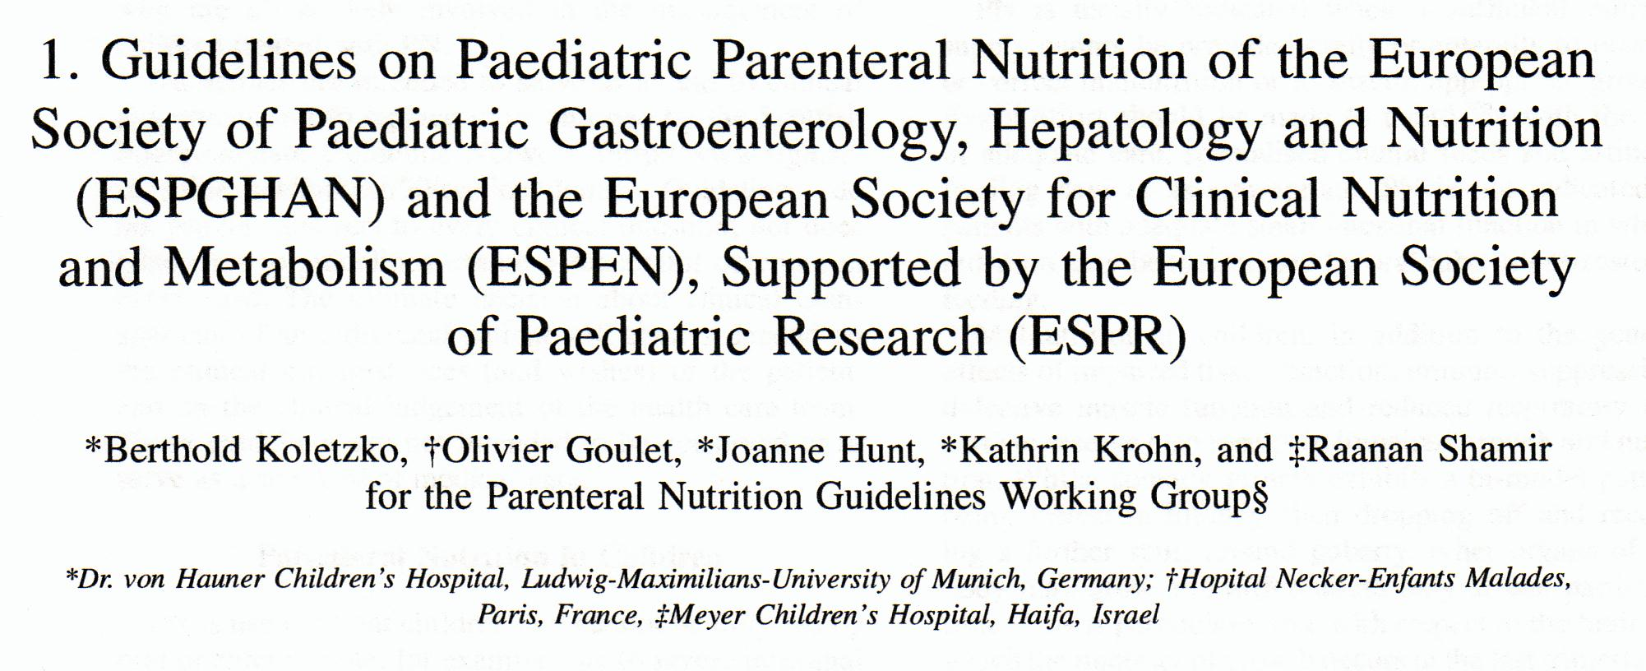
Journal of Pediatric Gastroenterology and Nutrition. 41: S1-S4

Slide 17
Espghan Guidelines
TPN initiation dependent on age, size, nutritional status, disease, surgery or medical intervention
In small preterm infants starvation for 1 day may be detrimental
Older children can wait up to 7 days dependent on circumstance
Journal of Pediatric Gastroenterology and Nutrition. 41: S1-S4

Slide 18
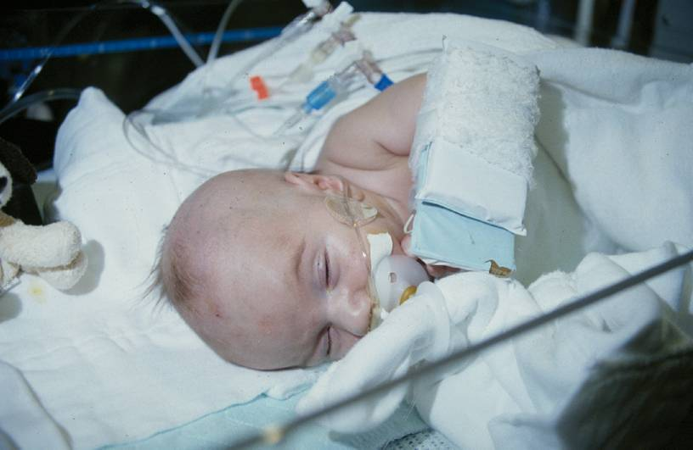
Enteral:
Enteral Nutrition Advantages:
Decreased cost
Decreased metabolic abnormalities
Decreased infectious risk
Promotes GI integrity
Stimulates enteric secretions, hormones and blood flow
Decreased bacterial translocation

Slide 19
Enteral:
Critically ill pediatric patients have multiple
factors that decrease gastric emptying:
Formula osmolarity
Fat content
Lipid carbon chain length
Medications (narcotics, benzodiazepines, sedatives)
Continuous feeds are best
Small bowel feeds very successful

Slide 20
Feeding the Hypotensive Patient
Splancnic bed gets:
25% cardiac output at rest
30% of oxygen consumption is in the splancnic
bed
      small intestine 44%
* Arterial blood flow stomach 12%
colon 17%

Slide 21
Biochemistries in PICU
Serum albumin, urea, triglycerides, magnesium
  ↓ Mg – 20%
  ↑ trig – 25%
  ↑ urea – 30%
  ↓ albumin – 52%
↑ uremia → ↓ SD scores for weight and arm circumference between admission and discharge
↑ triglycerides → > ventilator dependence days and length of stay than children with triglyceride levels
Journal of Nutritional Biochemistry 17 (2006) 57-62

Slide 22
Nutrition Support in the ICU is not generic but:
Patient specific
Disease specific
Macro and Micronutrient specific
Biochemically specific
Stage specific

Slide 23
Nutritional Support of the VLBW Infant

Slide 24
Gold Standard of Growth for VLBW Infants
To approximate the in utero growth of a normal fetus of the same post-conceptional age.
  Body weight
  Body composition

Slide 25
Unique Nutritional Aspects of the VLBW Infant
Higher organ:muscle mass ratio
Higher rate of protein synthesis and turnover
Greater oxygen consumption during growth
Higher energy cost due to transepidermal water loss
Higher rate of fat deposition
Prone to hyperglycemia
Higher total body water content

Slide 26
Preventing Feeding-Related Morbidities in VLBW Infants
Necrotizing enterocolitis
Osteoporosis
Vitamin and mineral deficiencies
Feeding intolerance
Prolonged TPN and related cholestasis
Prolonged hospitalization
Lack of full physical and intellectual potential

Slide 27
Nutritional Care/Outcomes in VLBW Infants - Potential Improvements
Human milk
“Early” TPN
  Prevent protein deficit
  Prevent EFA deficiency
GI priming/MEN/Trophic feeds
  Prevent GI atrophy effects
  Faster realization of full enteral feeds
Fortification/Supplementation
  Starting earlier
  Continuing longer

Slide 28
Parenteral Nutrition for VLBW Infants

Slide 29
Best Practice
Parenteral nutrition, including protein and lipids, should be started within the first 24 hours of life.
Parenteral nutrition should be increased rapidly so infants receive adequate amino acids (3.0-4.0 gm/kg/day) and calories (85-110 kcal/kg/day) as quickly as possible.

Slide 30
Best Practice
Start parenteral lipids within the first 24 hours of life. Lipids can be started at doses as high as 2 g/kg/d. Lipids can be increased to doses as high as 3.0-3.5 g/kg/day over the first few days of life.

Slide 31
Establishing Enteral Feedings

Slide 32
Best Practice
Human milk should be used whenever possible as the enteral feeding of choice for VLBW infants.

Slide 33
Best Practice
Enteral feeds, in the form of trophic or minimal enteral feeds (also called GI priming), should be initiated within 1-2 days after birth, except when there are clear contraindications such as a congenital anomaly precluding feeding (e.g. omphalocele or gastroschisis), or evidence of GI dysfunction associated with hypoxic-ischemic compromise.

