Slide 1
اصول تغذيه انترال
دکتر عبدالرضا نوروزی
استادیار تغذیه بالینی و متابولیسم
دانشکده پزشکی مشهد

Slide 2
‘A slender and restricted diet is always dangerous in chronic and in acute diseases’
Hippocrates 400 B.C.

Slide 3
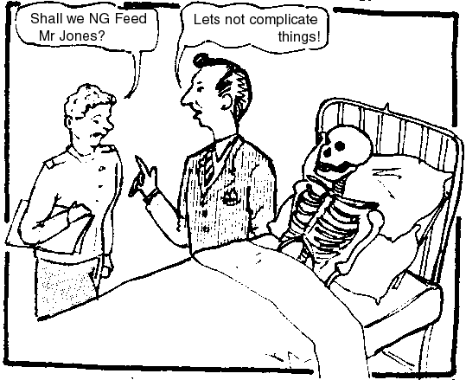

Slide 4
Critical Illness
Heterogeneous patients
Extreme physiological stress/organ failure
Acute phase response: TNF, IL-6, IL-1β
Immuno-suppression: monocytes, MØ, NK cells, T and B lymphocytes
Insulin resistance: hyperglycaemia
Protein loss and fat gain in muscle
Impaired gut function

Slide 5
Consequences of malnutrition
Increased morbidity and mortality
Prolonged hospital stay
Impaired tissue function and wound healing
Defective muscle function, reduced respiratory and cardiac function
Immuno-suppression, increased risk of infection
CIPs lose around 2%/day muscle protein

Slide 6
Scale of the problem
McWhirter and Pennington 1994:
>40% of hospital patients malnourished on admission
Recent Mashad data 65%
Estimated cost to hospitals: £3.8bn/yr
Many ICU patients malnourished or at risk on ICU admission

Slide 7
Nutrition trials in ICU
Small, underpowered
Heterogeneous and complex patients
Mixed nutritional status
Different feeding regimens
Underfeeding – failure to deliver nutrients
Overfeeding – adverse metabolic effects
Hyperglycaemia
Scientific basis essential

Slide 8
What is the evidence in ICU?
Early enteral feeding is best
Hyperglycaemia/overfeeding are bad
PN meta-analyses controversial
Nutritional deficit a/w worse outcome
EN a/w aspiration and VAP, PN infection
EN and PN can be used to achieve goals
Protocols improve delivery of feed
Some nutrients show promising results

Slide 9

Guidelines

Slide 10
What Guidelines are available?
Canadian Critical Care Network 2003/2007: Clinical Practice Guidelines
ICS: Practical Management of Parenteral Nutrition in Critically Ill Patients 2005
ESPEN: Enteral Nutrition 2006
NICE: Nutrition Support in Adults 2006

Slide 11
Background
Definition: Provision of a liquid formula diet by tube into the GI tract.
1980’s “Decade of enteral”
Gavage

Slide 12
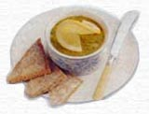
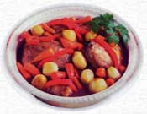
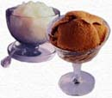
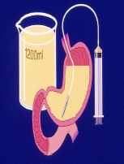
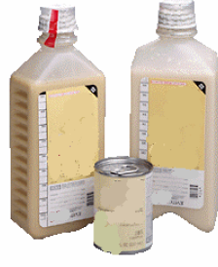
ICU Nutrition in the 1970s

Slide 13
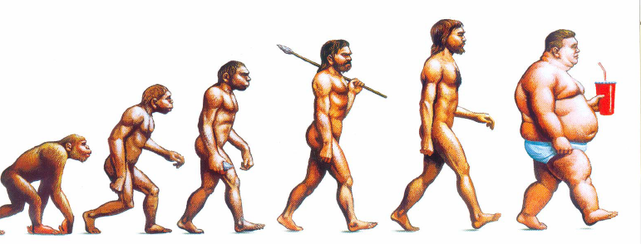
ICU Nutrition through the ages
Overfeeding
1980s

Slide 14
General Indications:
Patient who can’t eat
Patient who won’t eat
Patient who shouldn’t eat
Patient who can’t eat enough

Slide 15
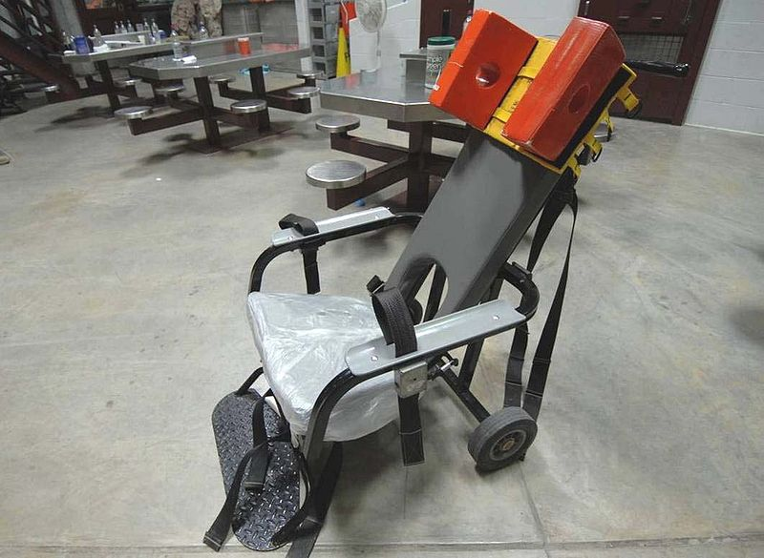
Medical indications
Forced feeding

Slide 16
Enteral feeding should not be used
Complete mechanical intestinal obstuction
Severe diarrhea
High output external fistulas
Severe pancreatitis
Shock
Aggressive nutritional support not desired by the patient or legal guardian, in accordance with hospital policy and existing law.
Prognosis not warranting aggressive nutritional support

Slide 17
Products
Home made gavage
Complete Formulas
Modular (Supplements)
Elemental
Disease Specific

Slide 18
Home made gavage
Low energy/macronutrient
Osmolarity problems
Bacterial contamination
High waste

Slide 19
Complete formulas
Also called meal replacements
Intact nutrients
One or two sources of protein, carbohydrate and fat:
  Carbohydrate: Maltodextan, hydrolyzed corn starch, corn syrup
  Protein: Soy protein, casein
  Fat: Soybean oil, canola oil, corn oil
  Vitamins: RDA in 1250 – 2000 ml
  Minerals: Na, K, MG, Phos, Ca & usually trace

Slide 20
Complete formulas
Standard feedings: Approx. 1 kcal/ml
  Unflavored isotonic: Jevity, Fresubin original
  Flavored: Ensure, Calshake
High calorie feedings for fluid restriction
  Fresubin HP 1.5 kcl/ml
  Ensure Plus 1.5 kcal/ml

Slide 21
Elemental formulas
Nutrients broken down
Low fat
MCT oil
Use: Malabsoption states: Short bowel, fistula, pancreatitis

Slide 22
Disease specific formulas
Hepatic disease
Renal disease
Trauma & stress
Pulmonary disease
Diabetes

Slide 23
Complications of enteral feeding
Gastric retention, emesis and aspiration
Diarrhea
Constipation
Hyperglycaemia

Slide 24
Gastric retention, emesis and aspiration
“Forced feeding”
May lead to aspiration pneumonia
Prevention:
  Elevate the head of the bed
  Check gastric residuals
  Hold feeding if > 100 ml
  Give promotility drug: metoclopromide
  Transpyloric placement of feeding tube
  Add green food coloring to feeding to monitor

Slide 25
Enteral feeding Administration Techniques
Short term access
Long term access
Continuous feeding
Bolus feeding

Slide 26
Short-term access
NG (nasogastric) tube
  Made of soft silicon material
  Various sizes
  Small bore feeding tube more comfortable
  Placement verified by x-ray
  Larger bore tube: check gastric residuals

Slide 27
Long-term Access
Gastrostomy
  Generally preferred: Less diarrhea; If pulled out can be
  replaced; larger bore tube- less clogging
Jejunostomy: Useful when there is an upper GI obstruction
Small bore, more diarrhea
PEG (percutaneous endoscopic gastrostomy
  Can avoid general surgery – costs less to place
  4% complication rate
  Small bore –more likely to clog

Slide 28
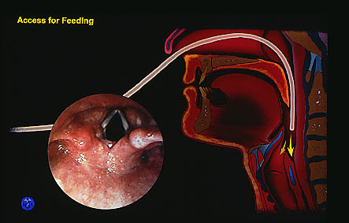

Slide 29
Practice Guidelines
(ASPEN 2002)
Tube placement can be confirmed by air insufflation, auscultation, aspiration of gastric or small bowel contents, or radiographically.

Slide 30
Tube Identification
Nasogastric
Nasoduodenal
Nasojejunal
Oral placement
Should be small
in diameter and soft
Notes:
6

Slide 31
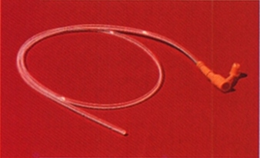
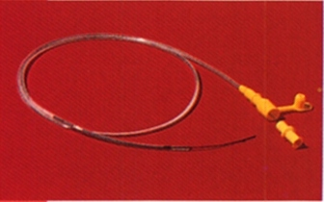

Slide 32
Gastrointestinal Tubes
Complications of tubes thru nose:
  Nasal septal injury/bleeding
  Respiratory distress
  Curling
  GI Bleeding
  Pneumothorax

Slide 33
Practice Guidelines
(ASPEN 2002)
Tube placement can be confirmed by air insufflation, auscultation, aspiration of gastric or small bowel contents, or radiographically.

Slide 34
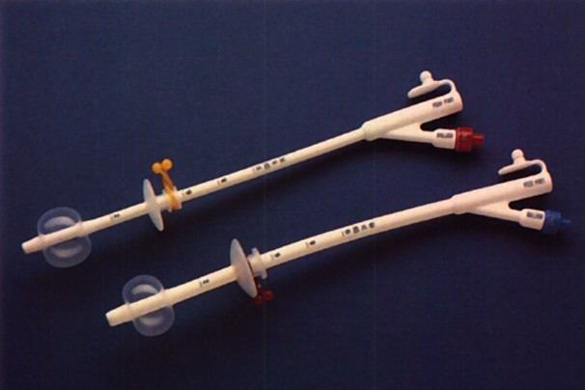

Slide 35
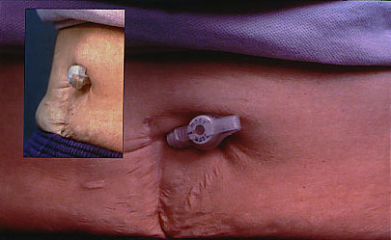

Slide 36
Continuous vs. bolus feeding
Continuous
  Most frequent method used in hospitals
  Less nursing time
  Generally better tolerance: Less diarrhea and emesis
Bolus
  Often used for home patients to self administer
  Costs less to administer
  Less tolerance

Slide 37
Requirement of energy
 | stress
Weight | Low | Moderate | Severe
Decrease | 15 kcal/kg | 20 kcal/kg | 25 kcal/kg
Maintenance | 20 kcal/kg | 25 kcal/kg | 30 kcal/kg
Increase | 25 kcal/kg | 30 kcal/kg | 35 kcal/kg

Slide 38
During the anabolic recovery phase
The aim
should be to provide 25–30 kcal/kg BW/day.

Slide 39
requirement of Protein
Usual stress | 0.8-1 g/kg
Mild stress | 1.25 g/kg
Moderate stress | 1.5 g/kg
Sever stress | 1.75-2 g/kg

Slide 40
Requirement of water 1
Fluid requirement: energy intake
Adults | 1 cc / kcal
Children | 1.5 cc / kcal

Slide 41
Requirement of water 2
Fluid requirement: body weight
(adults)
25-55 | 35 ml/kg
56-65 | 30 ml/kg
65< | 25 ml/kg

Slide 42
weight?
Non-protein energy?
Delivery
Home total parenteral nutrition (home TPN)

Slide 43
Enteral Nutrition Monitoring
Wt (at least 3 times/week)
Signs/symptoms of edema (daily)
Signs/symptoms of dehydration (daily)
Fluid I/O (daily)
Adequacy of intake (at least 2x weekly)
Nitrogen balance: becoming less common (weekly, if appropriate)

Slide 44
Enteral Nutrition Monitoring
Serum electrolytes, BUN, creatinine (2 –3 x weekly)
Serum glucose, calcium, magnesium, phosphorus (weekly or as ordered)
Stool output and consistency (daily)

Slide 45
Enteral Feeding Tolerance
Signs and symptoms:
  —Consciousness
  —Respiratory distress
  —Nausea, vomiting, diarrhea
  —Constipation, cramps
  —Aspiration
  —Abdominal distention

Slide 46
Diarrhoea
Most common complication
Prevalence: 2-65%
To check:
  Review EN prescription
  Exclude infectious diarrhoea
  Rule out diarrhoae induced drugs

Slide 47
Diarrhoea
Solution:
  Decrease delivery rate
  Change to a EN formula with soluble fibre source
  If malabsorpition is suspected change to mono-meric formula
  If persists, consider PN

Slide 48
Nausea & Vomiting
20% of patients experience N&V
Increases the risk of aspiration
Delayed gastric emptying is most common cause
Treatment:
  Reduce sedating medication
  Use low fat formula
  Reduce rate of delivery
  Administer prokinetic drugs

Slide 49
Constipation
Can result from: inactivity, decreased bowel motility, decreased water intake (calorie dense formulas), impaction, lack of dietary fibre
Consider bowel obstruction

Slide 50
Constipation
Treatment:
  Adequate hydration
  Insoluble fibre
  Stool softeners or bowel stimulant

Slide 51
Aspiration
Life threatening
Incidence: 1-4%
Prevention:
  Monitor residue
  Use prokinetic drugs
  Semi-recumbant (45 ̊ position)

Slide 52
Tube related complications
Tracheal bleeding
GI bleeding/perforation
Upper GI fistula (long-term use)
Tube clogging
Prevention:
  Using small bore tubes
  Attentive nursing care
  Consider gastrotomy tube
  Flushing

Slide 53
Monitoring Gastric Residuals
Performed by inserting a syringe into the feeding tube and withdrawing gastric contents and measuring volume
Often a part of nursing protocols/physician orders for tubefed patients

Slide 54
Enteral Nutrition Monitoring: Gastric Residuals
The value and method of monitoring of gastric residuals is controversial
Associated with increase in clogging of feeding tubes
Collapses modern soft NG tubes
Residual volume not well correlated with physical examination and radiographic findings
There are no studies associating high residual volume with increased risk of aspiration

Slide 55
Absorption/Secretion of Fluid in the GI Tract
Addtions (mL)
Diet | 2000
Saliva | 1500
Stomach | 2500
Pancreas/Bile | 2000
Intestine | 1000
Subtractions (mL)
Colointestinal | 8900
Net stool loss | 100
Harig JM. Pathophysiology of small bowel diarrhea. Cited in Rees Parrish C. Enteral Feeding: The Art and the Science. Nutr Clin Pract 2003; 18;75-85.

Slide 56
Enteral Nutrition Monitoring: Gastric Residuals
Monitoring of gastric residuals in tubefed pts assumes that high residuals occur only in tubefed pts
In one study, 40% of normal volunteers had RVs that would be considered significant based on current standards
For consistency, all hospitalized pts, with or without EN should have their RVs routinely assessed to evaluate GI function
Rees Parrish C. Enteral Feeding: The Art and the Science. Nutr Clin Pract 2003; 18;75-85.

Slide 57
Enteral Nutrition Monitoring: Gastric Residuals
Clinically assess the patient for abdominal distension, fullness, bloating, discomfort
Place the pt on his/her right side for 15-20 minutes before checking a RV to avoid cascade effect
Try a prokinetic agent or antiemetic
Seek transpyloric access of feeding tube
Raise threshold for RV to 200-300 mL
Consider stopping RV checks in stable pts
Rees Parrish C. Enteral Feeding: The Art and the Science. Nutr Clin Pract 2003; 18;75-85.

Slide 58
Practice Guidelines
(ASPEN 2002)
Gastric residuals should be checked frequently when feedings are initiated and feedings should be held if residual volumes exceed 200 mL on two successive assessments.
- Feeding tubes should routinely be flushed with 20 to 30 mL of warm water every 4 hours during continuous feedings and before and after intermittent feedings and medication administration.
- Standardized protocols for enteral nutrition ordering, administration, and monitoring should be utilized.

Slide 59
Metabolic complications
Re-feeding syndrome
Electrolyte disturbance
Dehydration
Hyperglycaemia
Hyperphosphataemia

Slide 60
Refeeding Syndrome
Patients at risk are malnourished, particularly marasmic patients
Can occur with enteral or parenteral nutrition
Results from intracellular electrolyte shift

Slide 61
Refeeding Syndrome Symptoms
Reduced serum levels of magnesium, potassium, and phosphorus
Vitamin deficiency (vitamin B1)
Interstitial fluid retention
Cardiac decompensation and arrest

Slide 62
Refeeding Syndrome Prevention/Treatment
Monitor and supplement electrolytes, vitamins and minerals prior to and during infusion of PN until levels remain stable
Initiate feedings with 15-20 kcal/kg or 1000 kcals/day and 1.2-1.5 g protein/kg/day
Limit fluid to 800 ml + insensible losses (adjust per patient fluid tolerance and status)
Fuhrman MP. Defensive strategies for avoiding and managing parenteral nutrition complications. P. 102. In Sharpening your skills as a nutrition support dietitian. DNS, 2003.

Slide 63
Unanswered questions
Should we aim for full calorific delivery ASAP using EN + PN?
What are the best lipids to use in PN?
What is the role of small bowel feeding?
Are probiotics helpful?
Which patients will benefit from immuno-nutrition?
The future: targeted Nutrition Therapy?

